Slide 1
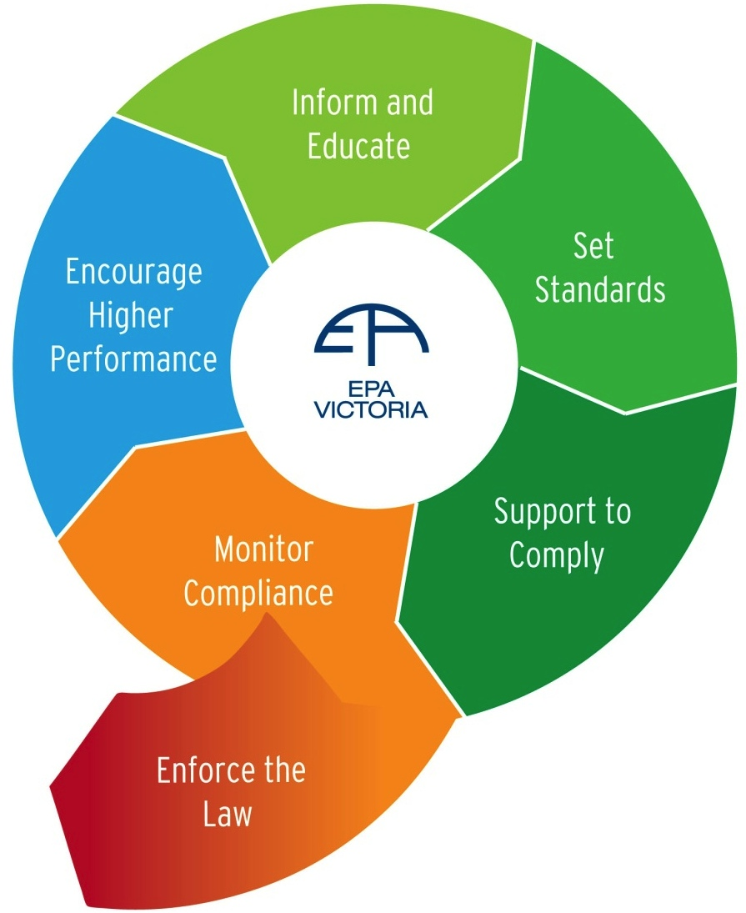




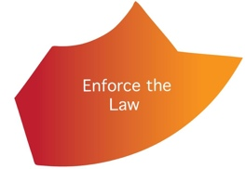
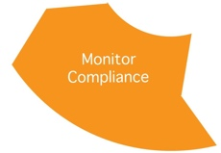
Regulatory Approach – to support questions
Educating broadly (in multiple languages) to raise awareness of the rules, expectations & requirements
Inform and Educate
Influencing people to go beyond current regulatory requirements
Regulatory Practice
Procedures, Manuals, Guidance & Training
Setting standards in permits, exemptions, licences or directions
Enforcing the law – with remedy and sanction, independently and assertively
Supporting people to comply through education, persuasion, guidance & compliance advice
Monitoring compliance with the relevant standards and laws
Adapted from EPA Victoria, Compliance & Enforcement Policy 2011
National Regulators Community of Practice – Setting Regulatory Practice at the speed of a pandemic

Slide 2
COVID response modes – to provide context
International – not in Australia
In Australia – not in Victoria
In Victoria – not widespread
In Victoria – widespread
National Regulators Community of Practice – Setting Regulatory Practice at the speed of a pandemic

