Slide 1

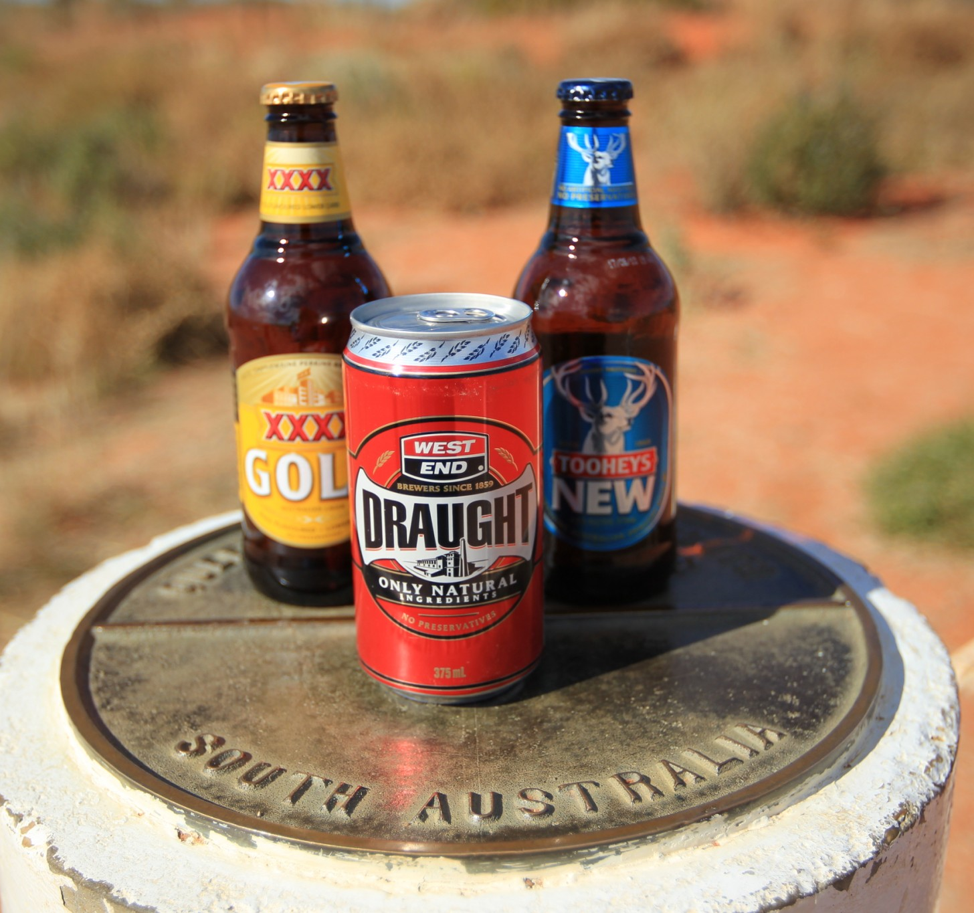
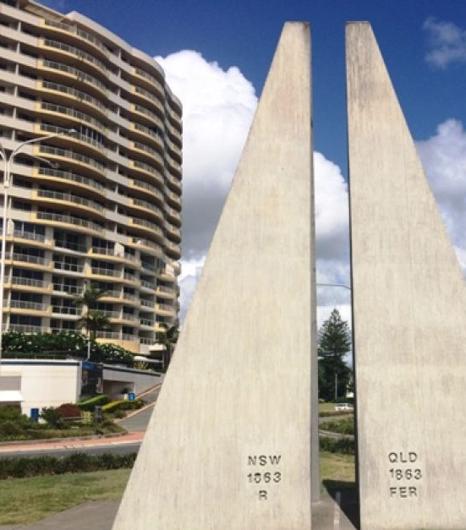
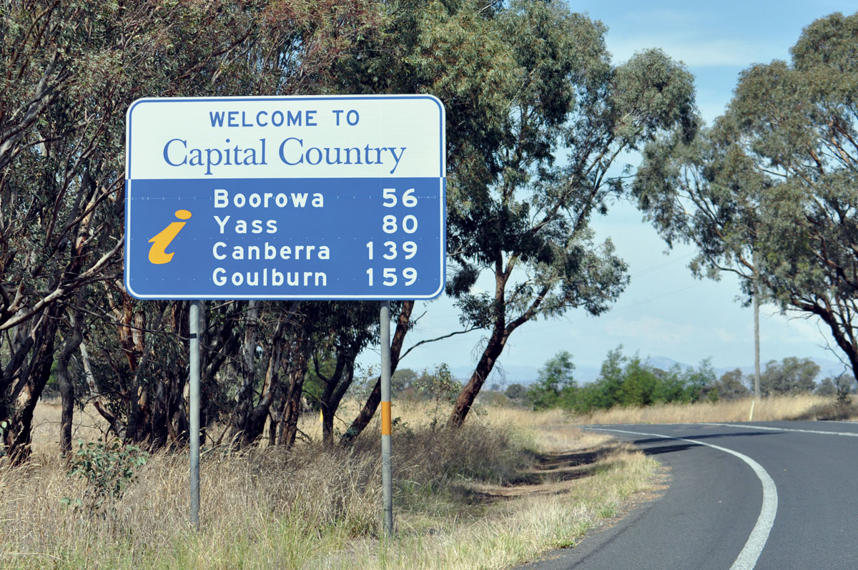
Not all borders are the same
Office of the Cross Border Commissioner, established 2012.
Assist border communities by connecting them with agencies and working with border states to understand their issues and improve outcomes.
Diverse demographic, economic and geographic drivers.
The issues and Cross Border arrangements and priorities reflect this diversity.
Different arrangements: MOUs ACT-NSW & QLD-NSW, Vic Cross Border Commissioner.
sli.do #P622

Slide 2


Observations: A new starter
The surprises
The breadth of issues.
What can be resolved without legislative or regulatory change or budget allocation.
How surprised people are about there being cross border issues.
Confirmed
Relationships are key.
Engagement improves authority and trust.
sli.do #P622

Slide 3
Why regulate?
Market failure?
Health and safety?
Law and order?
Service provision?
To protect people!
Regulating on the borders
Compliance versus outcome approach.
Harmonisation of practice, if not of legislation/law to improve outcomes.
Room for innovation or re-evaluation of practice?
Keep it simple!
sli.do #P622

Slide 4
What does good look like?
A dialogue
Interplay between developing capacity, building relationships and informing decision making.
  Planned, strategic and timely.
  Invest and be curious.
  Transparent and accountable.
sli.do #P622

Slide 5
Borders in the time of a pandemic
What can we all be thinking about?
Can I cross the border to pick up a rabbit from Melbourne?
QLD, Tasmania, SA, WA and the NT have movement restrictions across state and territory borders, while NSW, Victoria and the ACT have not.
Not BAU and has also re-emphasised existing Cross Border issues.
First, do no harm.
Accurate, timely information.
Looking past the near term.
sli.do #P622

