Slide 1
June 2020
Regulator Watch
The enforcement performance of Australia’s consumer protection regulators (2nd ed)

Slide 2

OUR VISION:
a just marketplace,
where people have power
and business plays fair

Slide 3

What do we do?
Assist and empower people – by advising them about their rights, connecting them with services, and supporting them to be capable self advocates
Support an effective community sector – by enabling community workers to help their clients through training, outreach and legal assistance
Shape a fairer system – by leading change to policy, laws and industry practice. We also litigate in the public interest and work to improve access to justice.
“Make life easier for people experiencing vulnerability & disadvantage”

Slide 4


Slide 5
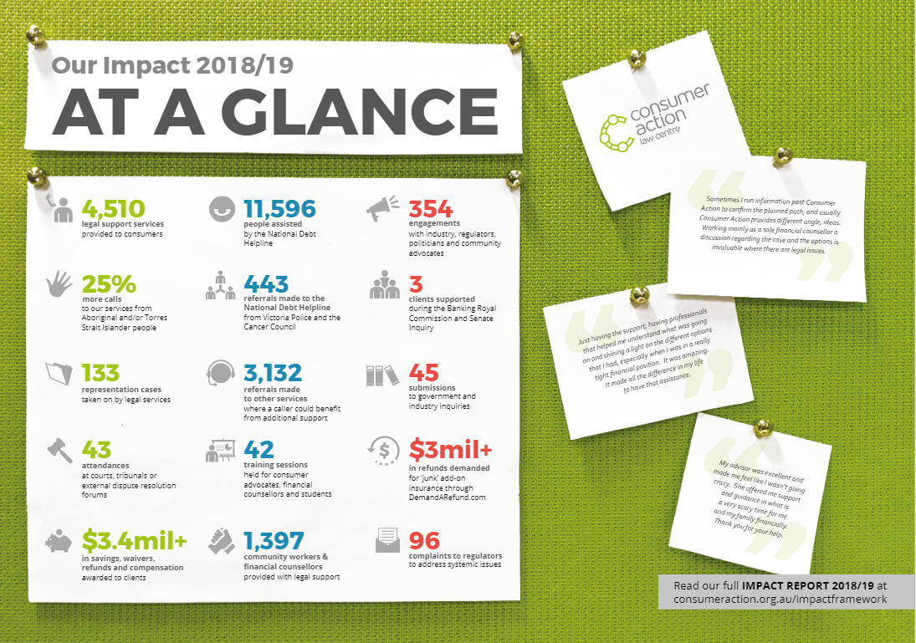

Slide 6

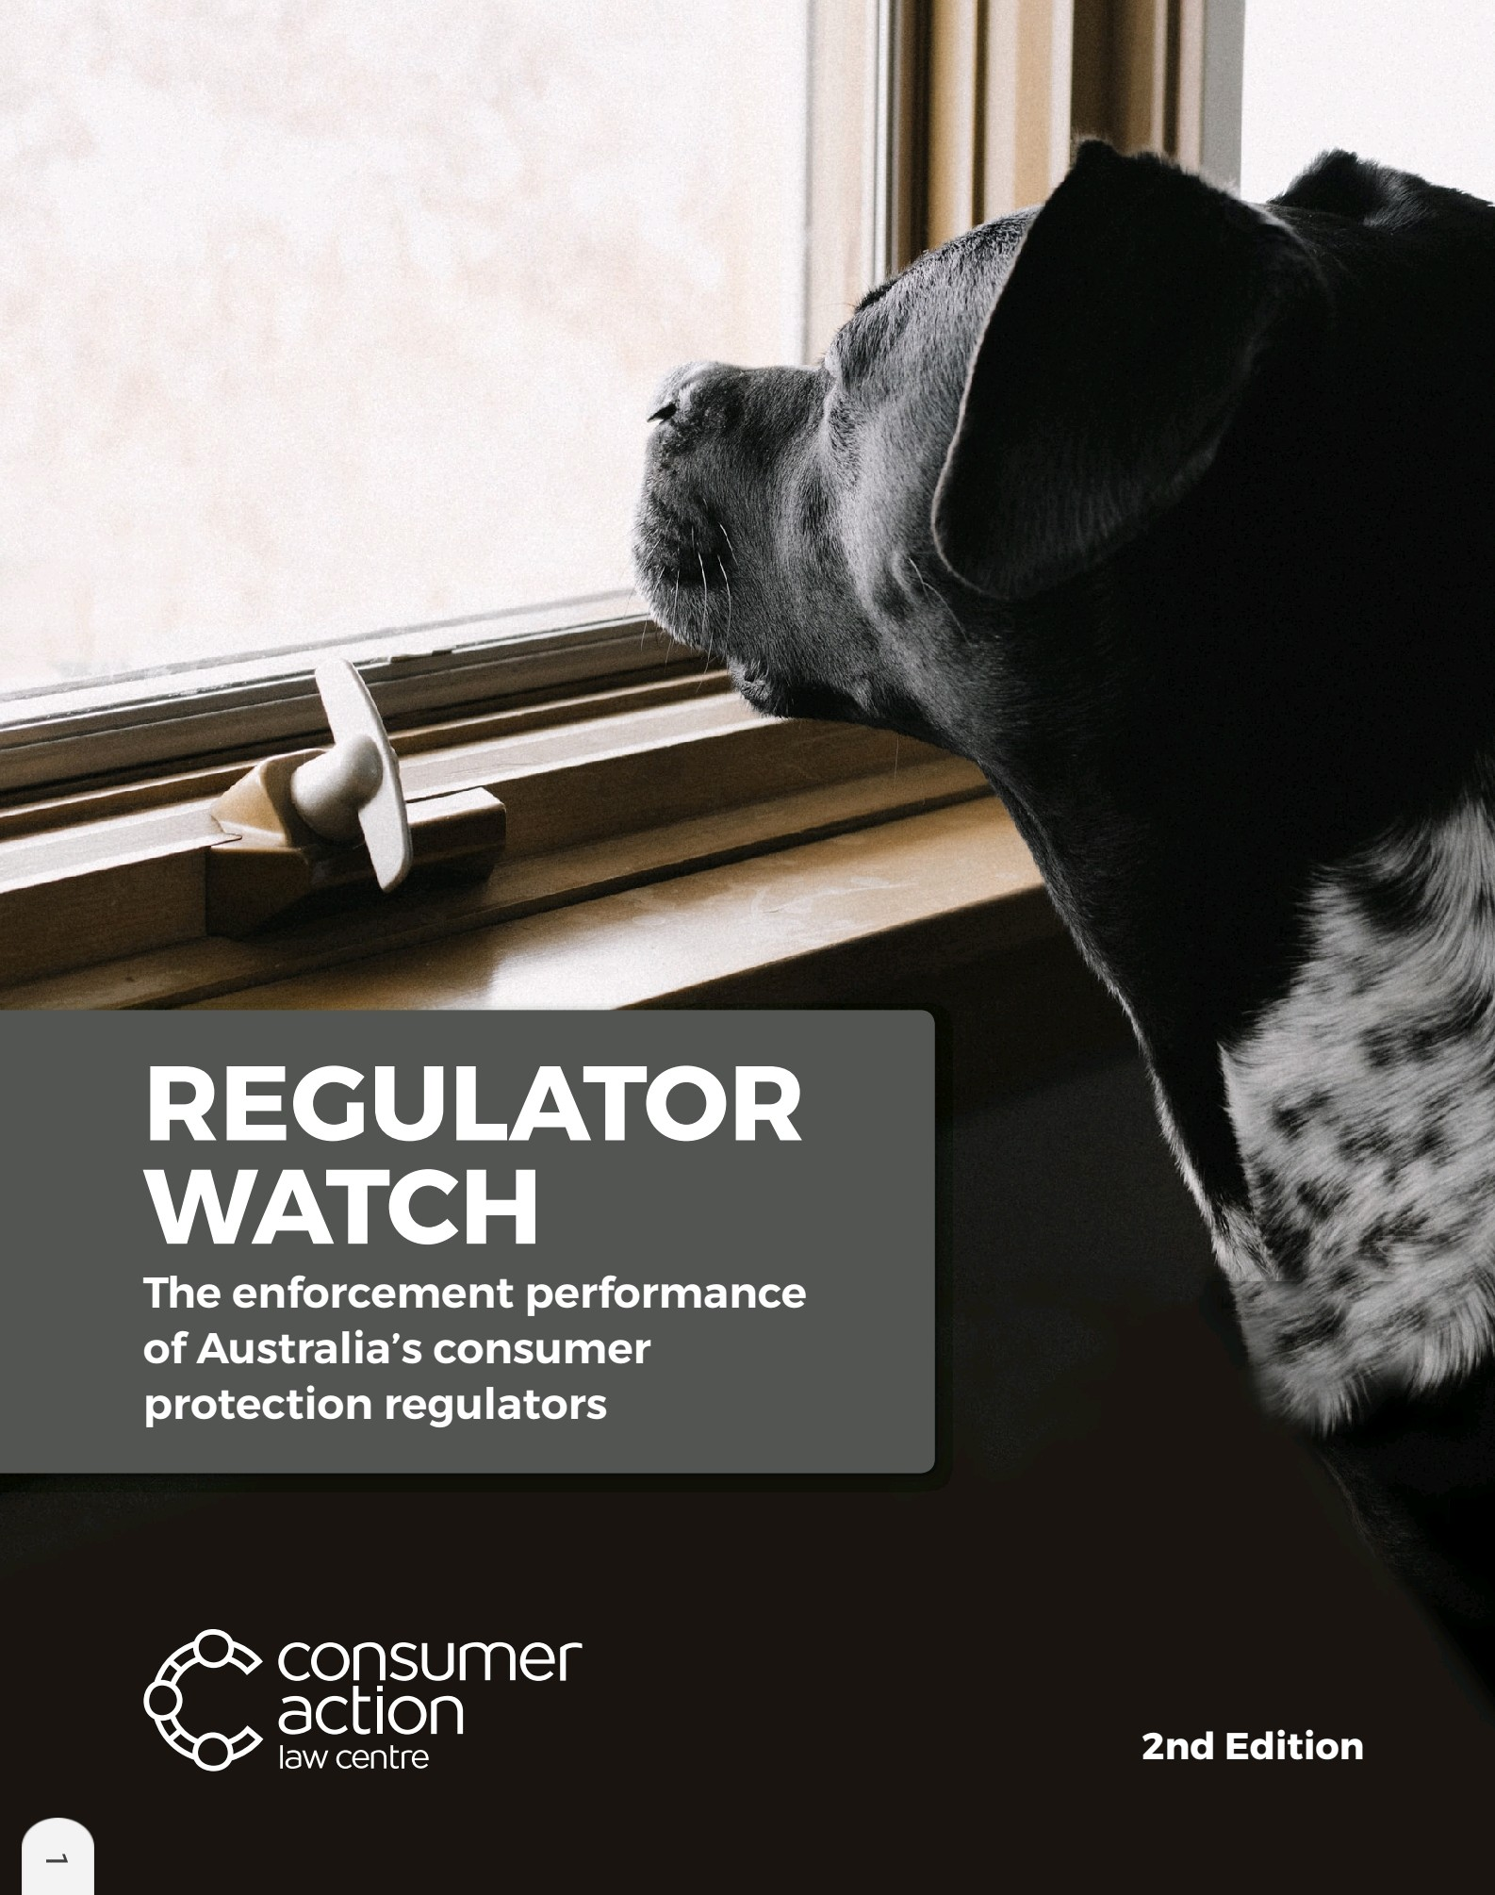
Why Regulator Watch?
Effective enforcement essential for consumers
Accountability to consumers, advocates who represent them, and parliament
Changes since our 2013 report
Impact of FSRC & other reviews
Notes:
Acknowledge consultants who prepared report
Effective enforcement essential to well-functioning consumer protection framework
The 2013 report – key finding was that the report finds that a number of regulators do not report on their work well. Regulators have not reported consistently over time and do not report consistently in relation to other similar regulators to enable comparison. We wanted to see what has changed.
Also, a lot has happened in regulatory landscape – reviews of ACL and the PC review of administration of ACL, reviews of sector specific regulators like ACMA, and the FSRC.
FSRC focused on ASIC – but criticisms could apply more broadly. Prior to FSRC, not uncommon for our discussions with some regulatory agencies to focus on whether enforcement is necessary not when or how it should be done.

Slide 7

Why enforcement?
“Breach of the law carries consequences. Parliament, not the regulators, sets the law and the consequences”
“The law is to be obeyed and enforced. The rule of law requires no less. And, adequate deterrence of misconduct depends upon visible public denunciation and punishment”
Notes:
Why focus on enforcement?
Regulators of course to a range of other work and tasks that have positive effects, and examining enforcement is only one part of its remit: for example, regulators provide information & education, provide regulatory guidance, & assist industry understand compliance obligations. Some regulator help resolve individual disputes. All of this work – and others – undoubtedly promote compliance and consumer protection.
However, enforcement remains a key part of a regulator’s toolkit and we would argue the most important part.
I think it’s fair to say that regulators can face incentives not to engage in enforcement work – for example, they can be criticised if they lose big cases.
Moreover, as Commissioner Hayne made the point well I think that enforcement work was particularly important when regulating conduct – indeed, he coined the “why not litigate” term which has become well-known, unless it is plain that the public interest requires there to be no litigation, all forms of regulatory enforcement should be under consideration.
We also hope that the role of our report reinforces Commissioner Hayne’s point: public accountability about the use of regulator enforcement tools is important to deliver

Slide 8
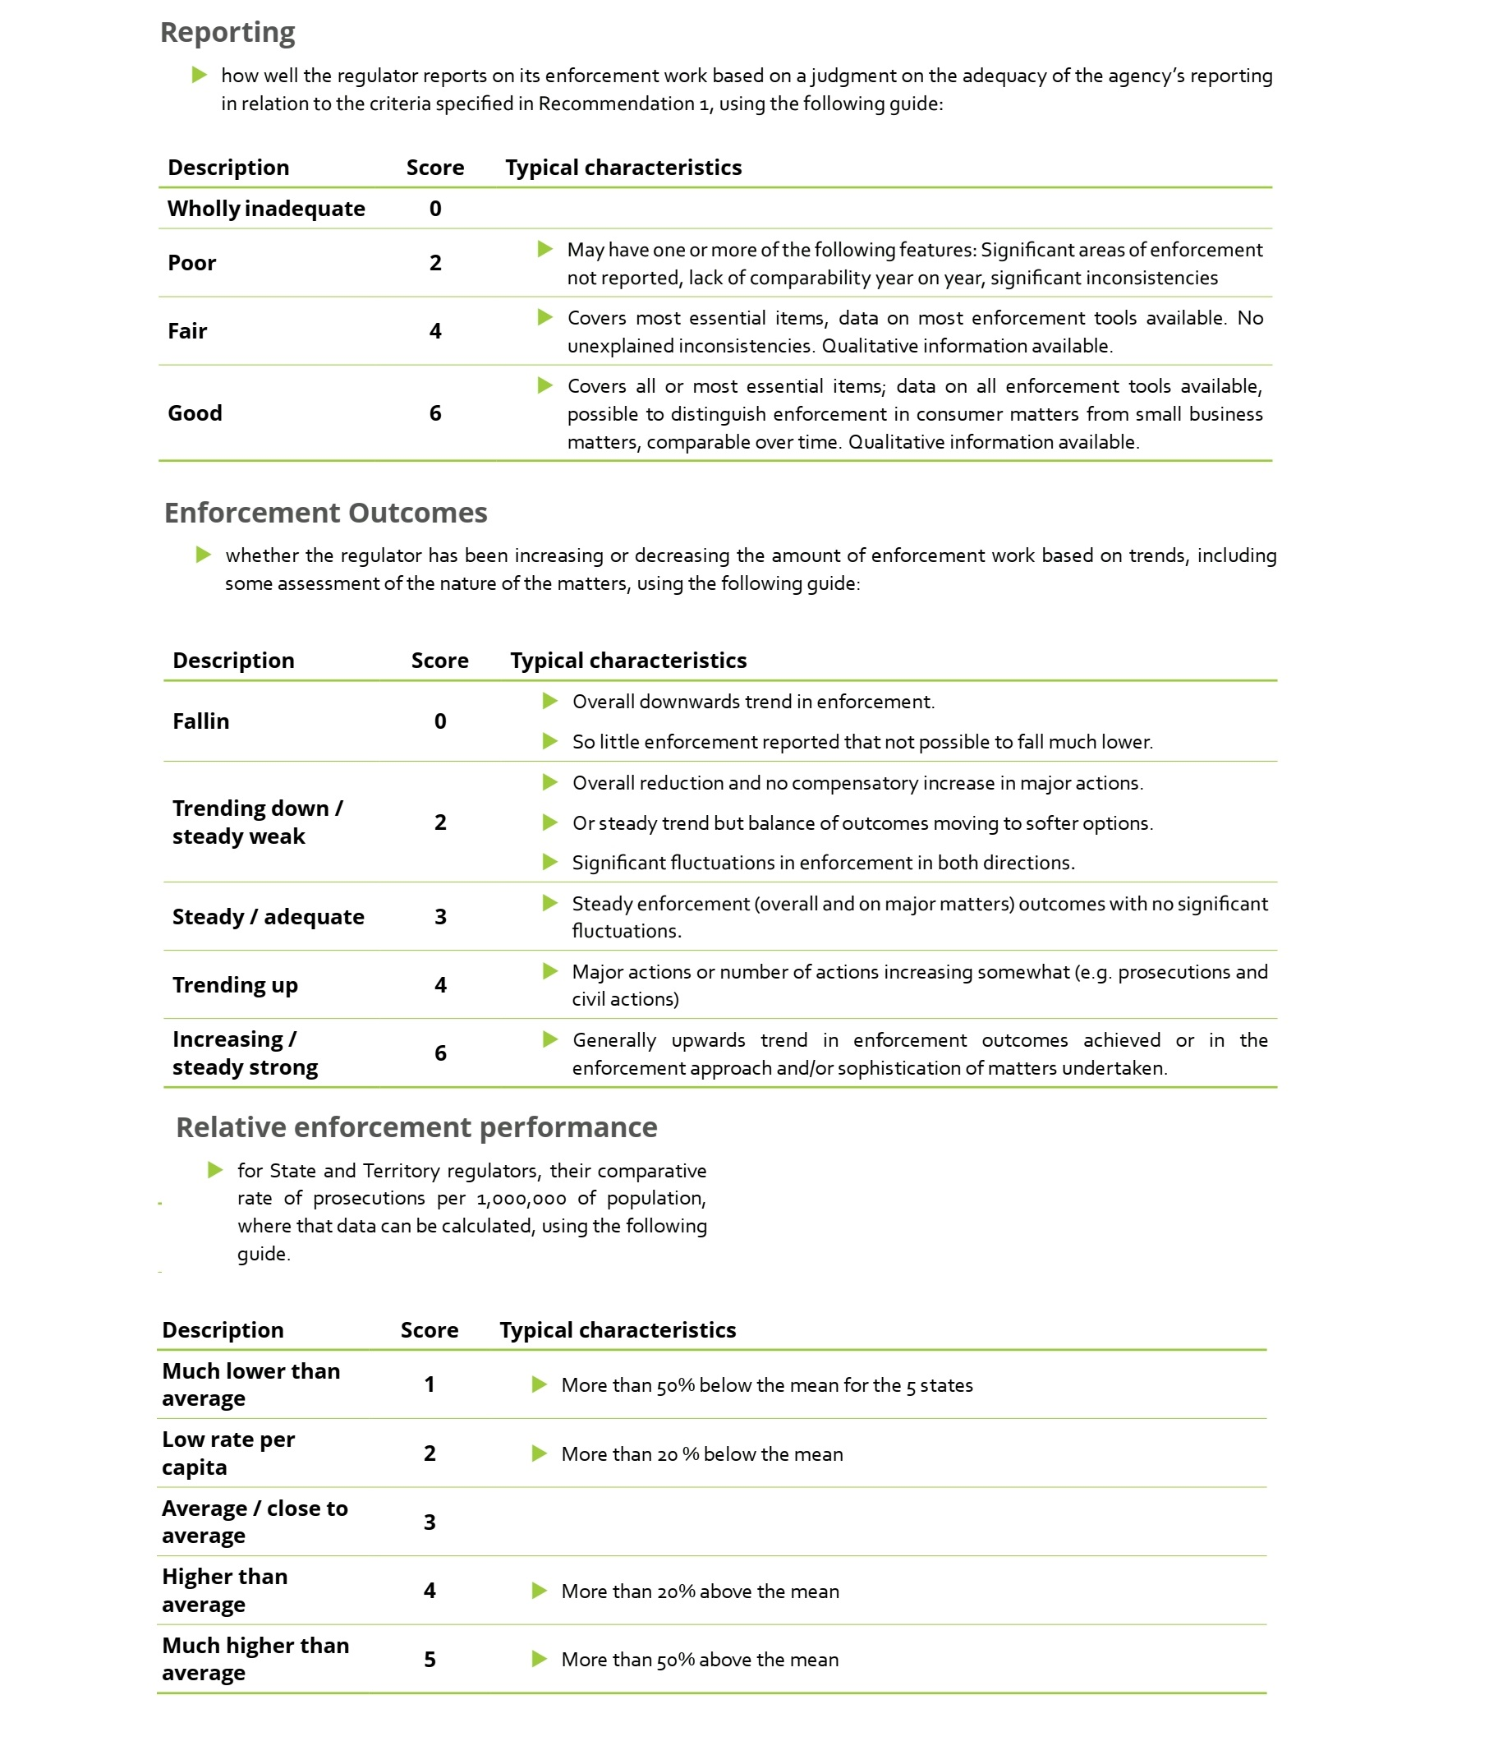
Report methodology
Enforcement performance & reporting on performance
Replicates 2013 report
Covers all ACL regulators (including ASIC) and adds ACMA and AER
Qualitative element – discusses certain current issues
Consumer advocate survey
Scorecard
Notes:
Which regulators? Some commentary about ARPA, AFSA
Score for reporting – judgment on adequacy of agency’s reporting
Score for enforcement – whether increasing or decreasing based on trends, including some assessment of the nature o the matters
Relative enforcement performance – for state & territory regulators, comparative rate of prosecutions per 1 million of population

Slide 9

Limitations/criticisms
Publicly available data only
Comparison remains difficult: so we don’t try, rather we use an individual agency scorecard
FSRC criticism: “number of proceedings, or infringement notices issued, will say little about ASIC’s enforcement culture unless the decisions behind those numbers are evaluated”
Notes:
We deliberately relied on publicly reported information only – some criticism of this. We consider transparency of enforcement action by regulators to be an essential part of their role, contributing to community understanding and confidence. I’d also note that in its 2017 report on Consumer Law Enforcement and Administration, the Productivity Commission also found that reporting contributes to accountability and allows agencies to benchmark performance. The Productivity Commission recommended that Australian Consumer Law regulators publish a comprehensive and comparable set of performance metrics. To our knowledge, this recommendation has not been implemented.
Comparison – while greater alignment of power & tools among ACL regulators, we still had difficulty comparing & there were reporting discrepancies – different categorisation about what constitutes enforcement work; different counting methodologies (e.g. by proceedings commenced versus proceedings concluded); not distinguishing consumer protection from non-consumer protection enforcement work.
Response to FSRC
Limits of purely quantitative measurement is accepted – that’s partly why the report also canvasses a range of issues ‘beyond the numbers’ – come back to this
We agree that an incremental rise or fall in number of enforcement actions tells us little without accompanying consideration of the complexity and importance of the actions behind those numbers
However, a sharp increase or decrease in activity, or little or no enforcement action by a particular regulator, can speak loudly about effectiveness and culture of that regulator
Finally, however, in absence of better performance measurement, we are left with a decision – do nothing or attempt to understand the enforcement landscape and advocate for improvements. We choose this route.
Perhaps in discussion we can talk about measurement of outcomes, which goes beyond counting things and looks more closely at impact. However, without counting output I’d argue that you can’t fully consider outcomes.

Slide 10

Key issues covered by the report
Regulatory reviews – ACL, REPI, ACMA
Regulator Performance Framework
Better use of data
Enforcement policies: risk-based, proportionality, “campaign” approaches
Costs of enforcement
Vulnerability
Publicising enforcement
Notes:
RPF – KPIs focus on reducing costs to business and compliance burden, and have the perverse effect of taking focus away from enforcing the law and protecting consumers
Enforcement policies – three categories
Policies that tend to reserve court proceedings to be last resort tool – e.g. serious offenders or egregious conduct
Policies that reflect a ‘right tool for the job’ approach
Policies that have a combination of the two
‘last resort’ is problematic – at odds with ‘why not litigate’ by Hayne
But even ‘right tool’ which was often phrased as ‘risk based’ or ‘proportional’ commonly left us scratching our heads – they rarely specified the nature of the risks to be considered, the consequences of different levels of risk being identified, or how proportionality is to be applied in practice
Risk is that this easily reverts to softer approaches which become ingrained in regulator culture, rather than the harder enforcement work
Cf Campaign approaches – can be proactive to tackle emerging problems or reactive to address systemic issues – take a range of complementary actions – information, education, research, policy work and of course strategic enforcement
Costs of enforcement – the report notes that even with right culture and tools, available resources clearly have an impact on effectiveness. An appendix to the report outlines our attempts to understand publicly available information about funding and staffing. This was very difficult though – and we couldn’t ascertain any clear correlation between enforcement performance & resourcing.
Vulnerable consumers – this is a key focus of all regulators so encouraging the development of sophisticated approaches. Touches on some best practices from here and overseas, including recognising ‘universal’ or ‘inclusive’ approaches – that is, making markets work for those that experience barriers means it will work for all. Also the renewed policy focus on fairness.

Slide 11

Consumer advocate feedback
Key survey results
  100% felt publication of information on complaint & enforcement were important
  Desire for reporting on outcomes, use of data (NSW Fair Trading Complaints Register), naming of businesses
Reporting back to consumer organisations
Notes:
Improved systems to regularly and routinely report to consumer organisations on outcomes of complaints made
Different mechanisms – Super Complaints, matters registers, Nth Qld Indigenous Consumer Taskforce
Benefits: two way knowledge exchange & transfer; collaborative enforcement outcomes; increased regulatory approach; timely feedback to consumer cases; improved partnerships

Slide 12

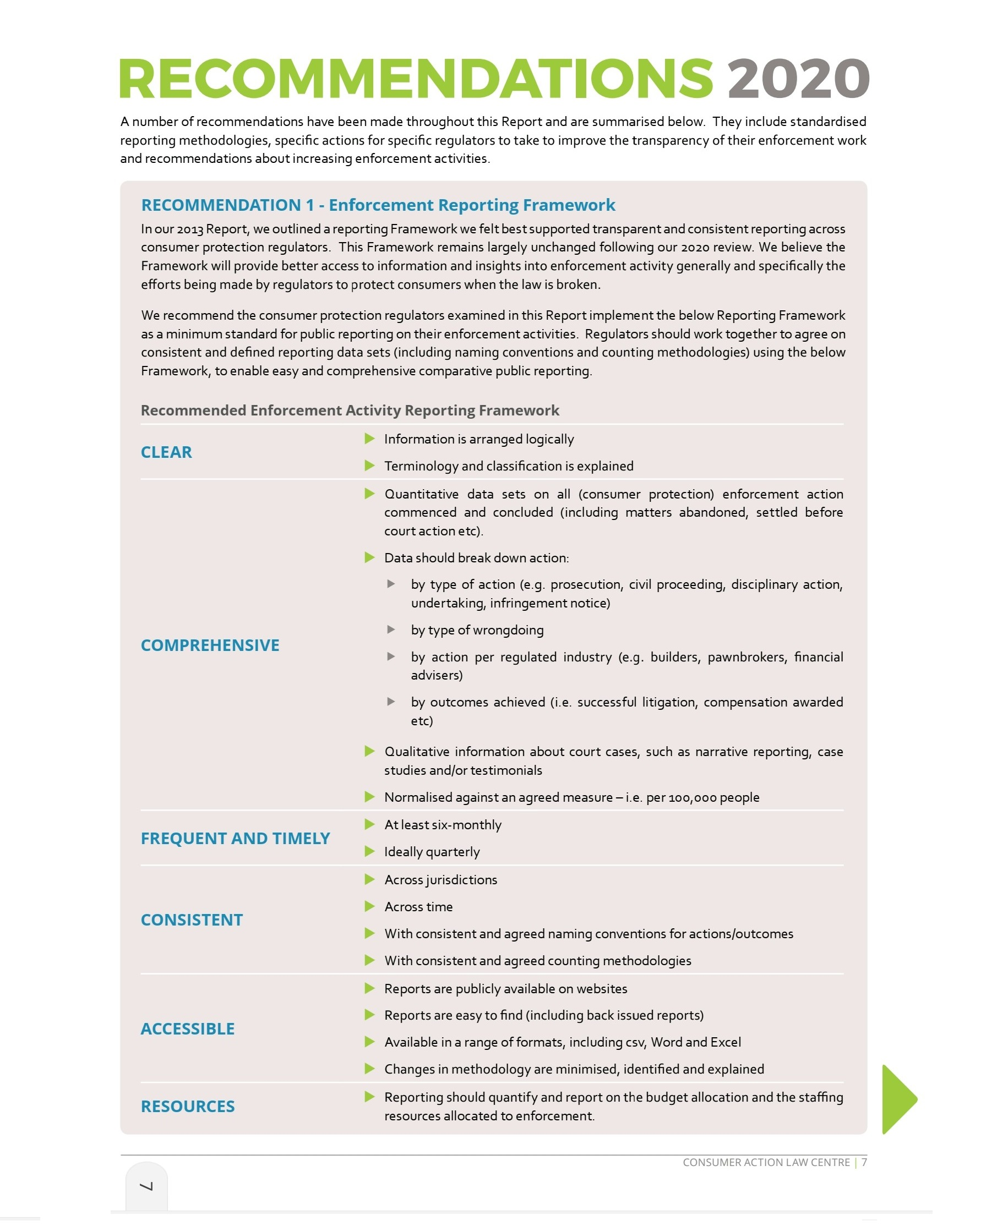
Key recommendation
A minimum-standard reporting framework
The same key recommendation as 2013
Notes:
I’m not going to go through the report for each regulator – you can look at the detail of the report.
IN summary, at a national level, regulators have largely remained strong on enforcement or improved over the period – including on reporting
At the state & territory level, some agencies have improved performance, some have remained weak, and others are trending down
Now I’ll move straight into the report recommendations
Minimum standard – clear; comprehensive, frequent & timely, consistent, accessible, clear reporting on resources

Slide 13
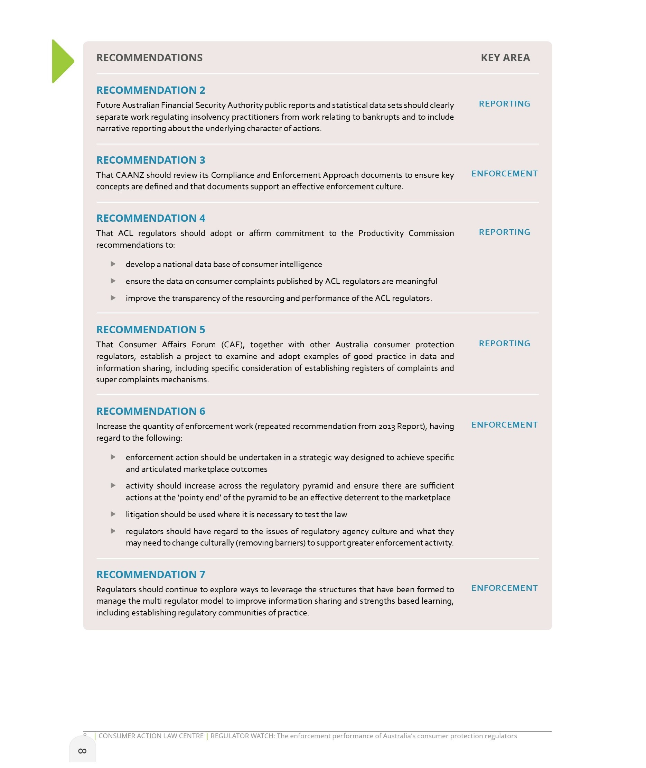
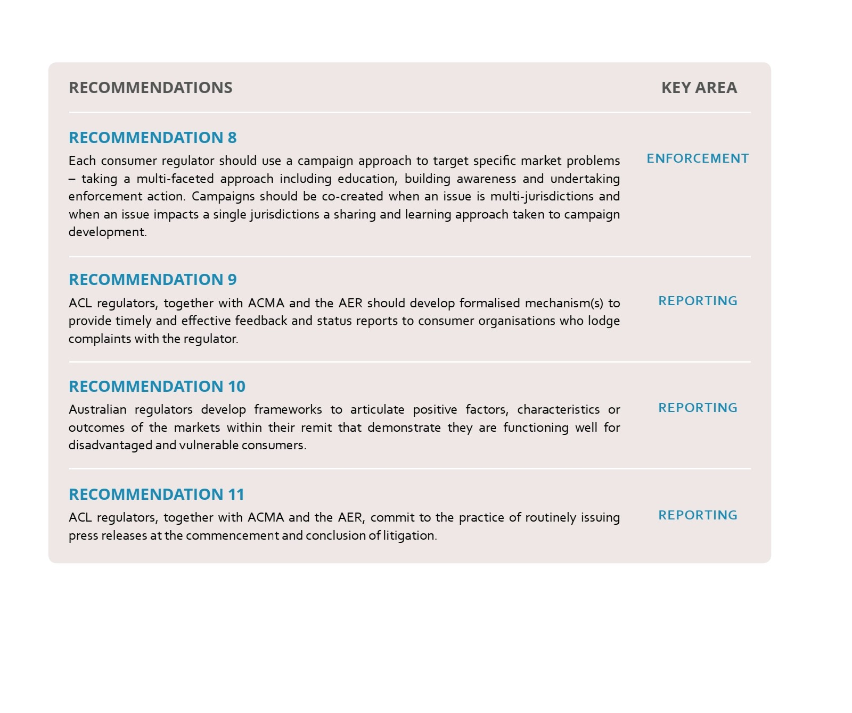
Other recommendations
Notes:
I won’t go through them all – but they respond to the various analyses and issues I’ve discussed throughout. Recommendations cover:
Increasing the quantity of enforcement work
Approaches to enforcement policies, including campaign approach
Better use of data – we suggest a CAANZ project on things super complaints & registers of complaints
Improving reporting to consumers
To develop mechanisms to determine whether markets & consumer protection working for people experiencing vulnerability
More consistent use of media to publicise enforcement work

Slide 14

14
Notes:
In conclusion, the key in our view is for consumer protection regulators to
Establish and nurture enforcement cultures within their agencies & across agencies
Align approaches to reporting, campaigning and enforcement activities – driving shared learning and efficiencies
Tell everyone what enforcement action has been taken and why – including consumer organisations, consumers, the media & the marketplace

