Slide 1
Covid-19 Compliance: Insights from Australia
Liam Smith
Sli.do #Comply

Slide 2
Language differences
Sli.do #Comply
Beliefs about the consequences of doing the behaviour = Perceived threat
Includes personal norm = Specific moral alignment
Non-normative obligation to obey the law
Capacity to comply
Opportunity to violate (for another behaviour)
Impulsivity = conscientiousness

Slide 3
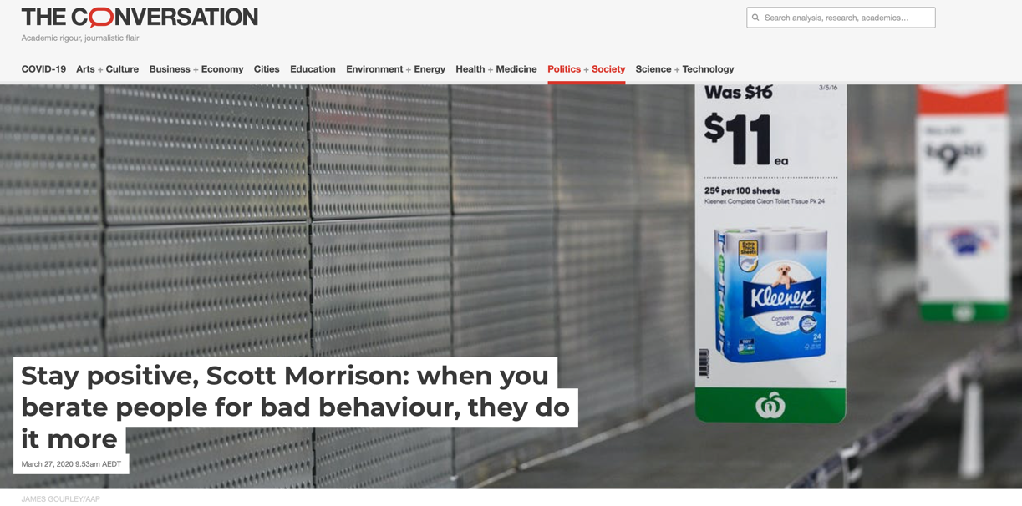
Survey about Corona Responses to Understand Behaviour (SCRUB)
Sli.do #Comply
“Stop hoarding. I can’t be more blunt about it. Stop it. … It’s one of the most disappointing things I’ve seen in Australian behaviour in response to this crisis”
Started because we were seeing behaviour and responses that could be better informed

Slide 4
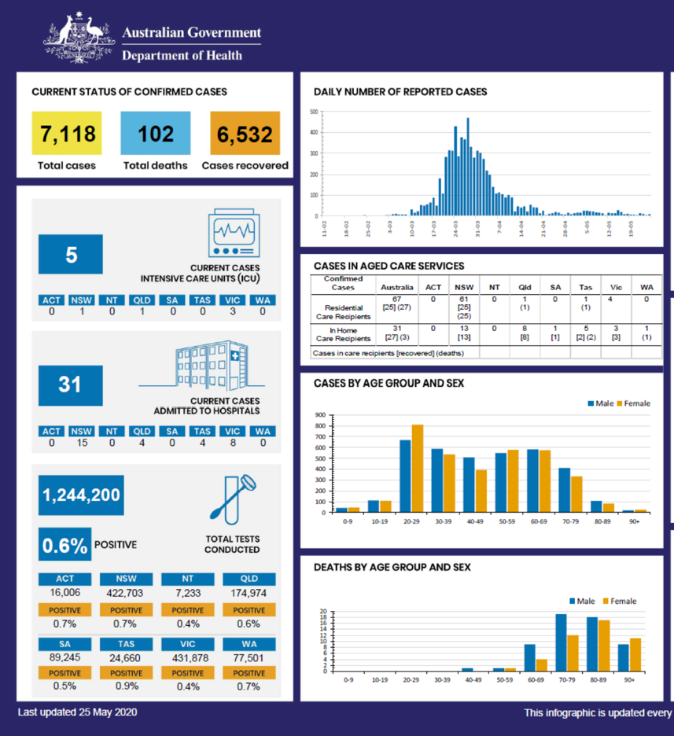
Actually the government has done well
In part, this can be attributed to the laws that were enacted.
Also relevant is the degree of compliance
But there’s the need to continue to encourage behaviour, particularly for hard-to-regulate behaviours
To assist, the SCRUB is looking at participation as well as drivers and barriers to many different behaviours
Sli.do #Comply

Slide 5
Contents of SCRUB waves
Sli.do #Comply
SCRUB Wave 1 (March, N=1000)
Participation in 5 core health behaviours + general diagnosis of drivers and barriers
Participation in 15 other behaviours (e.g. excess buying, cancelling or avoiding meetings)
Worries
Where information is sought
Who is trusted
Wellbeing
Message testing (Commitment to hygiene behaviours
+ many more
SCRUB Wave 2 (April, N=1000)
Participation in 5 core health behaviours + specific diagnoses of drivers and barriers
Participation in 8 other behaviours (excess buying, wearing face mask, avoiding gatherings)
Worries
Confidence in authorities
Wellbeing
Message testing (App downloading / use)
+ many more
SCRUB Wave 3 (May, N=2000)
Participation in 3 core behaviours (2 hygiene behaviours omitted)
Behaviours and intentions in two core areas: transport and economic participation
Impact of different policy options on transport intentions
Worries
Confidence in authorities
Wellbeing
Work participation and where
+ many more
Notes:
Start with some general observations before focussing in on these behaviours / data

Slide 6
Compliance: knowledge of rules (wave 3)
How would you rate your knowledge about the rules that apply to you in your State?
Sli.do #Comply
Notes:
Interesting because in many compliance contexts, many are unaware of the rules.

Slide 7
Compliance: adherence to rules (wave 3)
How frequently are you following the government COVID-19 rules and regulations in your State?
Sli.do #Comply

Slide 8
Perceived norm: what others are doing (wave 3)
How many of 100 people in your State do you think are following the government COVID-19 rules and regulations?

Slide 9
Two key behaviours: specific diagnoses from waves 2 and 3
Sli.do #Comply
Notes:
Align to Ben’s outcomes (DV).

Slide 10
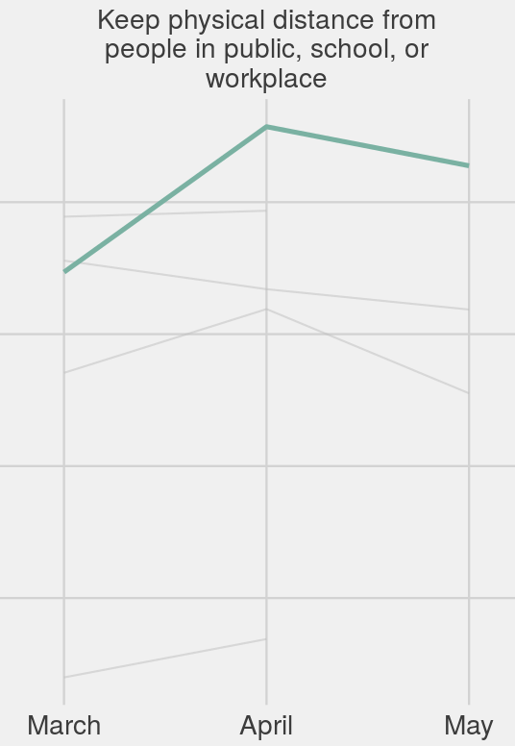
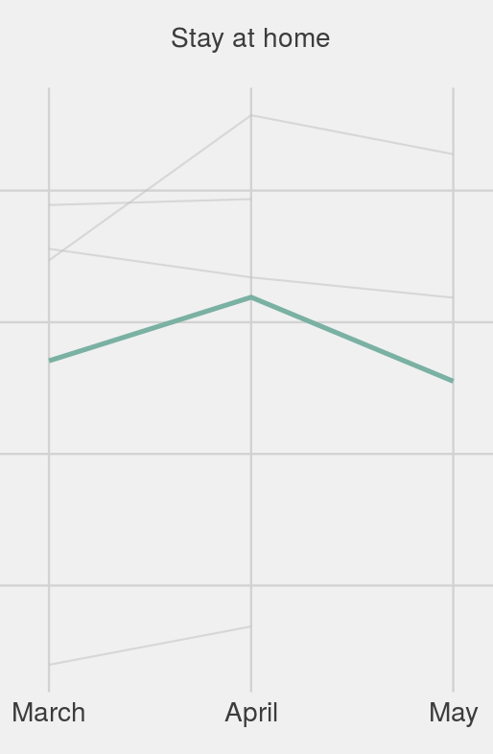
Trends over time
Sli.do #Comply

Slide 11
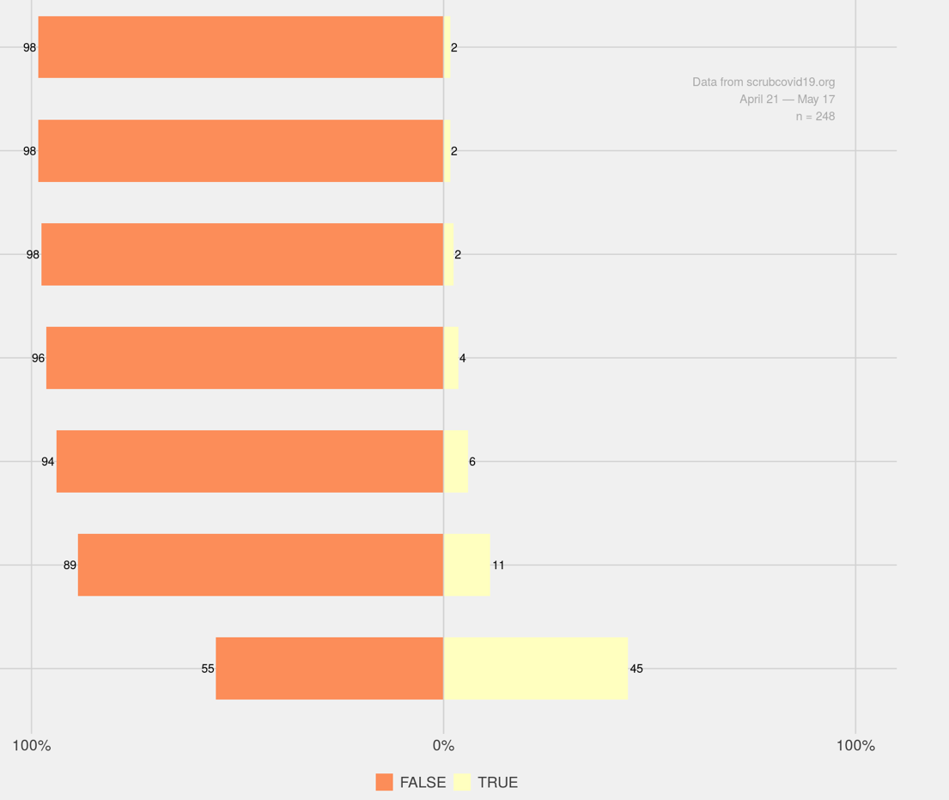
What stops people from staying at home?
I don’t know about it
None of these
I don’t know how to do it
I don’t remember to do it
I don’t want to do it
I don’t have the resources to do it
No one else is doing it

Slide 12
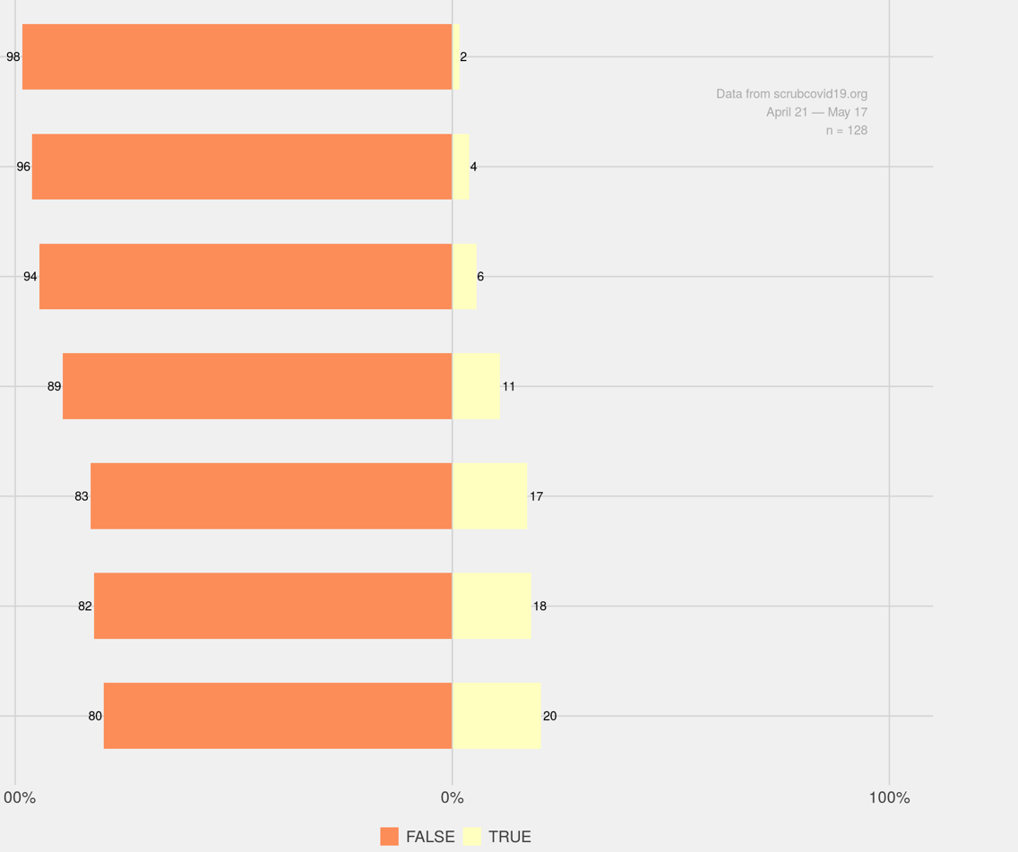
What stops people from keeping distance?
None of these
I don’t know about it
I don’t know how to do it
I don’t have the resources to do it
I don’t remember to do it
I don’t want to do it
No one else is doing it

Slide 13
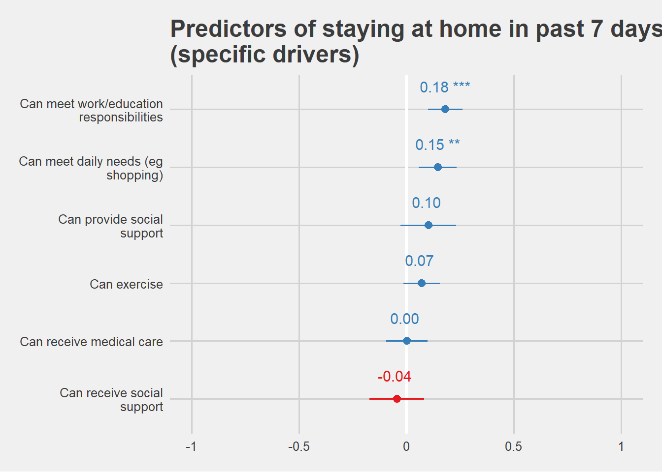
Can meet work / education responsibilities
Can meet daily needs (e.g. shopping)
Sli.do #Comply

Slide 14
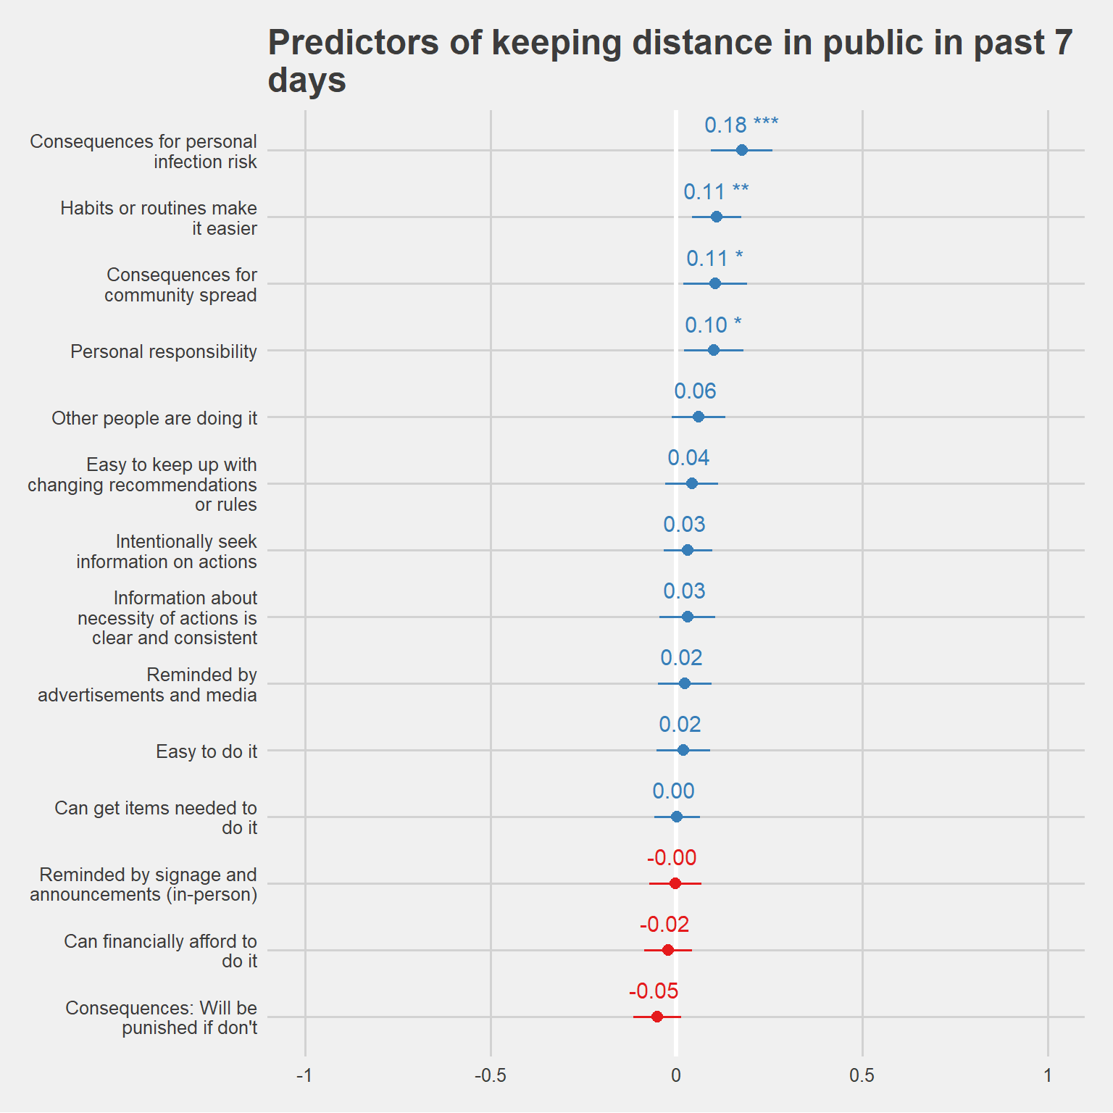
Consequences for personal infection risk
Habit and routines
Consequences community spread
Personal responsibility
Sli.do #Comply

Slide 15
Summary
Australians are generally compliant but this is waning
Norms aren’t a predictor but they are positive and we know they can be used
Deliver interventions that enable people to get what they need and to facilitate working from home
Emphasise the consequences for themselves and others
Play with the data yourself at https://noetel.shinyapps.io/covid/
Sli.do #Comply

