Slide 1
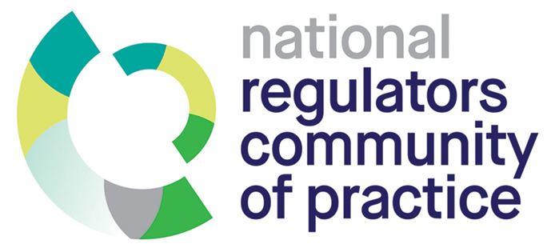
Covid-19 Compliance: Insights from surveys in the US, UK and the Netherlands
Benjamin van Rooij
Sli.do #Comply

Slide 2
Results from the US
April 3, 570 participants from 35 States
Self-reported compliance was high (6.32 out of 7)
What played a role in compliance?
  Specific moral alignment (+)
  Negative emotions (+)
  Impulsivity (-)
  Social norms (+)
  Capacity to comply (+)
  Opportunity to violate (-)
  Non-normative obligation to obey the law (-)
Sli.do #Comply

Slide 3
Results from the UK
Sli.do #Comply
April 6-8, 555 participants, nationally representative UK
What played a role in compliance?
 | Meeting People | Safe Distance | Lockdown
Compliance (1-7) | 6.47 | 6.41 | 6.51
Fear of disease |  |  | -
Specific moral alignment |  |  | +
Negative emotions |  |  | -
Knowledge of the rules |  |  | +
Capacity to comply | + | +
Normative obligation to obey the law | + | +
Political orientation (conservative) |  | -

Slide 4
Results from the Netherlands
April 7-14, 568 participants
Self-reported compliance was high (6.05 out of 7)
What played a role in compliance?
  Fear for health (+)
  Specific moral alignment (+)
  Impulsivity (-)
  Knowledge of the measures (+)
  Capacity to comply (+)
  Opportunity to violate (-)
Sli.do #Comply

Slide 5
Overall findings and thoughts
Fear of punishment did not play a role in any of the cases
What mattered were intrinsic motivations and practical abilities and opportunities
With lockdowns easing, compliance with social distancing will likely get harder as intrinsic motivation goes down and opportunities to violate go up, while it will be harder to enforce the rules.
The findings show generally that governments can achieve massive behavioral change and that to do so they can look beyond a focus on deterrence
Sli.do #Comply

