Slide 1
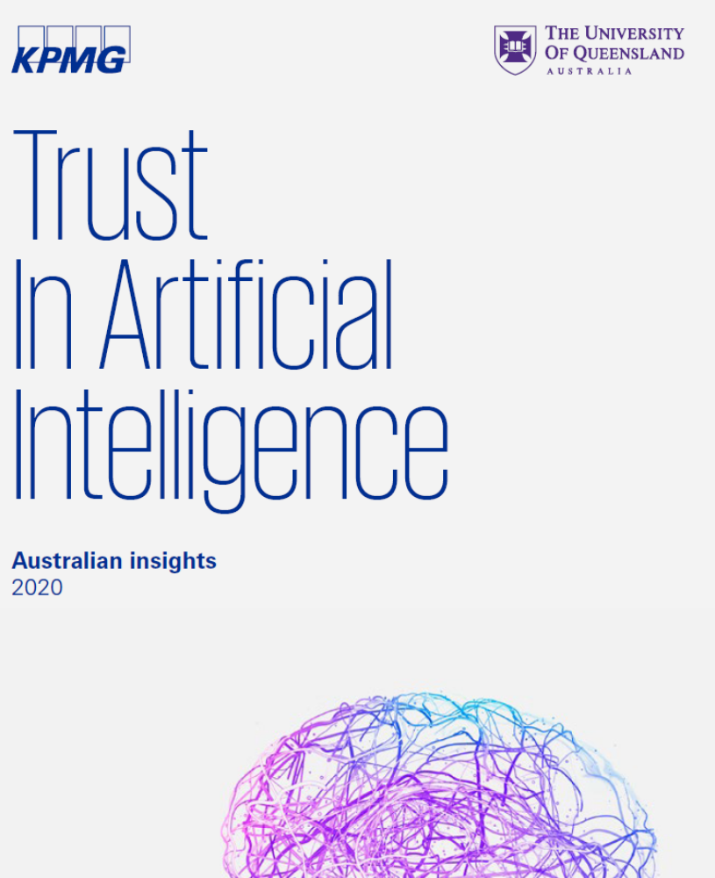

Artificial Intelligence: What is it, what are its benefits and risks?

Slide 2
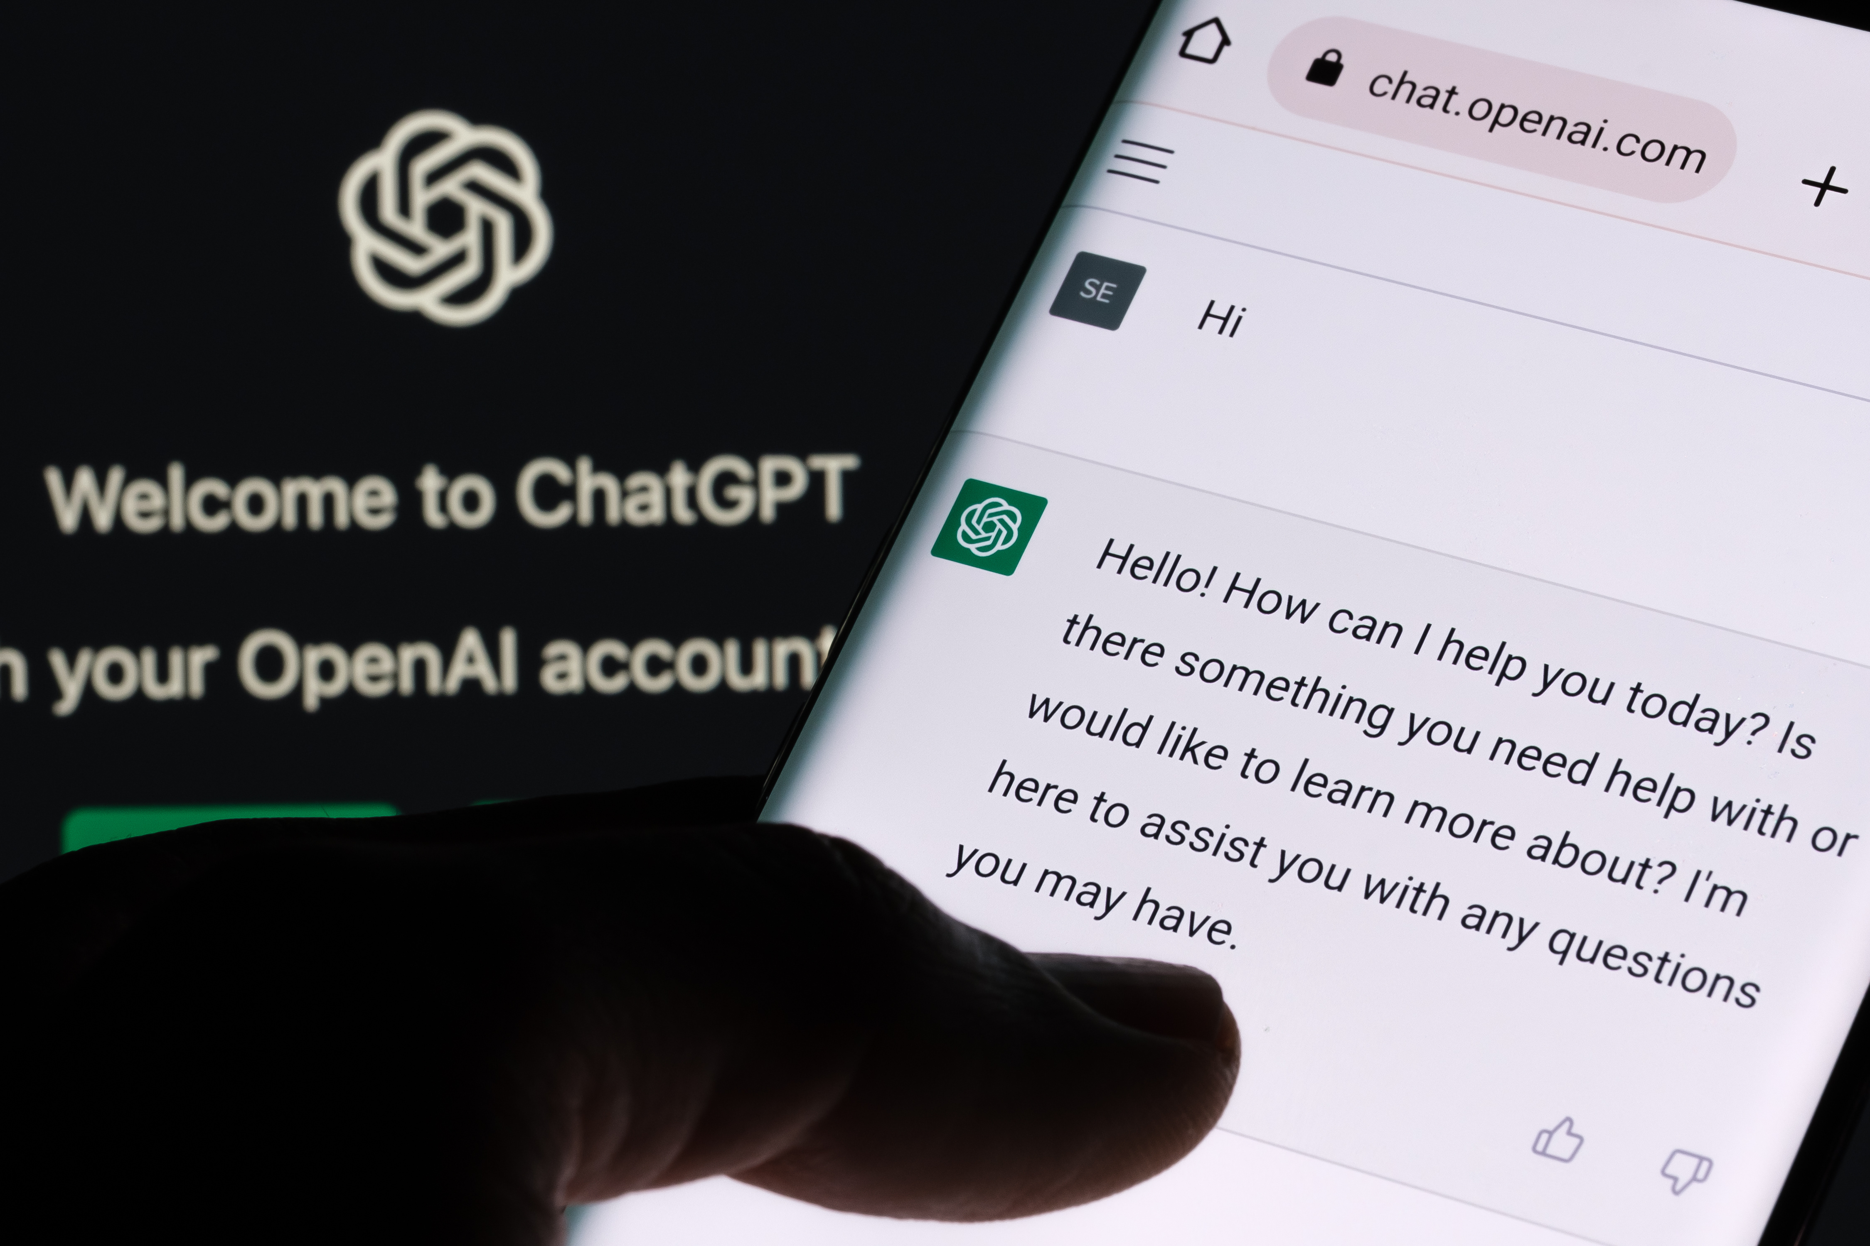
What is ChatGPT and generative AI?
Adobe stock images

Slide 3
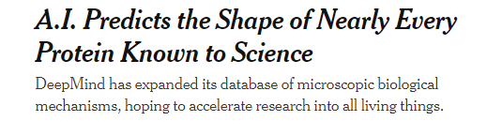

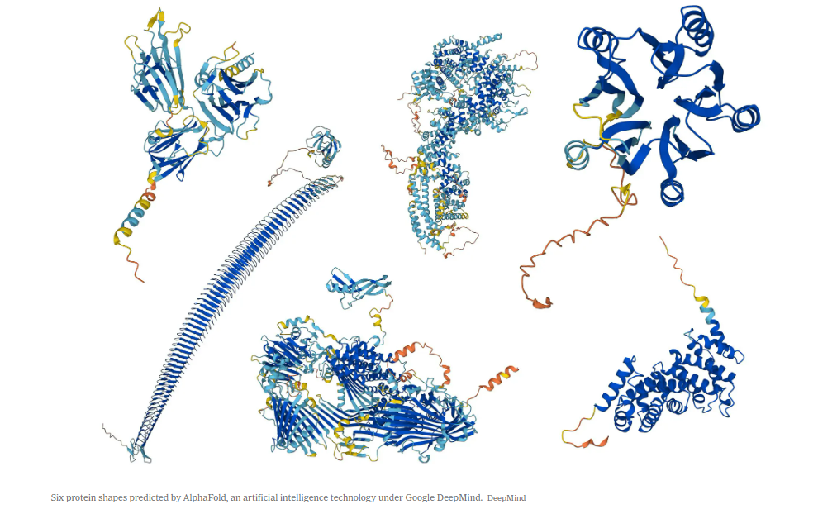


Cade Metz. The New York Times. July 28, 2022.
https://www.nytimes.com/2022/07/28/science/ai-deepmind-proteins.html

Slide 4
Accuracy,
Accountability, &
Transparent Use

Slide 5
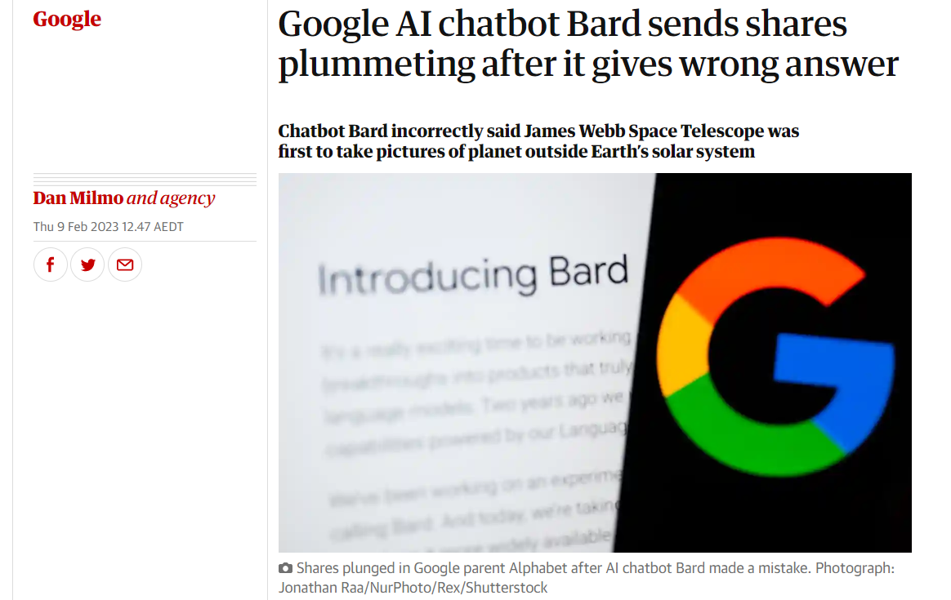

Dan Milmo and agency; The Guardian. Feb 9, 2023
https://www.theguardian.com/technology/2023/feb/09/google-ai-chatbot-bard-error-sends-shares-plummeting-in-battle-with-microsoft

Slide 6
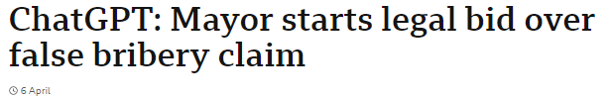

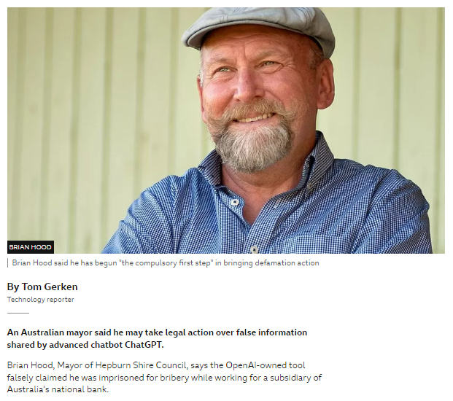

Tom Gerken; BBC News. April 6,, 2023
https://www.bbc.com/news/technology-65202597

Slide 7
Bias

Slide 8

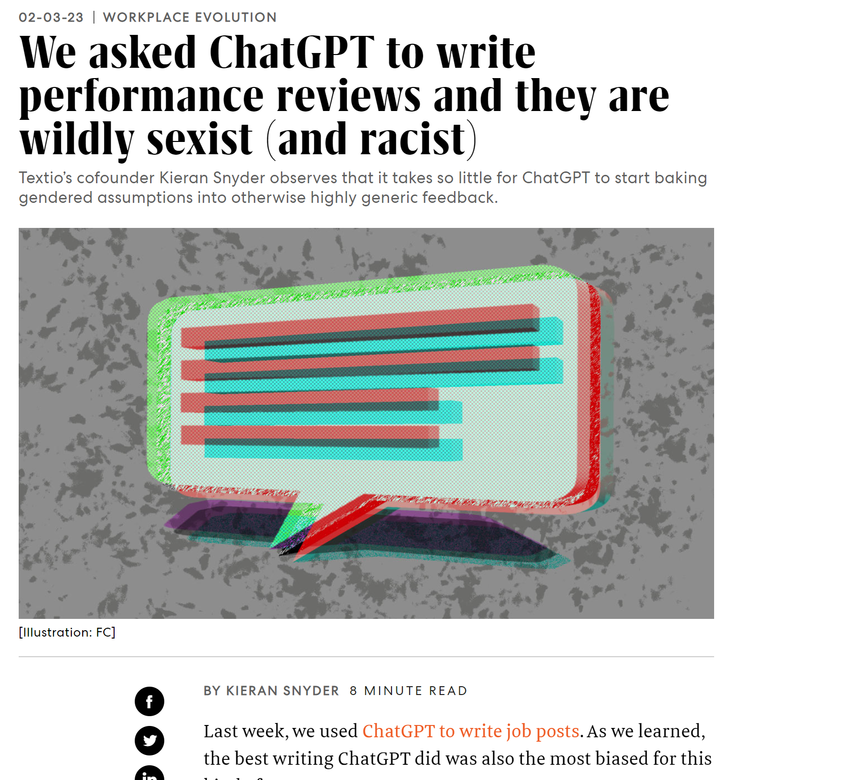
Kieran Snyder, Fast Company. Feb 3, 2023.
https://www.fastcompany.com/90844066/chatgpt-write-performance-reviews-sexist-and-racist

Slide 9
Privacy and Security

Slide 10
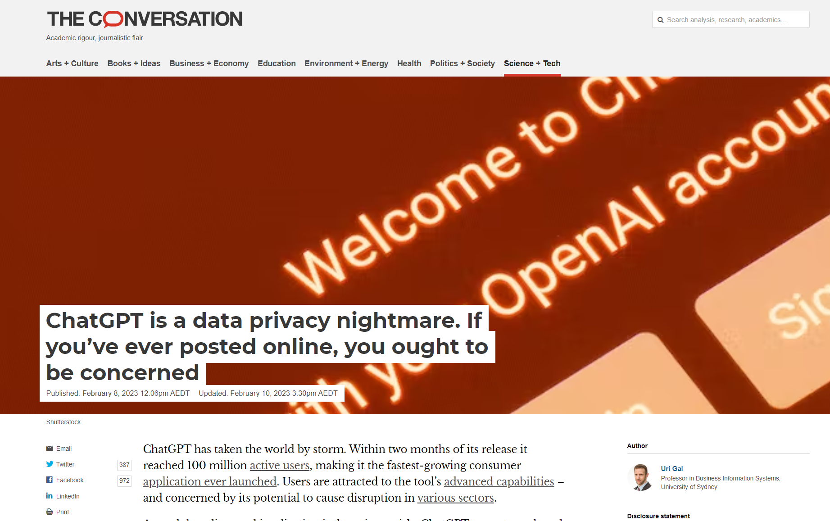
Uri Gal, The Conversation. Feb 8, 2023.
https://theconversation.com/chatgpt-is-a-data-privacy-nightmare-if-youve-ever-posted-online-you-ought-to-be-concerned-199283

Slide 11
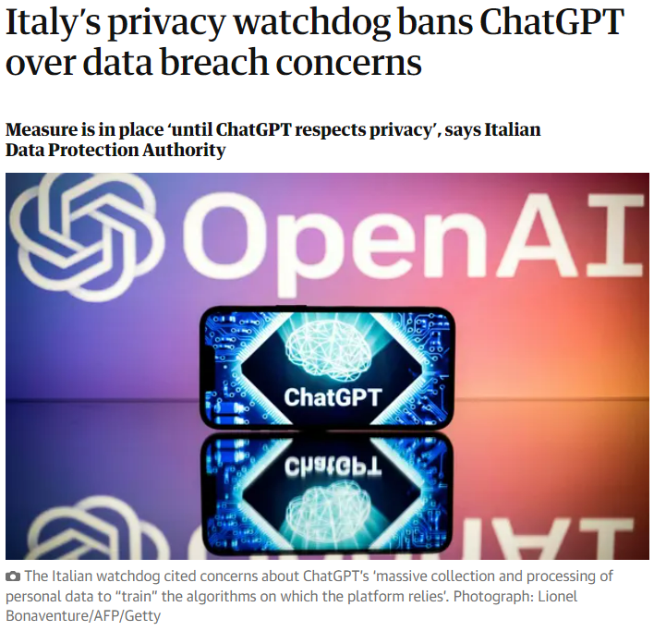


Dan Milmo and agencies,The Guardian. April 1, 2023.
https://www.theguardian.com/technology/2023/mar/31/italy-privacy-watchdog-bans-chatgpt-over-data-breach-concerns

Slide 12
Access and Equity

Slide 13
Intellectual Property

Slide 14

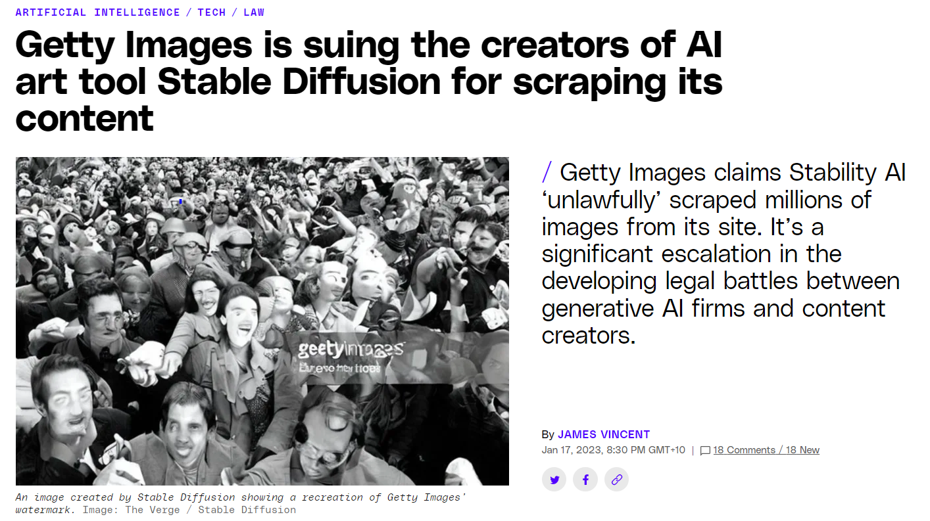
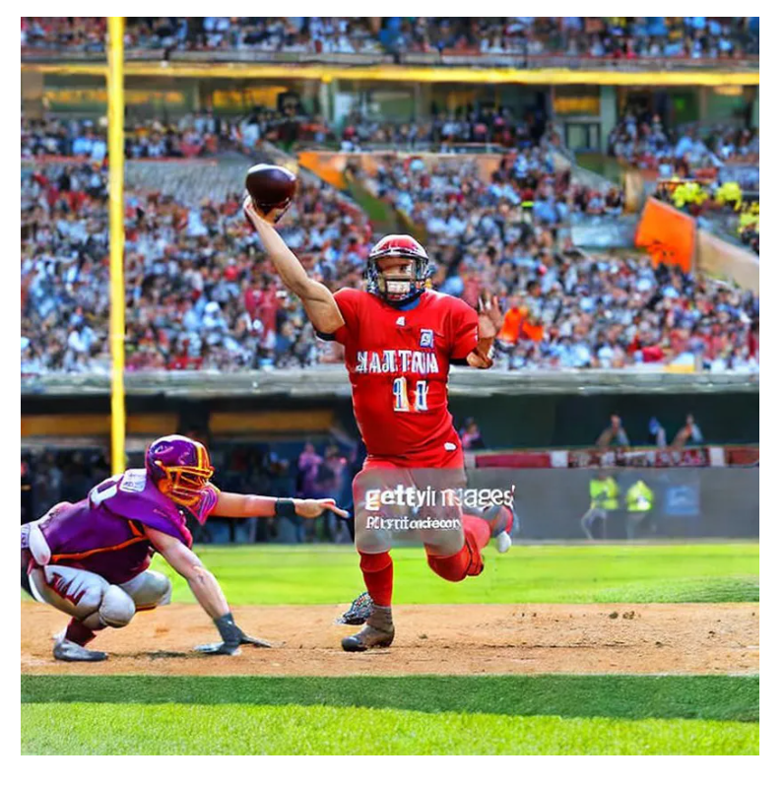
James Vincent, The Verge. Jan 17, 2023
https://www.theverge.com/2023/1/17/23558516/ai-art-copyright-stable-diffusion-getty-images-lawsuit

Slide 15
“The three C’s”: Consent
Compensation
Credit

Slide 16

Kyle Chayka, The New Yorker. Feb 10, 2023. (“The three C’s”: Matthew Butterick)
https://www.newyorker.com/culture/infinite-scroll/is-ai-art-stealing-from-artists

Slide 17
Fake information, misinformation and deep fakes

Slide 18


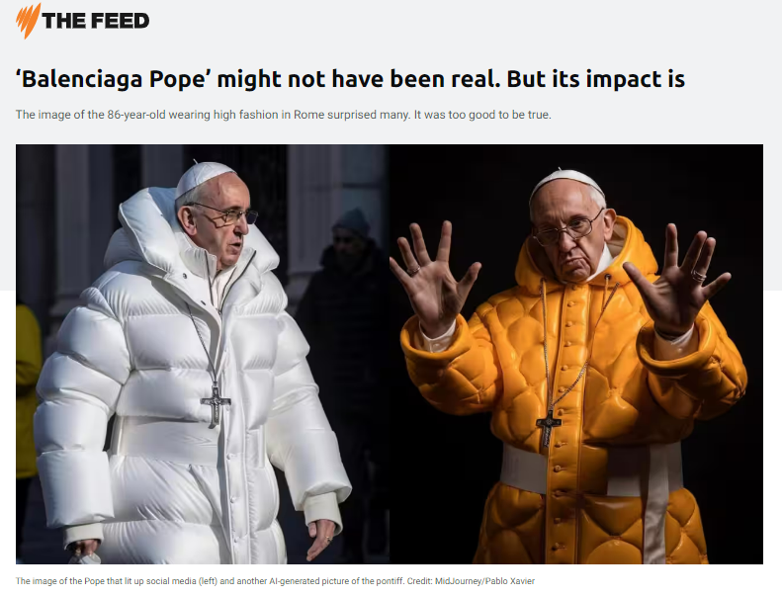


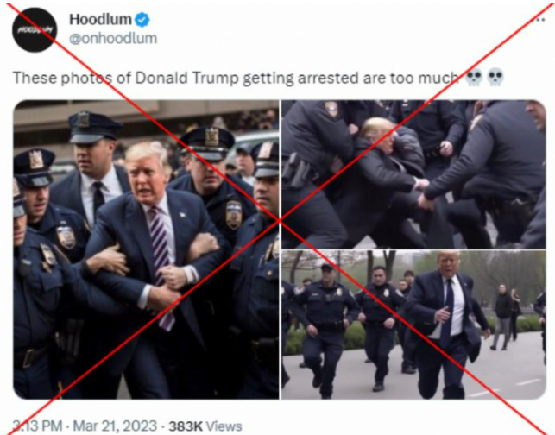

M. Elias & N. Razik. SBS News. March 29, 2023.
https://www.sbs.com.au/news/the-feed/article/balenciaga-pope-might-not-have-been-real-but-its-impact-is/61v1i9h3x
M. Jacob. AFP Fact Check. March 25, 2023.
https://factcheck.afp.com/doc.afp.com.33BY6R4

Slide 19
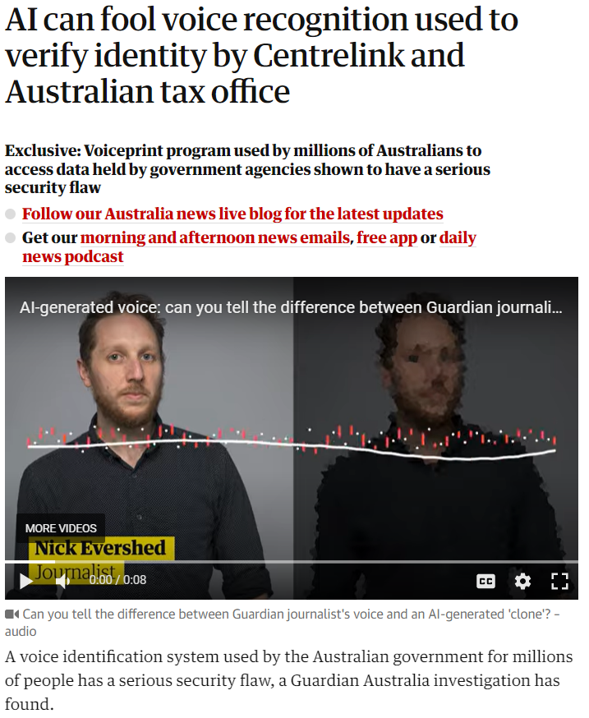

N. Evershed & J. Taylor. The Guardian. March 17, 2023.
https://www.theguardian.com/technology/2023/mar/16/voice-system-used-to-verify-identity-by-centrelink-can-be-fooled-by-ai

Slide 20
Jobs

Slide 21
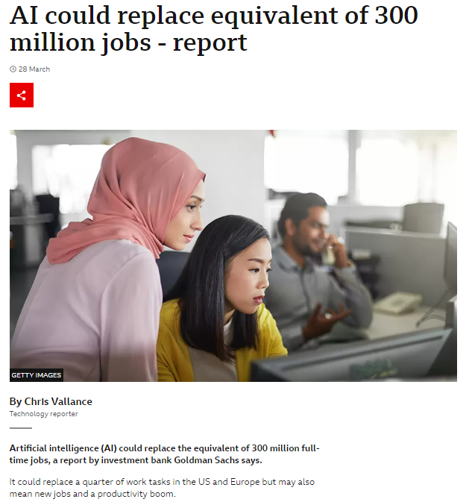


Chris Vallance. March 28/, 2023.
https://www.bbc.com/news/technology-65102150

Slide 22
How do you view these risks in your area of expertise?

Slide 23
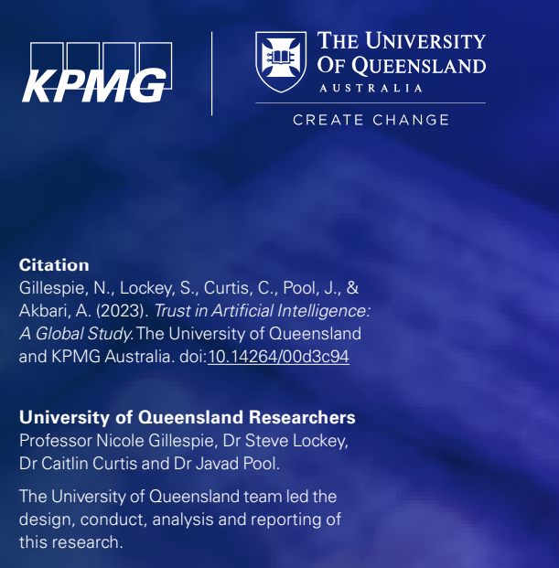
Research insights from a global survey of public trust in AI

Slide 24
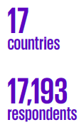
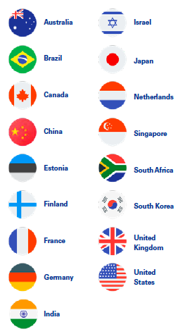
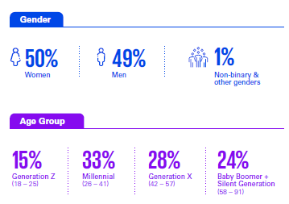
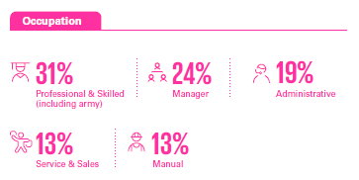
How we conducted the research

Slide 25
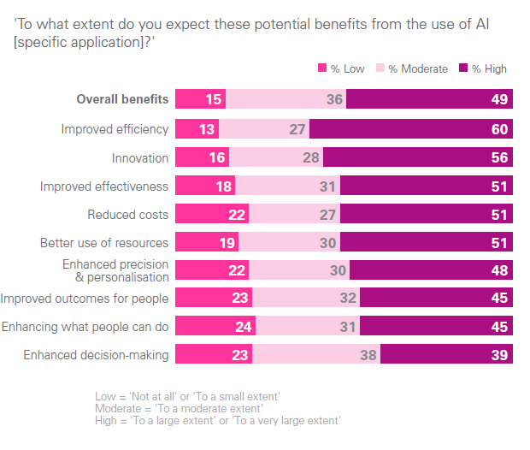
How do people perceive the benefits of AI?
85%
expect a range of AI benefits
50%
believe the benefits of AI outweigh the risks
44%
of Australians and people in western countries
58-81%
in the emerging economies
Notes:
However, on average, only one in two people believe the benefits of AI outweigh the risks, and a minority of people in Australia and other western countries believe the benefits of AI outweigh the risks

Slide 26
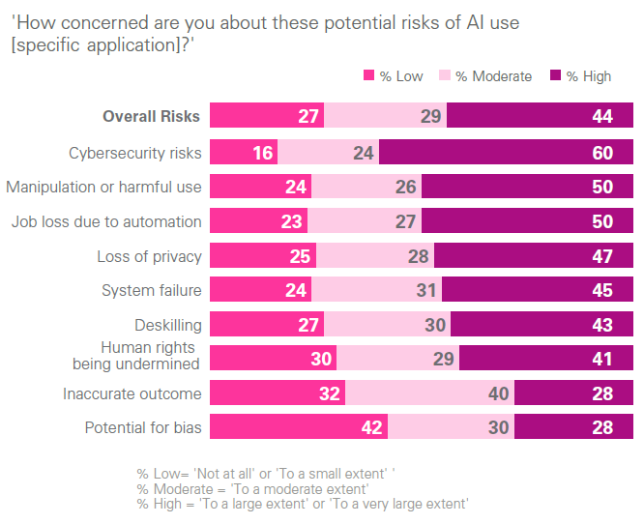
How do people view the risks of AI?
73%
concerned about potential risks
Risks of AI
viewed in a comparable way across countries
Cyber-security
is top rated risk globally

Slide 27
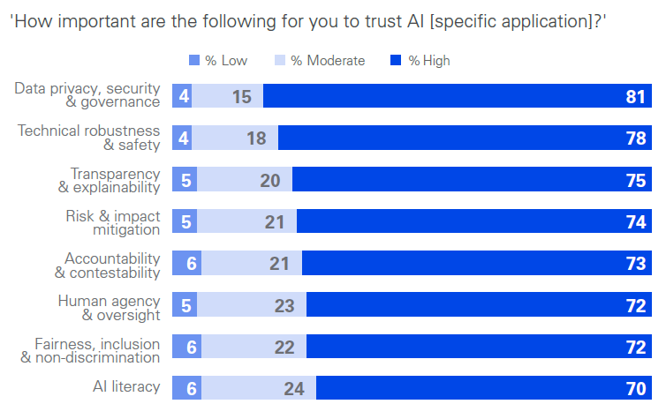
What principles and practices are important for trust in AI?
Strong global endorsement of the Trustworthy AI management and governance principles
>95%
say each of these principles are important for their trust
Trust is contingent on upholding and assuring these principles are in place

Slide 28
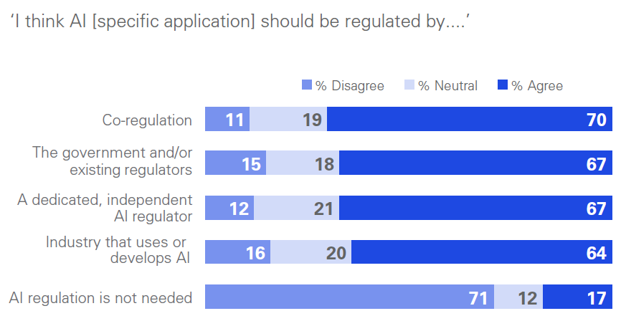
What are people’s views on AI regulation?
71%
Current regulations and safeguards are insufficient given the perceived uncertainty around AI
Only two in five believe safeguards are sufficient to make AI use safe
35% in Australia
believe AI regulation is required
People support multiple forms or regulation but expect some form of external, independent oversight
44-46% of Australians have no or low confidence in tech companies and organisations to regulate AI in public’s best interest
34% no or low confidence in the government

Slide 29




Pathways for supporting public trust and responsible AI
Institutional Pathway
Strengthening governance, regulatory and legal frameworks and safeguards
Building confidence in business and government’s use and governance of AI
Uncertainty Reduction Pathway
Similarities in perceived risks and strong consensus on expected principles and practices for trustworthy AI support a global approach to risk mitigation
Motivational Pathway
Demonstrating the benefits of AI to people and society and taking a human-centred approach
Knowledge Pathway
People trust AI systems more when they understand AI and are skilled in using digital technologies

Slide 30
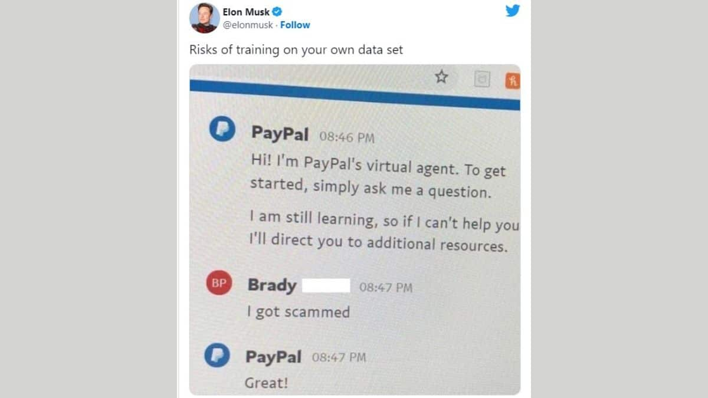

Questions

Slide 31
AI regulation in Australia: What do regulators need to know?

Slide 32
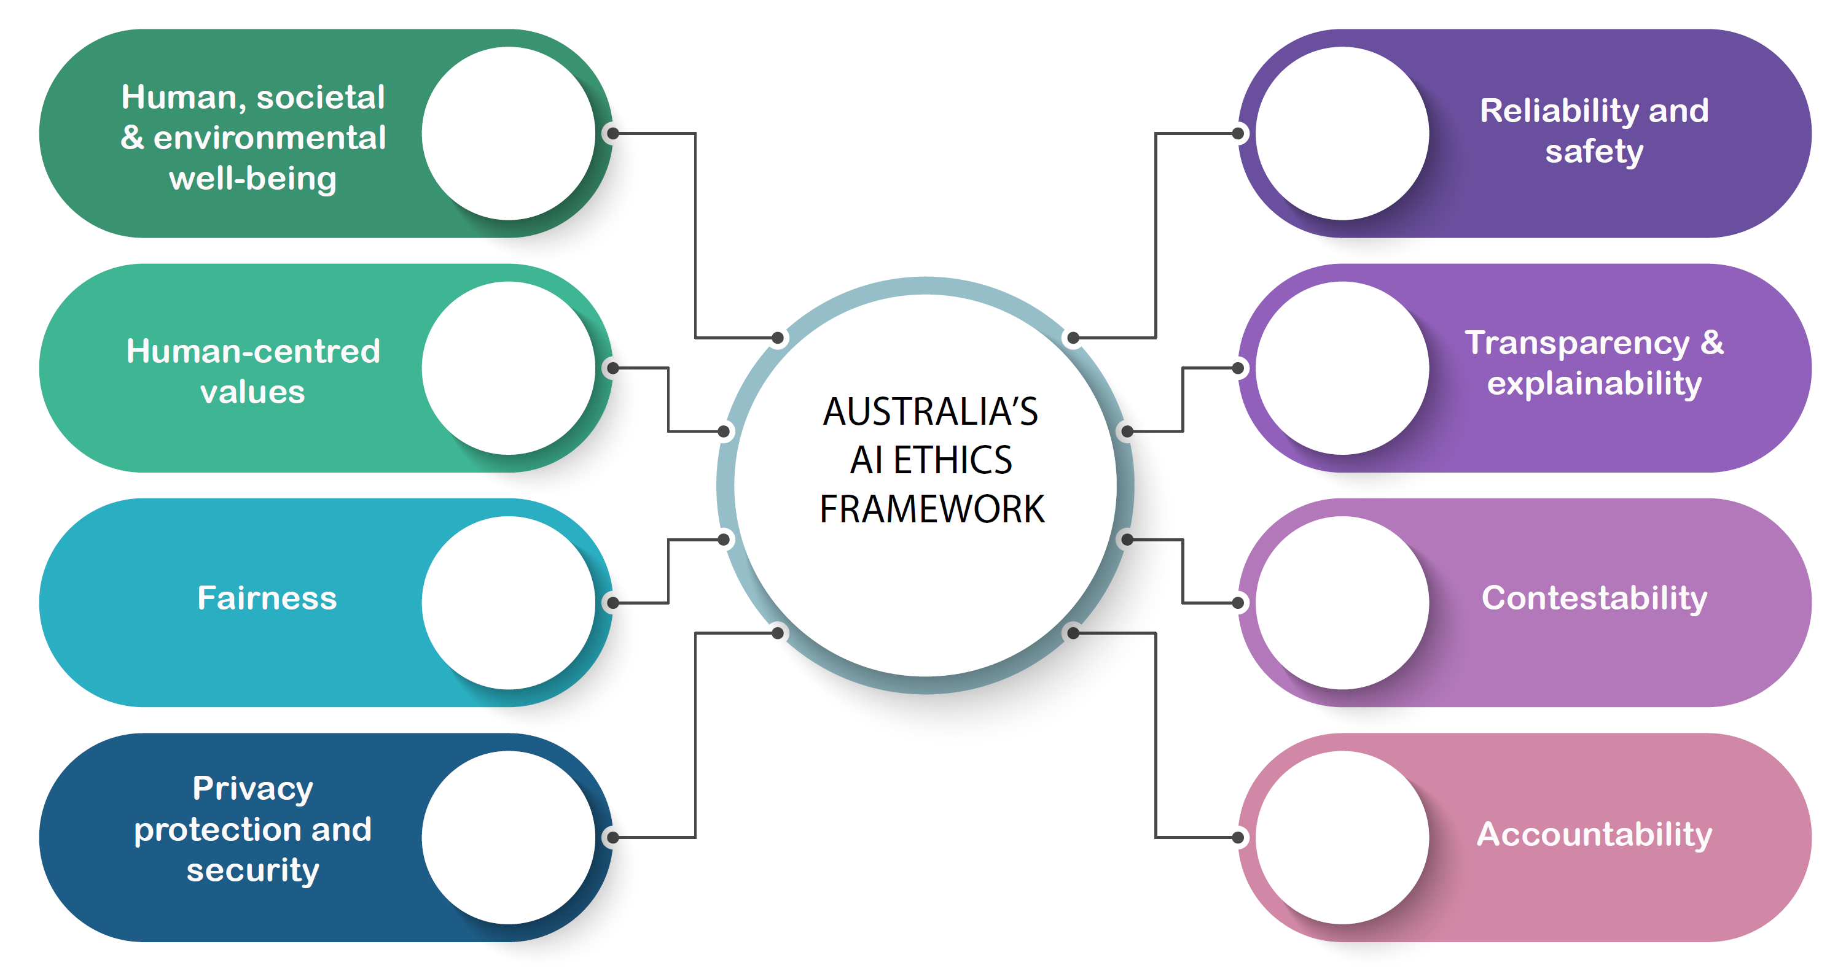









Australia’s AI Ethics Principles: https://www.industry.gov.au/data-and-publications/australias-artificial-intelligence-ethics-framework/australias-ai-ethics-principles
Infographic created for BSAN7210 (C. Curtis) based on AI Ethics Framework

Slide 33

National AI Centre
https://www.csiro.au/en/work-with-us/industries/technology/national-ai-centre

Slide 34
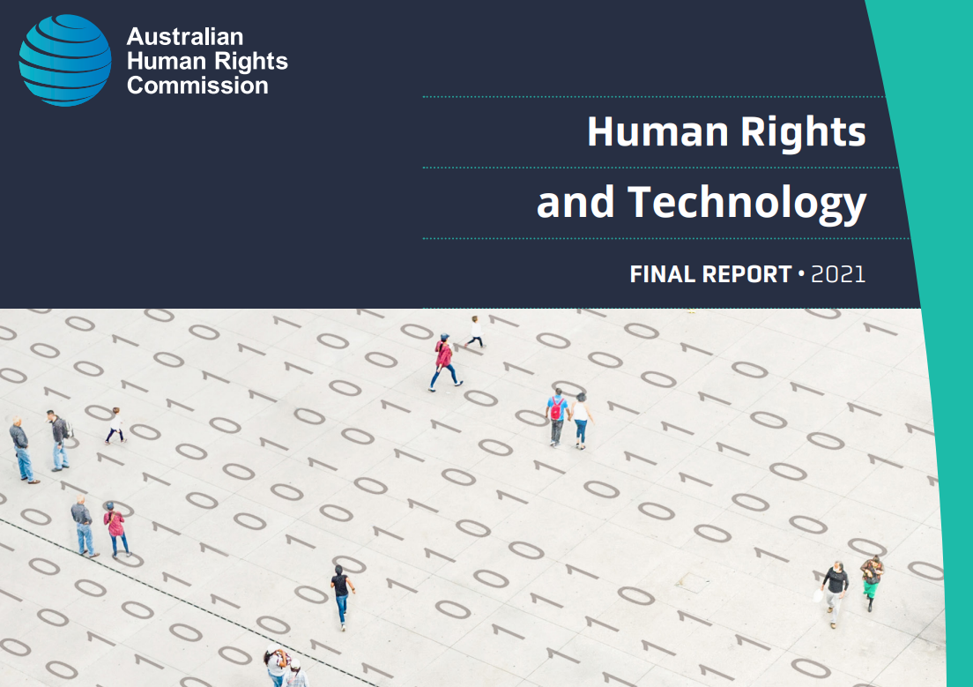
Stronger laws and policies
Independent AI Safety Commissioner
Australian Human Rights Commission. Human Rights and Technology Report. 2021.
https://tech.humanrights.gov.au/?_ga=2.51386538.2098086380.1681771030-928788736.1677153572

Slide 35
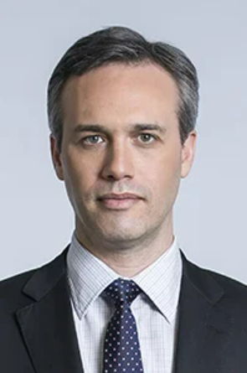
“The law does apply - it needs to be applied. It is just as unlawful to discriminate against someone using an abacus and a human making a decision, as it is using the most sophisticated form of neural network or anything in between.”
Ed Santow
Former Australian Human Rights Commissioner
(2016 – 2021)

Slide 36
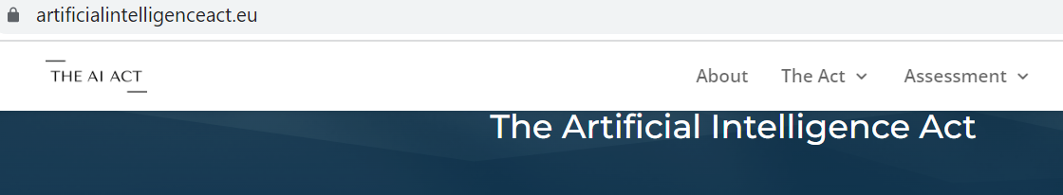
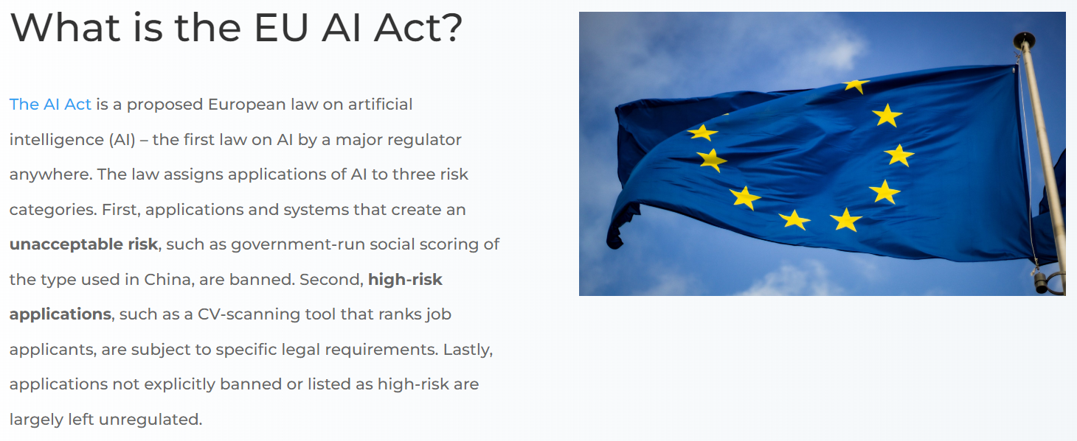
The EU AI Act
https://artificialintelligenceact.eu/

Slide 37
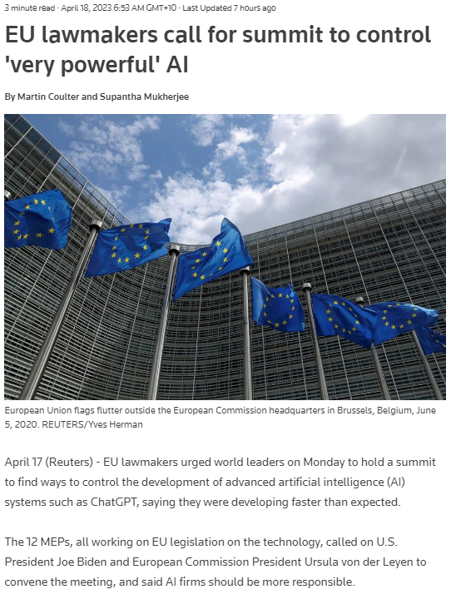

Martin Coulter and Supantha Mukherjee. Reuters. April 17, 2023. https://www.reuters.com/technology/eu-lawmakers-call-political-attention-powerful-ai-2023-04-17/

Slide 38

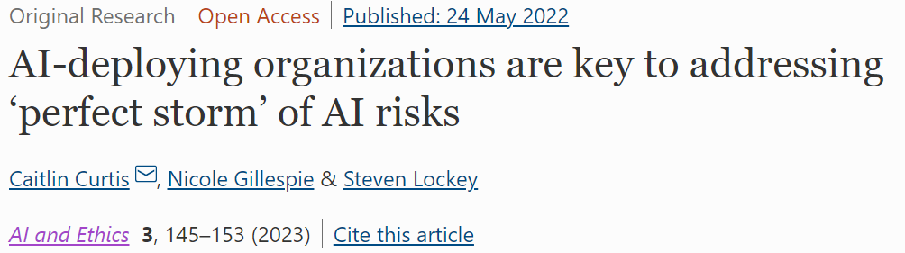
Caitlin Curtis, Nicole Gillespie, Steven Lockey. AI and Ethics. 2022. https://link.springer.com/article/10.1007/s43681-022-00163-7

Slide 39

Moving forward
Strong support in Australia for increased regulatory safeguards
Support for an Independent AI regulator or AI Safety Commissioner
Regulatory agencies may need to create new positions/and or employ technical specialists with the capability to interrogate and audit algorithms

Slide 40
Thank you!

