Slide 1
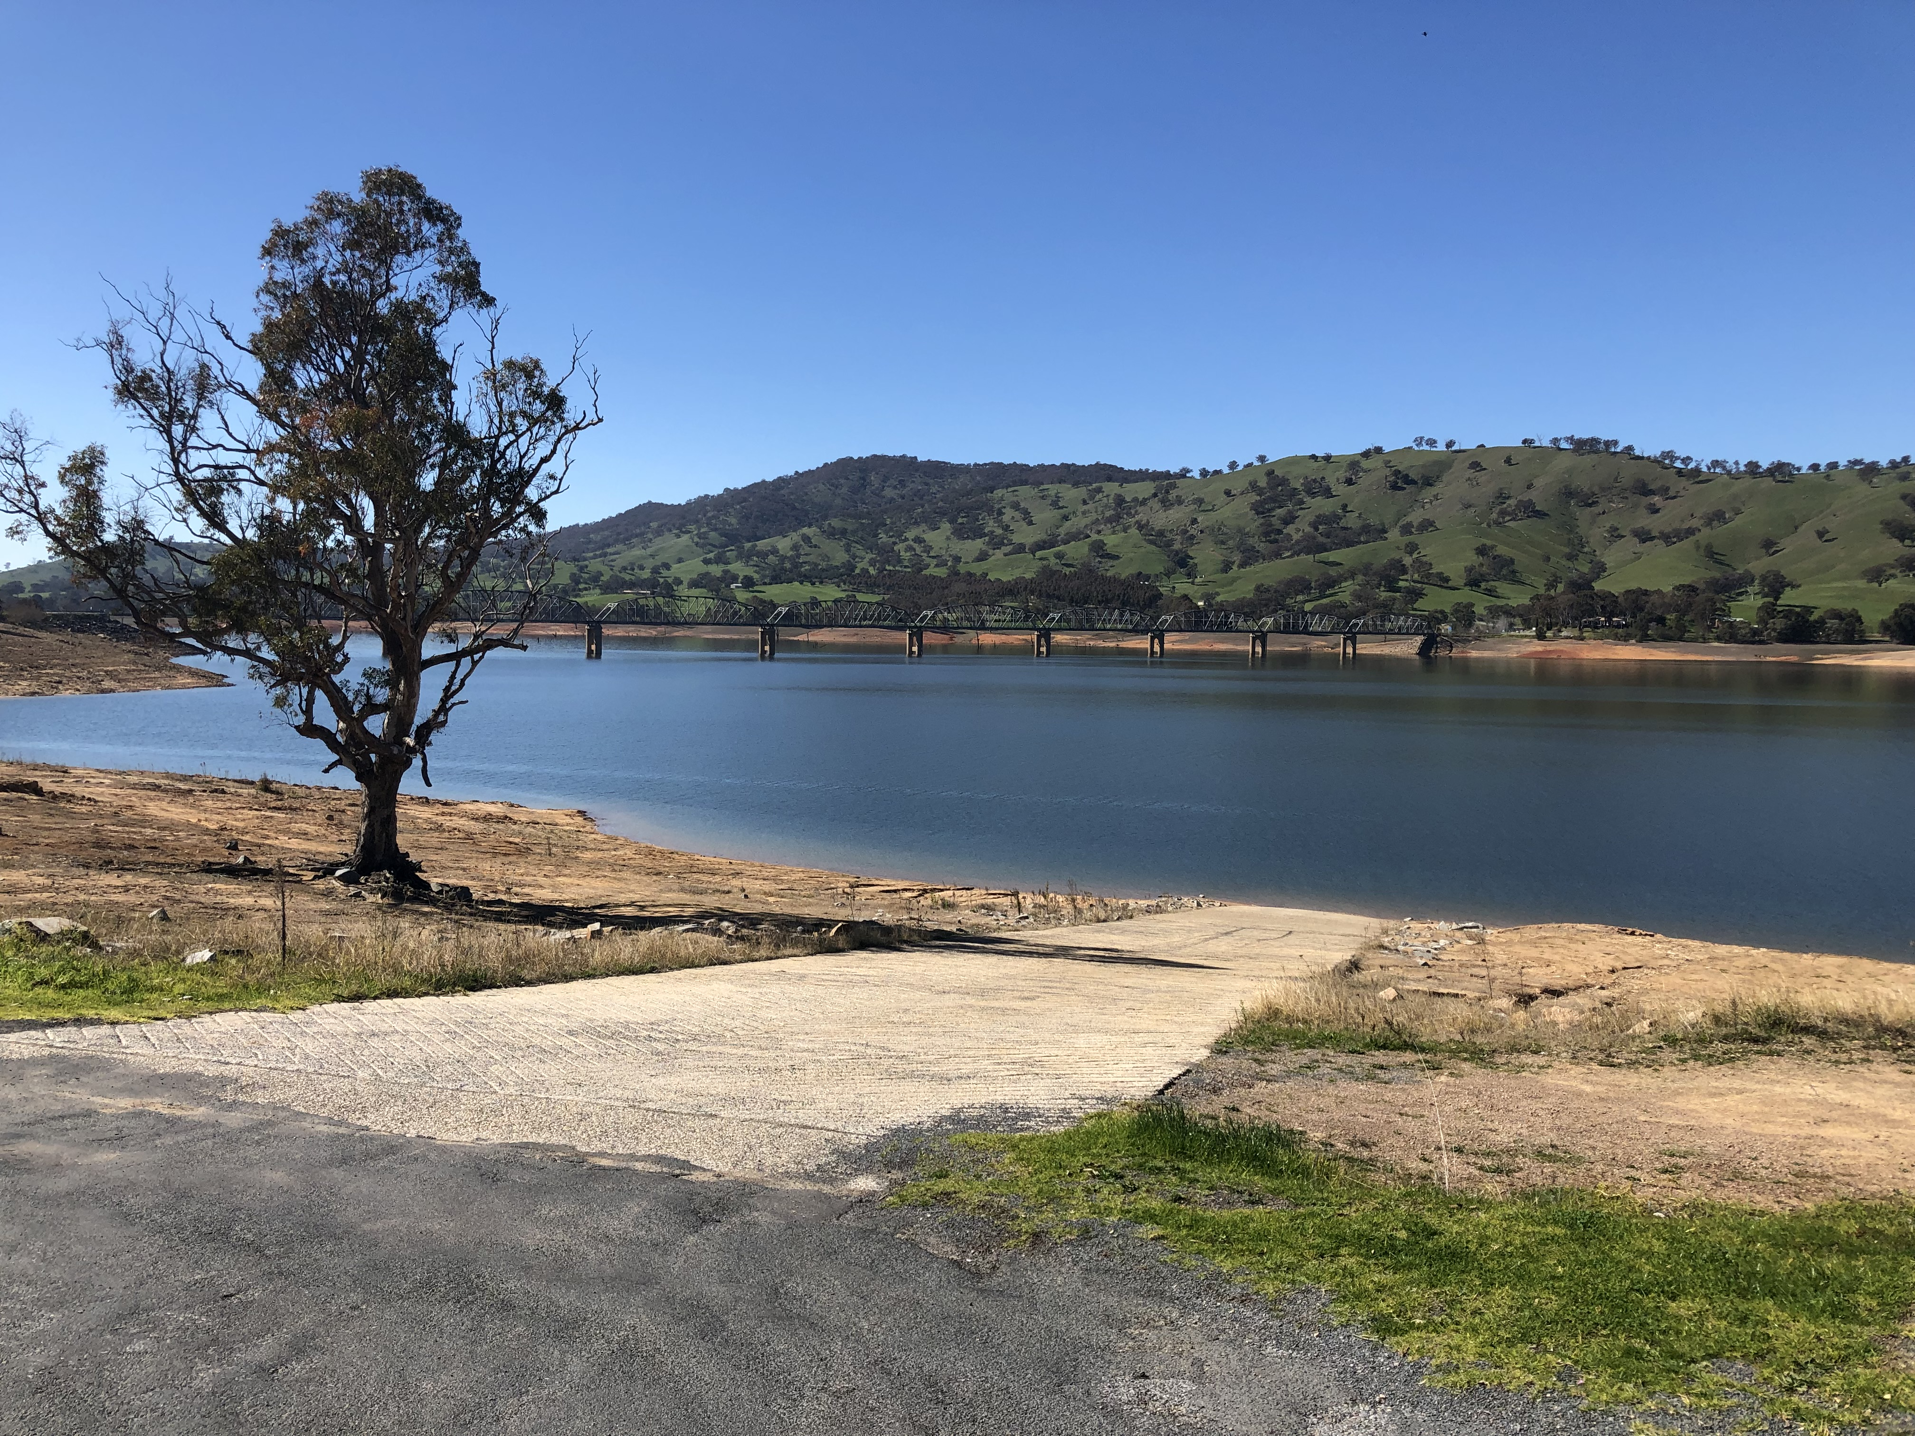
Sli.do #P622

Slide 2
Regulatory issues
P and L plate rules
Mutual Recognition
RSAs
Business regulation
Extradition (et al)
Mental health orders
Domestic violence info sharing
Taxi licences
School bus standards
Working With Children
Fishing
Voluntary Assisted Dying
Sli.do #P622

Slide 3
What do I see good regulators do?
Recognise we have borders
Ask the border question​
Meet and talk with border stakeholders
  What will work on the ground?
Invest in counterpart relationships across the border
Recognise their practices – mutual recognition
Push the learnings back into policy and regulation design
  Easier to fix in design stage
sli.do #P622

