Slide 1
Achieving regulatory excellence – delivering fairer public transport fare enforcement in Victoria
Kate Maddern, Director, Victorian Disability Worker Commission
(formerly Director, Public Transport Regulatory Operations, Department of Economic Development, Jobs, Transport and Resources)
ANZSOG and NRCOP webinar, Tuesday 16 June 2020

Slide 2




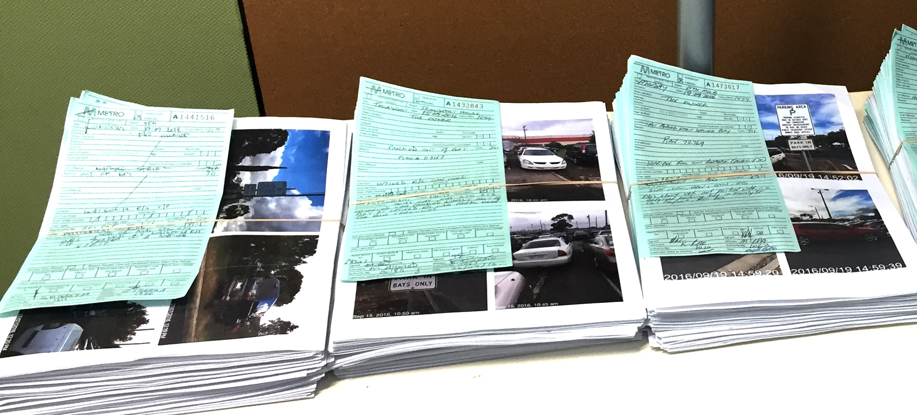



Context for reform in late 2016
Departmental regulator
    public transport infringement cycle
    conduct of authorised officers
Stakeholder concerns and loss of public confidence about fairness
(including Public Transport Ombudsman and Victorian Ombudsman)
Department review and Ombudsman report both released in May 2016

Slide 3
Regulatory excellence
Utmost integrity
Empathic engagement
Stellar competence
… consistently holds itself to the highest standards of integrity
… engages empathically with all segments of society when making decisions and exercising authority
… demonstrates consistently stellar competence by using its available resources to maximise public value
An excellent regulator:
Respect for democracy
Commitment to public interest
Fidelity to law
Even handedness
Listening
Responsive-ness
Analytical capability
Instrumental capacity
High performance

Slide 4
What did we do?
Utmost integrity
Empathic engagement
Stellar competence
Improved systems and processes and training
Rationale in response to review requests
Clearer assessment criteria
‘Plain English’ responses
Staff engaged in improving systems and processes
Staff training
Systematic use of warnings
Better processes for exercising discretion
Removing vulnerable people from the infringement cycle earlier

Slide 5
How we delivered?
Adapted framework for
operational use
Lived and celebrated
regulatory excellence
Applied across the business
Were curious

Slide 6
Empathic engagement in practice
‘I don’t think the Department even read my request to have this infringement reviewed, as all I received was a standard reply letter …’
Before
After
  This offence is one upon which the law imposes an 'absolute liability'. Absolute liability means that intent to commit the offence is not a point of proof required for the offence to be complete and a person can be equally liable whether they deliberately or they unintentionally commit the offence. Assessment is solely on a factual basis with the fundamental matter under consideration being the legality or illegality of the act itself.
  The law requires every person travelling on public transport to have a valid ticket for each journey and to take all reasonable steps to ensure that the ticket is valid. Failure to do so is an offence against the law.
  Your explanation provided in the application for review has been considered, however, …

Slide 7
Removing vulnerable people with special circumstances from the infringement cycle as early as possible
Educate authorised officers
Tick box on authorised officer’s form for ‘maybe’ special circumstances
Assess for evidence at internal review
Assess for evidence at prosecution
Special circumstances applies to a person who for various reasons (including mental or intellectual disability, a serious addiction to drugs, or homelessness) is unable to understand or control conduct that constitutes an offence under the Act
Utmost integrity
Empathic engagement
Stellar competence

Slide 8
Outcomes?
Reform of the regulator
30% decline in complaints to the Public Transport Ombudsman
Same resources in the regulator
40% more reports on non-compliance

Slide 9
Regulatory excellence: lessons for other regulators
Go beyond strategy
Involve staff
Live and celebrate
regulatory excellence
Be curious

