Slide 1



PUBLIC SECTOR

Slide 2

The Public Sector Reputation Index began in 2016 in response to demand from our public sector clients for rigorous, independent benchmarks of their reputation.
We took our globally validated reputation measurement framework, RepZ, and customised it to the needs of the New Zealand public sector.
In 2020 we:
Surveyed 2,750 New Zealanders
10-25 March 2020 (lockdown started on 25 March)
Measured the reputation of 54 public sector agencies

Slide 3
Uses our globally validated RepZ framework, customised to the New Zealand public sector, with reputation measured across four pillars.
TRUST
SOCIAL RESPONSIBILITY
LEADERSHIP
FAIRNESS
Listens to the public’s point of view
Uses taxpayer money responsibly
Is trustworthy
Can be relied upon to protect individuals’ personal information
Behaves in a responsible way towards the environment
Is a positive influence on society
Has a positive impact on people’s mental and physical wellbeing
Is a forward looking organisation
Contributes to economic growth
Is easy to deal with in a digital environment
Is a successful and well-run organisation*
Prepares New Zealanders for the future challenges that we face as a nation*
Treats their employees well
Deals fairly with people regardless of their background or role
Works positively with Māori to improve Māori wellbeing*
Works positively with Pacific peoples to improve Pacific wellbeing*
* New reputation statements in 2020

Slide 4

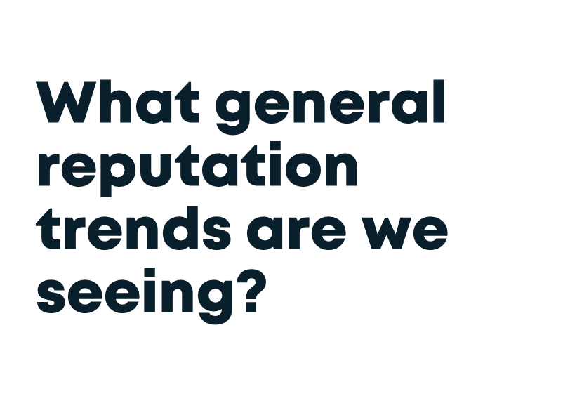

Slide 5
In 2020, social responsibility had joined trust as a key driver of agency reputation, reflecting public focus on the environment and wellbeing.
29%
29%
24%
18%
Steady
+4%
Steady
-3%
TRUST
SOCIAL RESPONSIBILITY
LEADERSHIP
FAIRNESS
Listens to the public’s point of view
Uses taxpayer money responsibly
Is trustworthy
Can be relied upon to protect individuals’ personal information
Behaves in a responsible way towards the environment
Is a positive influence on society
Has a positive impact on people’s mental and physical wellbeing
Is a forward looking organisation
Contributes to economic growth
Is easy to deal with in a digital environment
Is a successful and well-run organisation*
Prepares New Zealanders for the future challenges that we face as a nation*
Treats their employees well
Deals fairly with people regardless of their background or role
Works positively with Māori to improve Māori wellbeing*
Works positively with Pacific peoples to improve Pacific wellbeing*
* New reputation statements in 2020
Footnote: percentages show the extent to which each pillar influences reputation.

Slide 6

However, in a COVID-19 environment trust becomes even more important.
PILLAR IMPACT ON AGENCY REPUTATION
Footnote: percentages show the extent to which each pillar influences reputation.
BASE: Pre-COVID-19 Alert Level 3 (n=2250) and Post-COVID-19 Alert Level 3 (n=520)

Slide 7
In the lead in to COVID-19 Alert Level 4, New Zealand’s public sector agencies were favourably positioned with unprecedented levels of trust.
Listens to the public’s point of view
Is trustworthy
% agree
% disagree
% agree
% disagree
Uses taxpayer money responsibly
Can be relied upon to protect individuals’ personal information
% agree
% disagree
% agree
% disagree
Footnote: average trust attribute scores for the 35 agencies who have been measured since 2017

Slide 8
New Zealanders’ perceptions of the public sector have notably improved across the other pillars. COVID has accelerated what was a more gradual trend in recent years.
Is a positive influence on society
Contributes to economic growth
Deals fairly with people regardless of background or role
% agree
% agree
% agree
Behaves in a responsible way towards the environment
Is a forward looking organisation
Treats their employees well
% agree
% agree
% agree
Footnote: average attribute scores for the 35 agencies who have been measured since 2017

Slide 9










OVERALL REPUTATION
120
112
111
111
110
109
109
108
107
107
REPZ TOP 10
2020
Fire and Emergency remains the benchmark agency when it comes to reputation.
The Defence Force jumps from 10th to 2nd position.
The Customs Service also moves up from 9th to 3rd.
Increase/decrease of 3+ points from 2019

Slide 10

Customer
Experience

Slide 11

Experiences matter
In 2019, we showed that the experience delivered by an agency to the public can have a significant impact on the proportion of advocates and critics.
Good experiences stick in people's memories and bad experiences are particularly damaging initially but linger for up
to ten years.

Slide 12
The experience delivered by an agency to the public can have a significant impact on the proportion of advocates and critics. Yet many are still leaving a poor impression.
44% of agencies
56% of agencies
Number of agencies
% experiences that are positive
DELIVERING
LESS POSITIVE
EXPERIENCES
DELIVERING
MORE POSITIVE
EXPERIENCES
Experience Score
What proportion of agencies are delivering positive experiences.
Footnote: New question in 2019

Slide 13

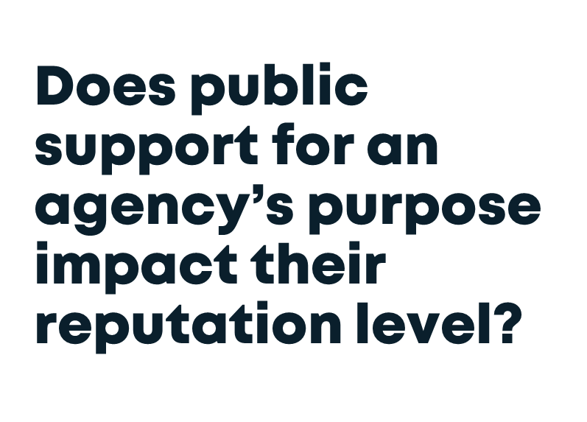

Slide 14

Most agencies have majority support for their purpose, with ten agencies having support of at least 75% of adult New Zealanders.
How much do you agree or disagree that what the agency does is important for New Zealand?
Average agreement (67%)
Number of agencies
LOW
HIGH
Legitimacy of purpose
The proportion of people who agree that the agency’s
work is important for New Zealand

Slide 15
Agencies which have clearly established their purpose in the eyes of the public are at an advantage.
However, it is still possible for agencies with moderate legitimacy of purpose to deliver a strong reputation performance, if they deliver on the four pillars.
Low (0% to 55%)
Moderate (56% to 74%)
High (75% to 100%)
89
99
108
Average RepZ:
Average RepZ:
Average RepZ:
LOW
HIGH
Legitimacy of purpose
The proportion of people who agree that the agency’s
work is important for New Zealand

Slide 16

The public’s impression of the importance of an agency’s work is more important than the extent of their knowledge of what the agency does.
A very weak relationship between knowledge of work and RepZ score
Which of the following best describes what you know about each of the organisations below in terms of who they are and what they do?
I’ve got a good understanding of what they do
I’ve got a basic idea of what they do
I have just seen or heard the name before
LOW
HIGH
Knowledge of work
The proportion of people who have a “good understanding” of what the agency does

Slide 17



Slide 18
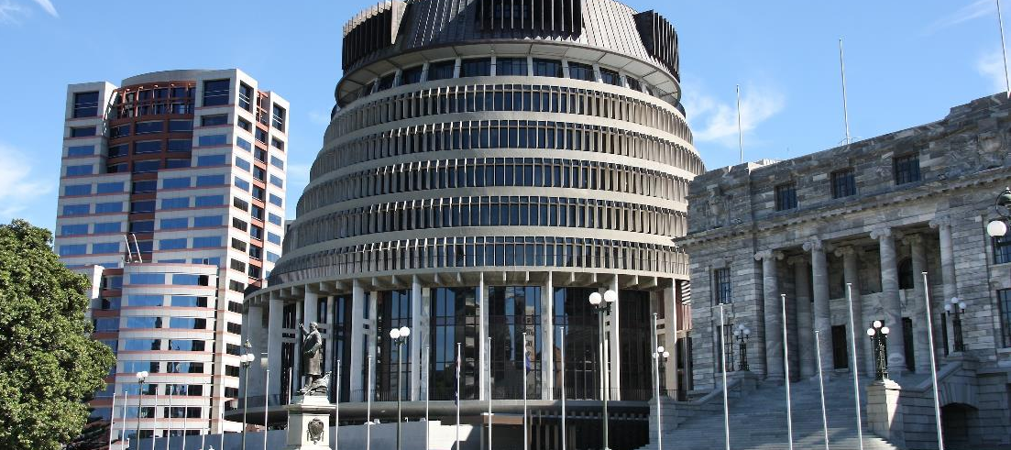
New Zealand’s leaders have largely had a ‘positive crisis’, and their response has helped lift trust in government
How much trust do you have in the Government to deal successfully with national problems?
12-17 June
‘A great deal’ or ‘a reasonable amount’ of trust in the Government:
59% | 86% | 77%
Feb 2020 | Apr 2020 | Jun 2020
Base: All New Zealanders 18+ (n=600)
*note: 2020 Public Trust Survey conducted for the Institute for Governance and Policy Studies at Victoria University of Wellington

Slide 19






New Zealand has built trust through its communications.
The Government’s communications have been rated more highly than the G7.
How would you rate [YOUR COUNTRY’S] Government on how it is communicating information about the coronavirus outbreak?
% fairly or very good
G7
Base: All New Zealanders 18+ (n=600); G7 countries (n=1000 each)
Note: Question not asked in USA

Slide 20
I love the updates and feel like we have been told all we need to know and have had a great deal of information passed along.
Daily updates that I can watch and interpret in my own way without a media slant.
It is always clear and concise and in language which is understandable without trying to over complicate things.
The people fronting the public are presenting information in plain language which is shown in graphics. The message is consistently projected at the same time everyday in the same format. Questions are answered by the PM, Jacinda Ardern, or Dr Bloomfield to the best of what information they have. If they don’t have that info they find out and share later. Other front people follow the same format - constant clarity, NO BS!
The consistency with which they are giving information - on a daily basis. They don't try to tell us they are very good, just human, and they admit to mistakes which is rare in a government.
The way they have tackled Covid-19 which has made us Covid-19 free for the present and have admitted it is probably going to come back.
Photo source:
Base: All New Zealanders 18+ (n=600)
https://www.stuff.co.nz/national/politics/300042986/coronavirus-ashley-bloomfield-recommended-new-zealand-spend-most-of-june-in-level-2

Slide 21
New Zealanders are more open to hearing messages from the Government, but are also more likely to critically evaluate what they’re hearing
Please indicate whether you are more likely to do each in the future than you were before the coronavirus outbreak?
Trust the government | Follow government advice | Paying attention to ads on healthy lifestyles | Paying attention to ads on safety | Criticise government policies, if you don't agree with them | Question whether media stories are true
The scale points not shown are: No difference, Don’t know, Not applicable
Base: All New Zealanders 18+ (n=600)

Slide 22



Slide 23


1
Improved perceptions of the public sector provided a strong platform for the Government’s COVID-19 response
2
Building legitimacy of purpose is essential
3
Delivering outstanding experiences will become even more critical in COVID-19 times

Slide 24
TAKE
OUT
Improved perceptions of the public sector provided the perfect platform for effective COVID communications
1
In the days leading up to COVID-19 Alert Level 4 i.e. "lockdown", New Zealand citizens placed greater weight on attributes relating to trust when evaluating the reputation of the nation's public sector agencies. These include being trustworthy, listening to the public, protecting an individual's private information and using taxpayer money responsibly.
Over the past four years, we have seen ratings for these trust attributes gradually improve. This positive trend also extends to the other three reputation pillars. This meant New Zealand entered the COVID-19 response with agencies favourably positioned in the hearts and minds of the public.
This helped provide the Government with a solid platform to deliver clear and effective COVID-19 communications.

Slide 25

TAKE
OUT
2
This year we started to explore the issue of agency purpose. This new area of inquiry was in response to previous deep dive reports for various agencies where it appeared the level of support (particularly lack of support) for an agency's purpose was placing a ceiling on the reputation heights it could achieve.
We examined purpose through two lenses. The first was the degree to which the public understands the role of the agency. This had a very weak, almost non-existent relationship with reputation. The second was through legitimacy of purpose, or more precisely the extent to which the public agreed that the agency's work was important for New Zealand. This had a much stronger impact on reputation, emphasising the need for agencies to build support for their work in order to achieve higher reputation levels.

Slide 26

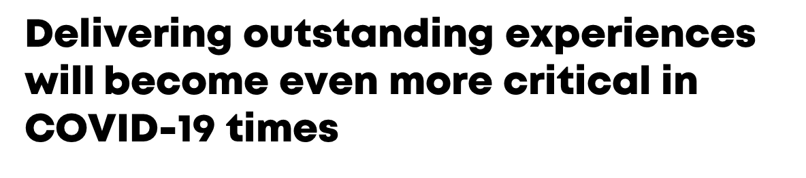
TAKE
OUT
3
Last year, we clearly demonstrated the impact positive and negative experiences have on the level of advocacy and criticism an agency can expect to receive. We also showed these effects can last for up to a decade and sometimes longer.
Yet many agencies are continuing to provide less than ideal experiences which have undesirable impacts on their reputation. The COVID-19 response provides agencies with the opportunity to break the mould even though the circumstances will be challenging and potential demand for services at record levels.

Slide 27

PUBLIC SECTOR
Edward Langley
or Katelynn Fuller
Edward.Langley@colmarbrunton.co.nz
Katelynn.Fuller@colmarbrunton.co.nz

