Slide 1

Regulating with the kiddy toolbox
Presented by
Tony Keenan
#PublicValue

Slide 2

Professor Arie Freiberg (Monash & ANZSOG) presents two definitions of regulation
“..Any measure or intervention that seeks to change the behaviour of individuals and groups” UK Better Regulation Taskforce 2003
“..the sustained and focussed attempt to alter the behaviour of others according to defined standards or purposes with the intention of producing a broadly defined outcome or outcomes…” Black (2002)
#PublicValue

Slide 3
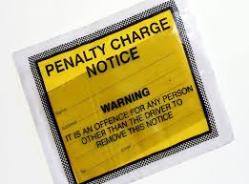
Coercion
#PublicValue

Slide 4
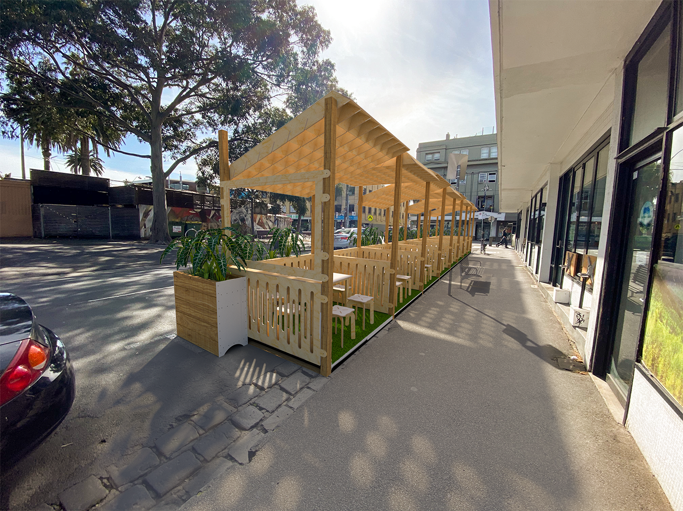
Permission
#PublicValue

Slide 5

Persuasion
#PublicValue

Slide 6
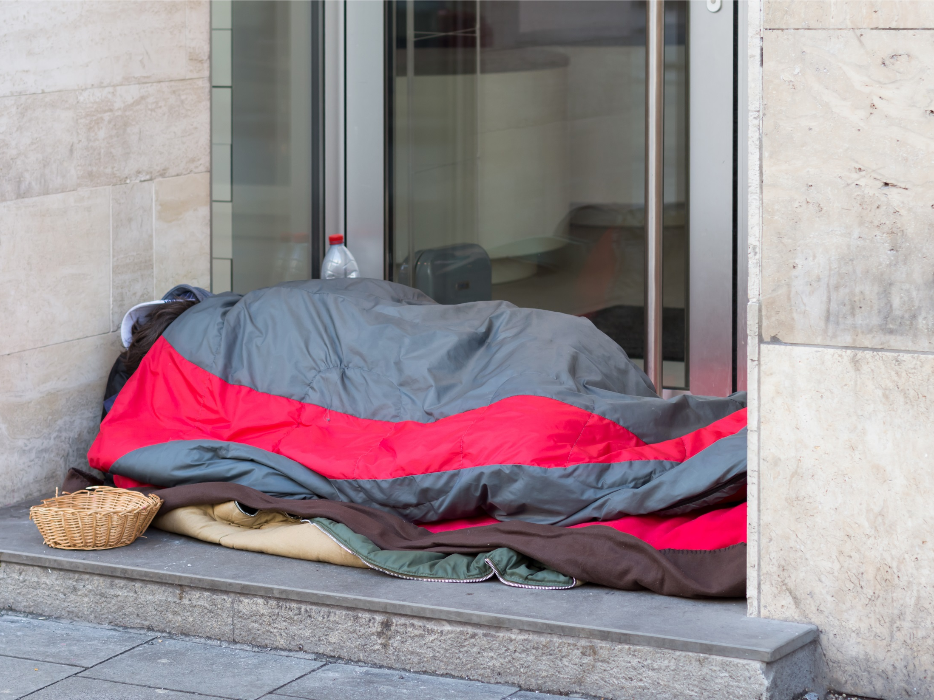
Rough sleeping
#PublicValue

Slide 7

Context
Increased by 50% since the 2016 census
Huge community concern and division
Multiple State and Commonwealth funded agencies involved, spending millions of dollars for no movement -homelessness outreach & support, teaching hospital, community health, police, AOD, mental health, ambulance, ATSI services, veterans…
100 people (approximately)
#PublicValue

Slide 8
Port Phillip Zero – Collective Impact
Aim to achieve functional zero rough sleeping in the City
Persuasion levers –relationships, incentives, grant and funding, in kind
Regulated largely through MOUs
Authorising – build on existing authority (results help!)
High level of investment in relationships and transactions
#PublicValue

Slide 9
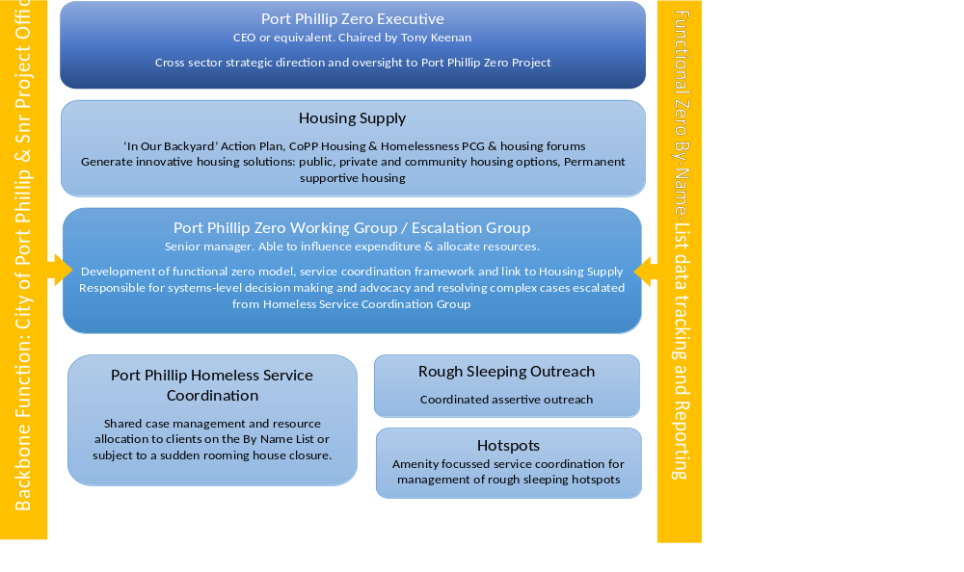
#PublicValue

Slide 10
Outcomes?
Of those who are active | 125
Temporary Stable housing | 9 | decrease 1
Respite Accomodation | 68
Sleeping Rough | 29 | increase 5
Alternative (incarcerated, hospital, etc) | 8 | increase 1
Unknown/Blanks | 5 | increase 4
Home (likely needs updating on SRS) | 6 | increase 6
#PublicValue

