Slide 1

NZ SSC & ANZSOG present:
DO YOU HAVE A QUESTION about today’s topic?
Send your questions through sli.do:
slido.com
#U761
All questions will BE ANSWERED AT THE END OF THE PRESENTATION
SLIDES FROM TODAY’S PRESENTATION WILL BE AVAILABLE ON THE ANZSOG WEBSITE
Regaining Trust and building ethical cultures: reflections on Victoria’s integrity journey
SPEAKER
Gill Callister
Associate Dean
ANZSOG
LOCAL SPEAKER
Stephen Walker
Chief Executive
Audit New Zealand
MODERATOR
Dr Barbara Allen
Senior Lecturer
School of Government VUW
Monday 11 February 2019

Slide 2
Questions?
DO YOU HAVE A QUESTION about today’s topic?
Send your questions through sli.do:
slido.com
#U761
All questions will BE ANSWERED AT THE END OF THE PRESENTATION
SLIDES FROM TODAY’S PRESENTATION WILL BE AVAILABLE ON THE ANZSOG WEBSITE
Regaining Trust and building ethical cultures: reflections on Victoria’s integrity journey
SPEAKER
Gill Callister
Associate Dean
ANZSOG
LOCAL SPEAKER
Stephen Walker
Chief Executive
Audit New Zealand
MODERATOR
Dr Barbara Allen
Senior Lecturer
School of Government VUW
Monday 11 February 2019

Slide 3
OPERATIONS ORD, DUNHAM & CULTURAL CHANGE

Slide 4
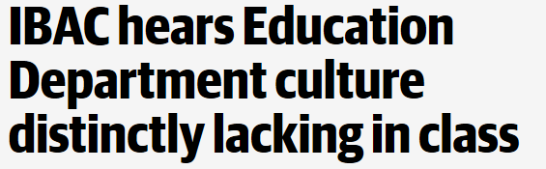
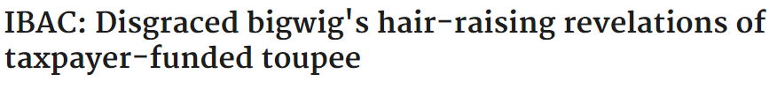
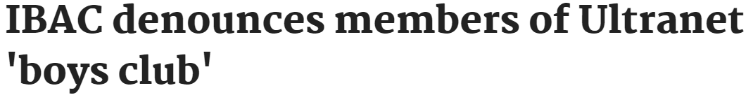

Slide 5

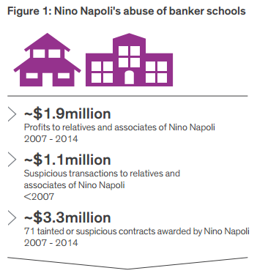
Operation Ord Investigation

Slide 6
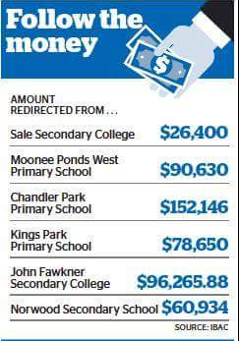
Exploitation of ‘banker schools’
Funds earmarked for school programs used for:
  the benefit of senior Department officers and their families
  extensively used to pay for personal expenses, goods, lavish lunches, conferences or excessive travel
  2010 audit of Program Coordination School model recommended it be shut down

Slide 7


Who else was involved?
Former Regional Director
Former Deputy Secretary
Principals & Business Managers

Slide 8
What did Operation Ord reveal about the Department?
An ethically neutral culture
Significant non-compliance
Weak governance and oversight
Low accountability and lack of consequences
Over reliance on inadequate internal audits
Culture of entitlement
Fear of speaking up

Slide 9
IBAC identified systemic failings that could be exploited by the actions of individuals. The Department has responded with reforms to build stronger systems, processes, leaders and culture to rebuild confidence in our public education system.
Failure of controls around procurement
Poor controls around financial management
Inadequate auditing
Incompatible financial systems
A culture of non-compliance, bullying and entitlement
Failure of senior leadership
IBAC findings
Introduced procurement frameworks for corporate DET and schools
Implemented a financial monitoring and assurance framework
Created measures to monitor ourselves including a new Integrity and Assurance Division and a more robust audit program
Edupay (corporate DET’s HR and payroll) and CASES21 (school staff payroll) are now compatible
Education and support for all staff about working with integrity and avenues to make complaints
New leadership charter and Executive Officer Development Centre for senior leaders to focus on leading with integrity
now

Slide 10
Operation Dunham
Considered similar themes
  Non-compliance with processes
  Misuse of public funds
  Inadequate systems and controls
  Low adherence to Code of Conduct
  Conflicts of interest

Slide 11
How did we respond?
During the hearings
  Swift and decisive employment action
  Leadership communications with 70,000 staff
  Support for affected school communities
  Travel freeze
  New governance on PCS model

Slide 12
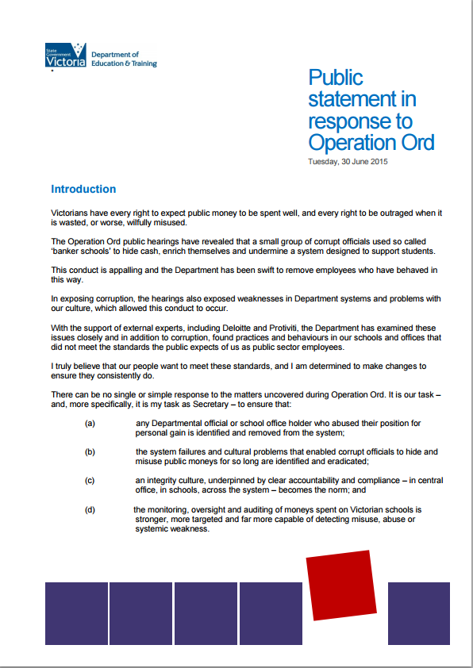
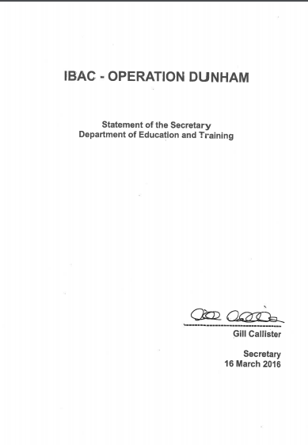
How did we respond?

Slide 13

The Integrity Reform Program
Good Governance
Ethical Leadership
39 Projects
Smart systems
& controls
Staff support and development
Underpinned by the public sector values

Slide 14
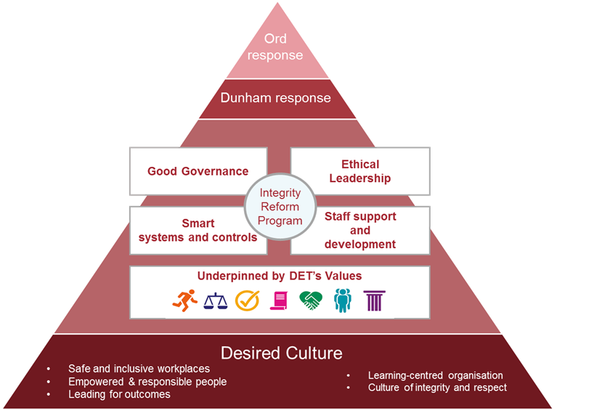
The IRP is a wide-ranging series of reforms that go well beyond preventing corruption to embed a healthy, high performing and ethical culture in our corporate workplaces and schools

Slide 15
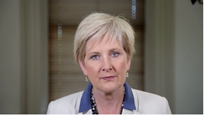
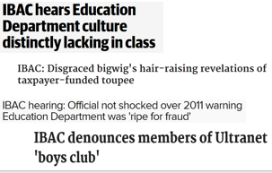




Communications and media
Media
School comms
Leadership comms

Slide 16
Achievements so far
Cessation of the PCS model and recall of funds
New misconduct legislation
Leadership charter and development program
Supporting a speak up culture
Promoting a ‘positive ethical culture’ through a focus on the public sector values

Slide 17
Challenges ahead
Continuing our culture program
School and corporate procurement
New funding governance model
Capability building
Improving finance function
Strengthening audit and assurance

Slide 18
What will success look like
Accountability systems that work
Improved compliance
Ethical leadership
Living the public sector values
Ethical decision making
Staff feel trusted and supported
Consequences for inappropriate conduct

Slide 19
Ethical leadership
ANZSOG – February 2019

Slide 20
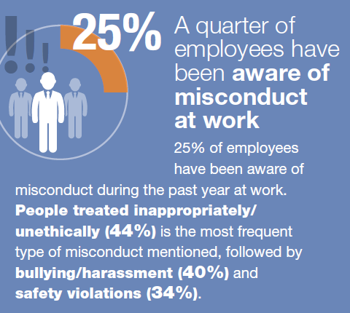
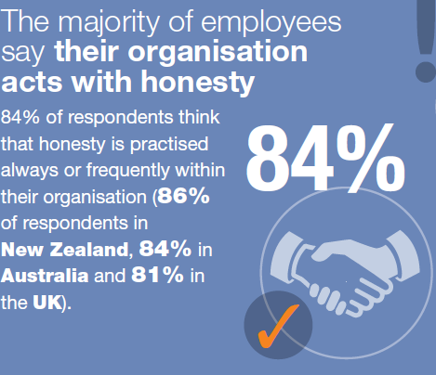
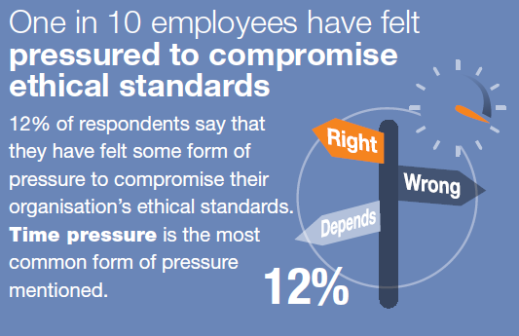
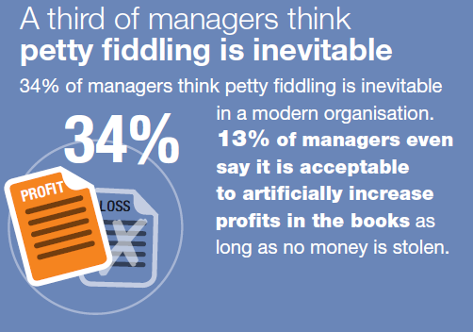
Have you been pressured to compromise your ethical standards?
Notes:
Shared some statistics from Institute of Business Ethics 2018 survey results for Australia, NZ and UK
84% of organisations act with honesty – good news, but…
34% say petty fiddling is inevitable (13% say it’s acceptable)
25% are aware of misconduct at work
12% (1 in 10) feel pressured to compromise ethical standards

Slide 21

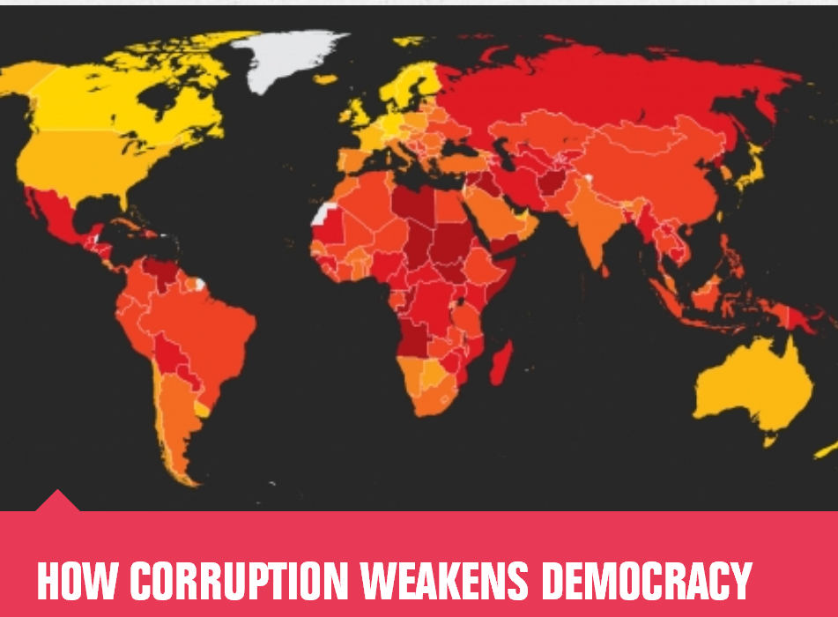
Public trust
Ethical leadership –
the cornerstone
Notes:
Ethical leadership is a cornerstone. Without it, gaining and maintaining trust and confidence in the public sector will be virtually impossible.
Yet to be effective, ethical leadership needs to be actively demonstrated across the public sector, within its entities, and by it’s people, whatever role they play – front line provider, policy analyst, middle or senior manager, chief executive or governor.
I’m wearing two hats here today – ED of Audit New Zealand and President of Chartered Accountants Australia and New Zealand – I’ll draw on some of the synergies that I believe link the public sector and the wide range of professionals, including Chartered Accountants, who work in or with the public sector.
So what is ethical leadership…?
At its most basic it’s “doing the right things all the time and in every situation. It’s important that it’s both visible and invisible…even when you are not visible to people around you; that you still maintain the highest standards of integrity. It has to be fundamental to how we each operate; it can’t be an ethical hat – which you can use for some decisions and not for others.”
The reward for strong ethical leadership is big, both within our organisations and for the benefit of New Zealanders. Positive organisational performance, attracting and retaining the best talent, cultivate strong teamwork and productivity, give your people meaning, as well as it’s just the right things to do!
Fortunately in NZ we are perceived to have the most trusted or least corrupt public sector in the world and are well supported by several professions that are equally strong and trusted (e.g. accountancy, legal, medical, directors, engineers, etc.).
Yet we know trust and confidence is a fragile thing and is constantly under pressure – Edelman trust barometer (doesn’t specifically comment on NZ) suggests overall trust is in free fall (increasingly due to the advent of fake news), also trust in government officials is decreasing. The message from the most recent barometer is the importance of Trust at Work and looking for a trusted relationship with and leadership from their employer.
From my perspective, looking at both public sector and the accountancy profession (and other professions). I would suggest we have a range of issues to address and that we can’t rest on our laurels. Complacency will be our biggest challenge.
My challenge to us all is that – At times our strategy appears to be more hope or an assumption that ethical leadership exists. We generally deal with the extreme/significant situations appropriately (but with huge effort). However we don’t do enough to set, reinforce, lead, and reinforce again the ethical expectations up front in organisations, from the top down and bottom up. As one quote from a previous Edelman survey suggests, we can’t just expect it, we need to take action to make it happen.

Slide 22
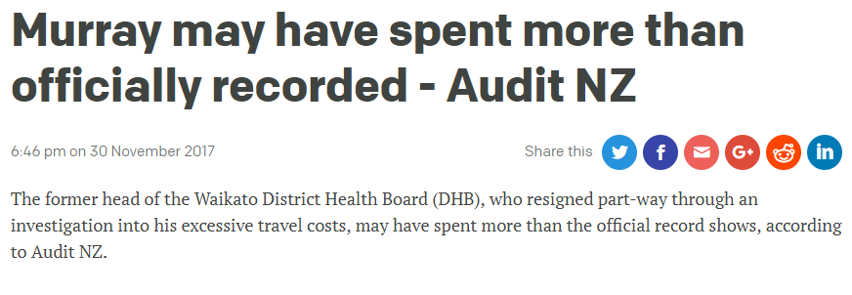
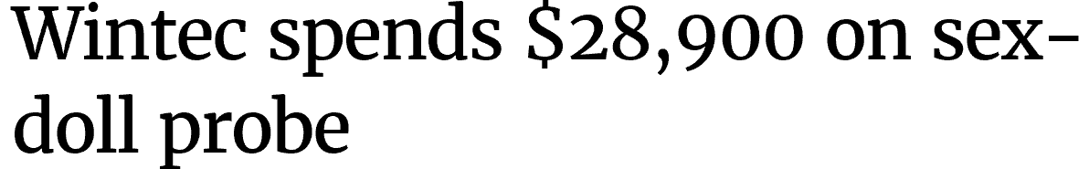
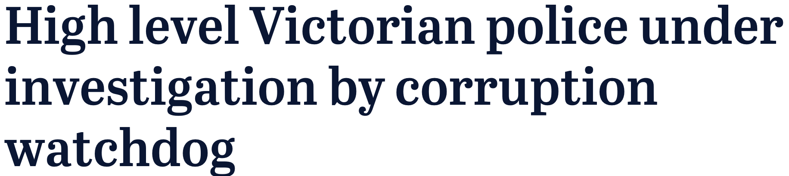


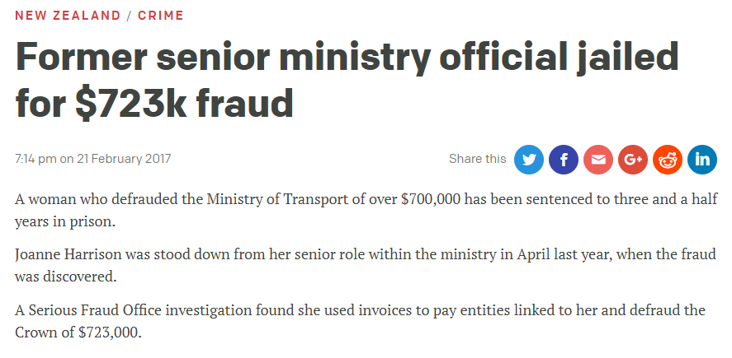
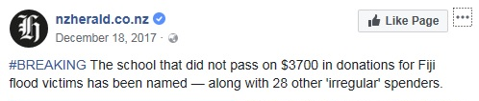
NZ Public Sector ethical failings
Notes:
Recent ethical failures – fraud, poor judgement, poor oversight, inappropriate behaviours
Even an Australian example thrown in.
Equally, I know that the impact of the particular wrong-doing has had significant ramifications for sectors, organisations and individuals.

Slide 23
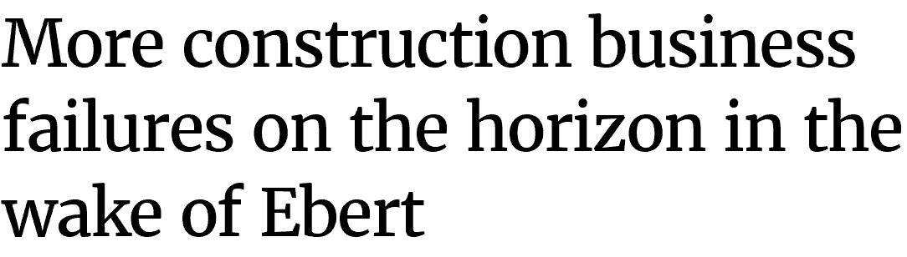

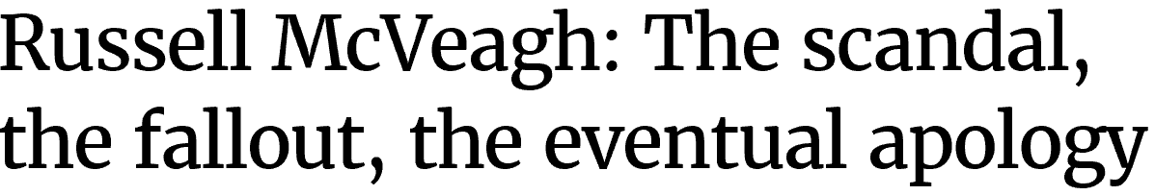

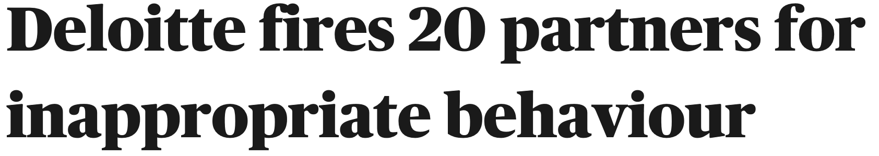
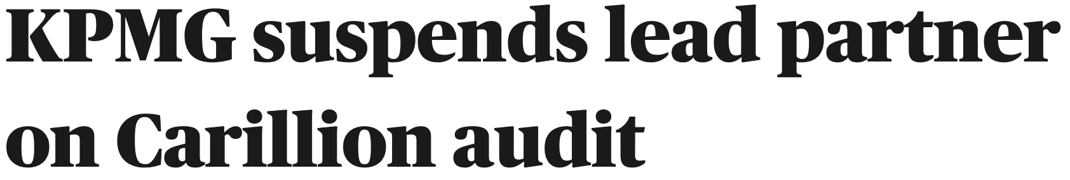
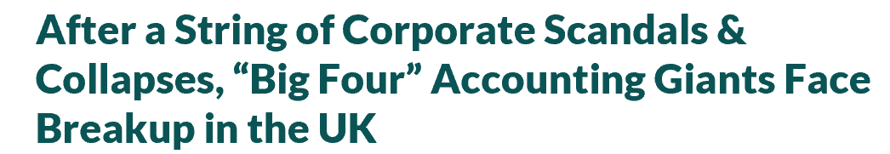
Professional ethical challenges
Notes:
In the accountancy profession globally there are instances of audit and accounting failure…audit/accountancy culture and ethical practices inside firms and organisations…questioning of role of audit within broader practice as well as accountants operating in organisations. This is likely to have a significant global impact
In the legal profession, the Law Society President has recently fronted what she has described as the legal profession’s biggest disruption factor and it’s not technology related. “A very different, equally powerful force: the courage of individuals to speak out against injustice and inequality.”
Professional directors are facing increasing scrutiny with recent challenges, including Fletcher Building and Mainzeal.
Currently the banking and insurance professions deserve a page of its their own

Slide 24
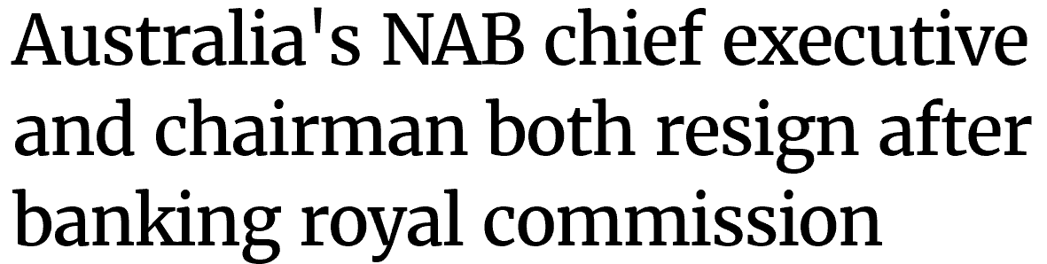
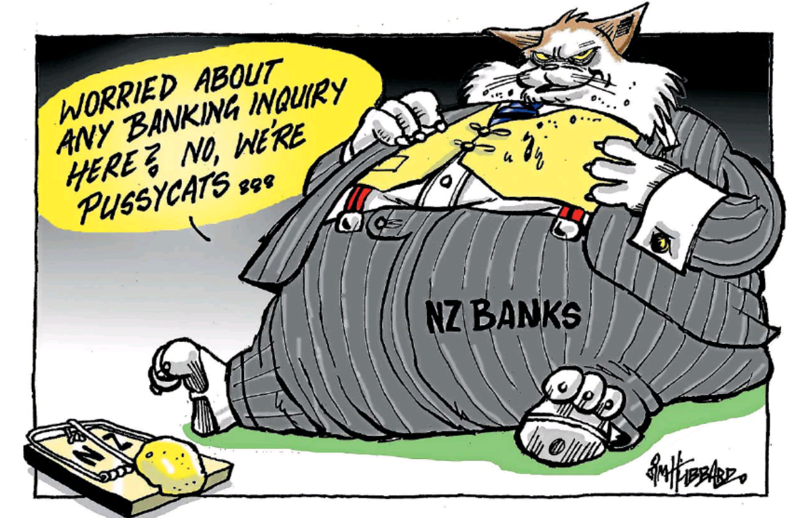
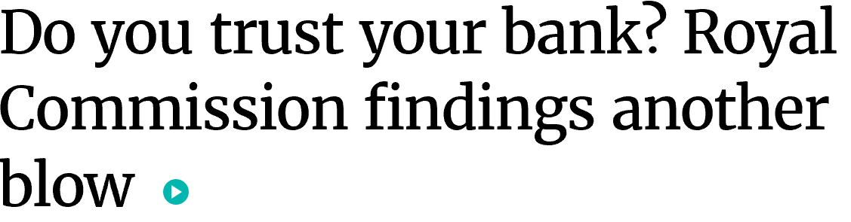
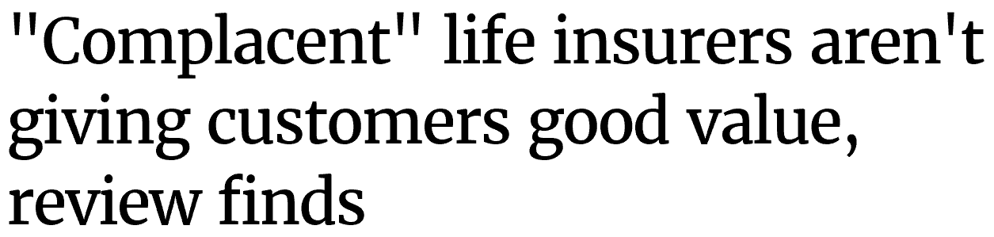
Professional ethical challenges
Notes:
Safe to say that every profession has a small number of individuals that bring that profession into disrepute.
So why does it all matter?
In both my roles as President of CA ANZ and as Executive Director of Audit New Zealand, every time there is a ethical failing I know it is causing some damage to trust and confidence. And in the sector we all represent, the public sector, trust and confidence is vital.

Slide 25
What people have said
Which is more damaging – poor performance vs poor behaviour
8% vs 92%
Does your organisation provide clear ethical expectations ?
Yes: 82%, No: 7%, Working on it 11%
How familiar are you with the ethical expectations of your organisation?
Very familiar: 60%, Somewhat familiar: 37%
Notes:
At our series of public entity events we polled various questions. While not all 850 attendees answered the numbers were strong enough to give us clear indications.
The first we’ve just covered. Pretty strong indication in favour of poor behaviour being the most damaging
I also asked two other questions:
one related to their entities ethical expectations, and
the second about their familiarity with those expectations.
The latter showing some work is needed

Slide 26

Guiding ethical behaviour
Guided by range of individual and situational factors and experiences, including cultural norms and professional training
Clarity of expectations critical – organisation
Support our people
to be ethical leaders
Programmes that
reinforce expectations
  Training
  Communications
Whistle-blower system
Notes:
So what guides our ethical behaviours? At times we appear to just expect to know what’s expected? That’s a very dangerous approach.
Individually, our ethical views are influenced by range of factors and experiences…often have brought us to work in the public service
Clarity of expectations is really important – Most organisations, professional bodies, and sectors describe their ethical expectations in a codes of ethics, codes of conduct, values and behaviours, no doubt various policies.
Do we support/encourage the professionals working in our organisations to be ethical leaders?
Programmes that reinforce implementation of expectations
Leave you with my thoughts on ethical leadership – At its most basic it’s “doing the right things all the time and in every situation. It’s important that it’s both visible and invisible…even when you are not visible to people around you; that you still maintain the highest standards of integrity. It has to be fundamental to how we each operate; it can’t be an ethical hat – which you can use for some decisions and not for others.”
A question to leave you with “what more could we be doing to demonstrate our ethical leadership?”
In conclusion
To reinforce the results of the question I posed earlier – behaviour matters. Poor or bad behaviour is particularly damaging to trust and confidence whatever role, profession or sector you operate in.
The follow on then is, ethical leadership matters and we all have a role to play.

Slide 27
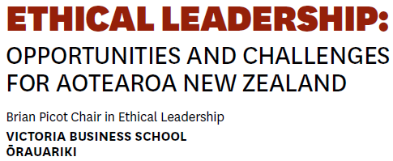



Other resources

Slide 28

Upcoming Thought Leadership Seminars
Everyone’s future: planning for an ageing workforce Speaker: Professor Peter Gahan | Rydges Wellington | 4 March 2019
Enquiries to:
Thought Leadership
T +61 3 8344 1900
appliedlearning@anzsog.edu.au

