Slide 1
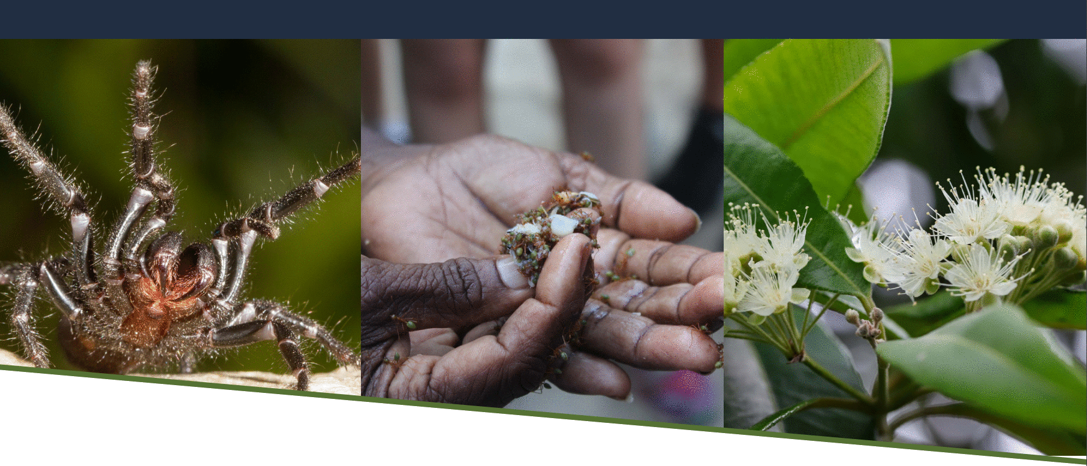
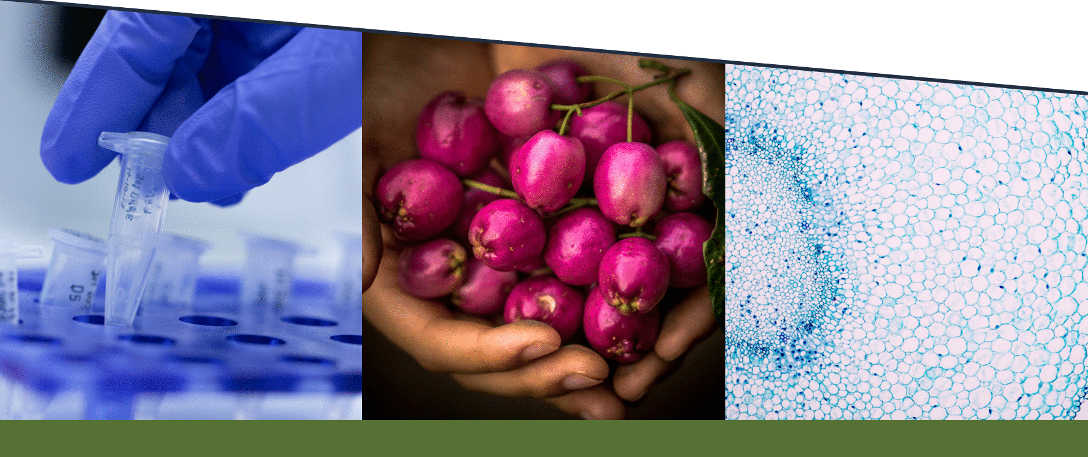
ANZSOG National Regulators Community of Practice – February 2023
Traditional knowledge protections
in biodiscovery

Slide 2
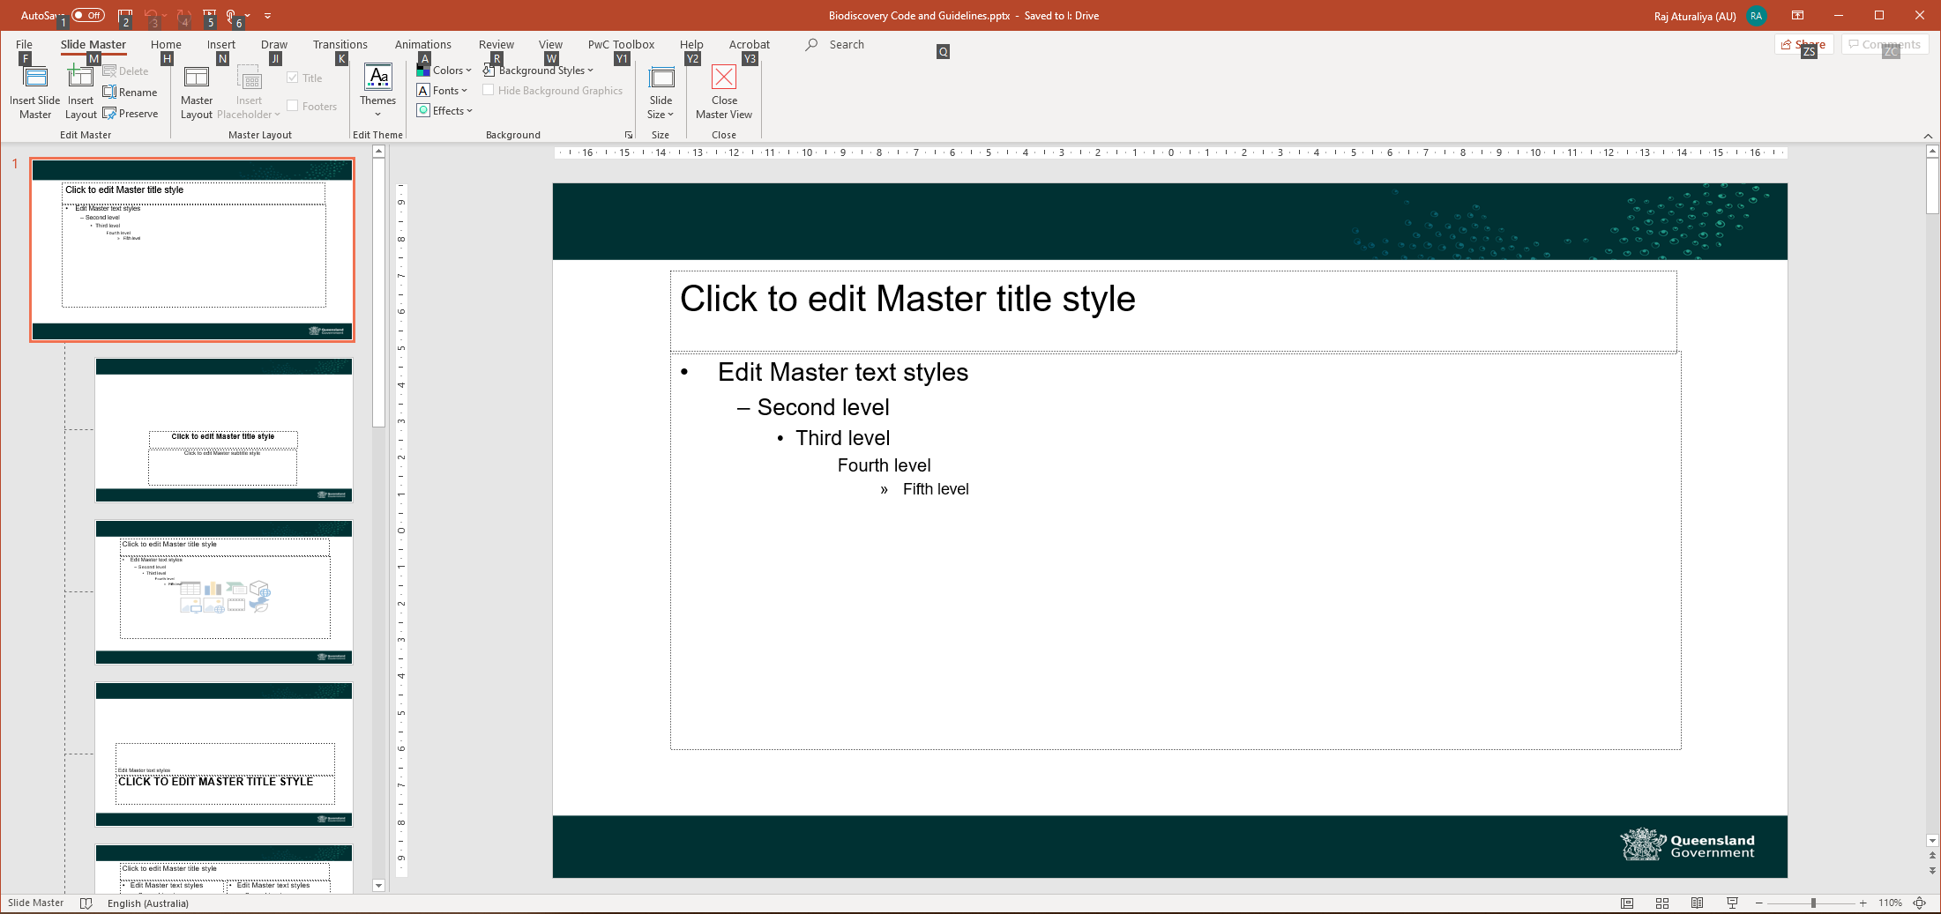
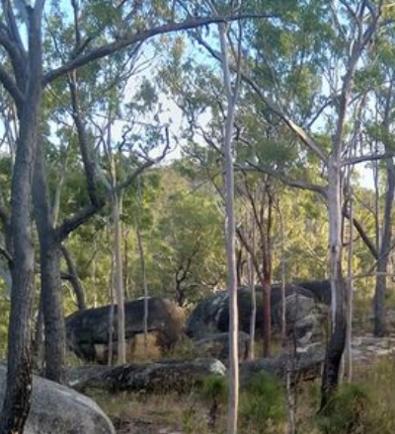
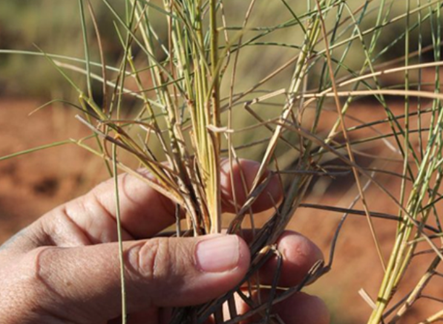
What is biodiscovery?
Native biological material
Plants
Collection
Medicines
Cosmetics
Animals
Other organisms
Research
Commercial application
Materials
    Case studies
Mbabaram Aboriginal Corporation and JCU
potential anti-inflammatory properties from medicinal plant species
Dugalunji Aboriginal Corporation and UQ
spinifex fibres for potential nanotechnology applications – improving physical properties of latex, paper, plastics and rubber

Slide 3
The reform process
International developments
Review of Act
Options paper
Legislative amendments
Code of Practice and Guidelines
Implementation and capacity strengthening
2007-2016
2016-2018
2018-2019
Co-design approach
Key principles
Country and its people at the centre
Self-determined and rights-based
Culturally connected and agile
Shared agency and mutual benefits
2020
2021
2021 - ongoing

Slide 4
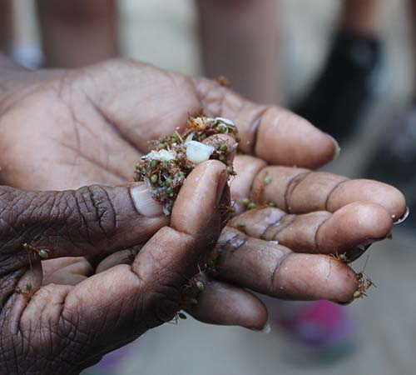
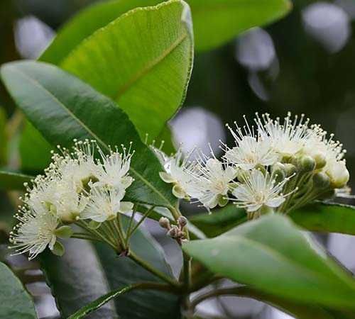
Obligations for biodiscovery entities
A person must not use traditional knowledge for biodiscovery other than under an agreement with the custodians of the knowledge
    Identify traditional knowledge custodians
  authority to speak for Country in accordance with customary protocols
  beyond native title rights holders
  biodiscovery cannot proceed if custodians cannot be found OR custodianship of the knowledge is not agreed upon
    Obtain free, prior and informed consent to use the knowledge
  consent is ongoing
  biodiscovery cannot proceed if custodians say no
    Establish a benefit sharing agreement on mutually agreed terms
  monetary and non-monetary benefits
  biodiscovery cannot proceed if agreement cannot be reached

Slide 5
Wrap up
"If you want to go fast, go alone; but if you want to go far, go together."
qldscience@des.qld.gov.au
https://environment.des.qld.gov.au/licences-permits/plants-animals/biodiscovery/traditional-knowledge:
        Traditional Knowledge Code of Practice
        Traditional Knowledge Guideline
        Capacity Strengthening Toolkit

