Slide 1
NZ SSC & ANZSOG present:
DO YOU HAVE A QUESTION about today’s topic?
Send your questions through sli.do:
slido.com
#X582
All questions will BE ANSWERED AT THE END OF THE PRESENTATION
SLIDES FROM TODAY’S PRESENTATION WILL BE AVAILABLE ON THE ANZSOG WEBSITE
Disruptive technologies: what might these mean for the future of work and the future of work-related policy?
Professor Peter Gahan
Professor of Management
The University of Melbourne
Dr Rose Ryan
Manager, Workforce & Workplace
Evidence and Insights Branch
MBIE
Monday 4 March 2019

Slide 2
Questions?
DO YOU HAVE A QUESTION about today’s topic?
Send your questions through sli.do:
slido.com
#X582
All questions will BE ANSWERED AT THE END OF THE PRESENTATION
SLIDES FROM TODAY’S PRESENTATION WILL BE AVAILABLE ON THE ANZSOG WEBSITE
Disruptive technologies: what might these mean for the future of work and the future of work-related policy?
Professor Peter Gahan
Professor of Management
The University of Melbourne
Dr Rose Ryan
Manager, Workforce & Workplace
Evidence and Insights Branch
MBIE
Monday 4 March 2019

Slide 3
The Future of Work
Where are we heading? And are we ready for it?
Professor Peter Gahan, The University of Melbourne
@PeterGGahan
slido.com
#X582

Slide 4
Envisioning the future
slido.com
#X582

Slide 5
The digital revolution
slido.com
#X582

Slide 6
Where have we come from?
slido.com
#X582

Slide 7
Where Are We Going?
slido.com
#X582

Slide 8
Tech trend #1: Robots & automation
“Robosourcing”
Automation
Offshoring
Globalisation of value chains
slido.com
#X582

Slide 9
slido.com
#X582

Slide 10
slido.com
#X582

Slide 11
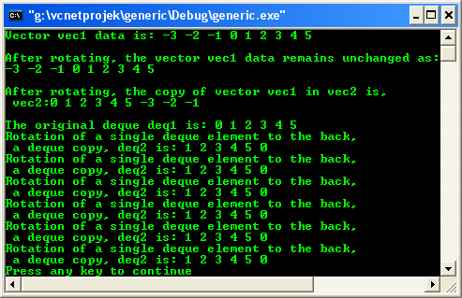
slido.com
#X582

Slide 12
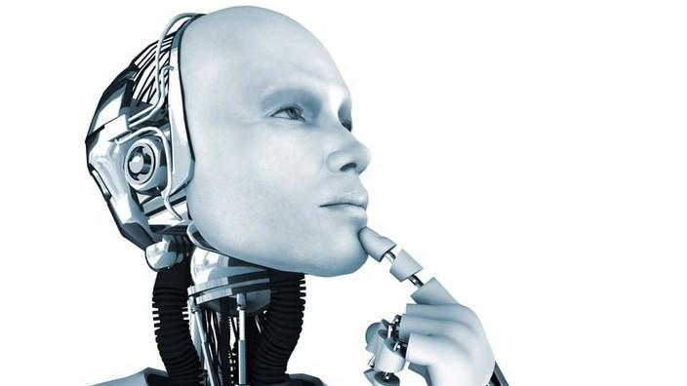
What next?
Dark factories
Intelligent automation
Driverless cars
Smart contracting & the bock chain
Are robots taking our jobs?
slido.com
#X582

Slide 13
Tech trend #2 – Wearables
Emerging applications
Communication
Sensors & GPS
Augmented reality
Holographics
slido.com
#X582

Slide 14
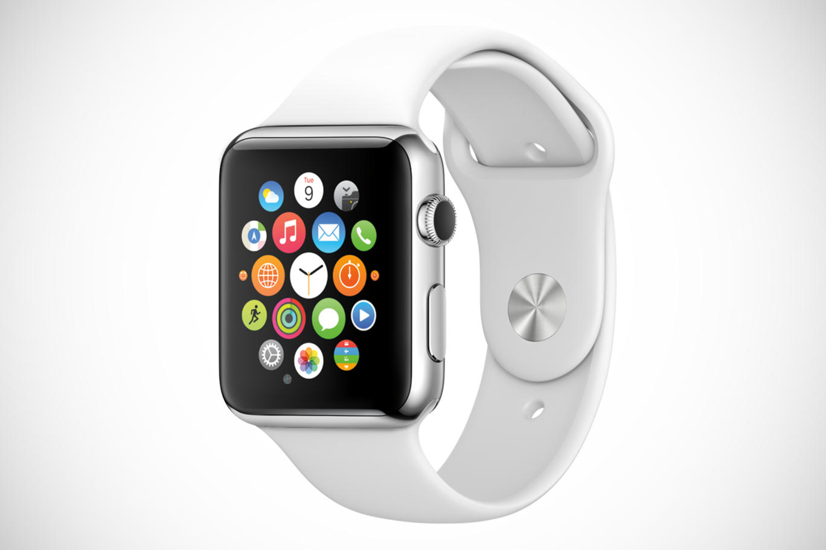
slido.com
#X582
Notes:
Tech trend #2 - Wearables

Slide 15
What’s next?
Virtual travel / meetings
Virtual key boards
Industry 4.0
Internet of things
Autonomous vehicles
Remote health care + surgery
Industrial applications of augmented reality
slido.com
#X582

Slide 16
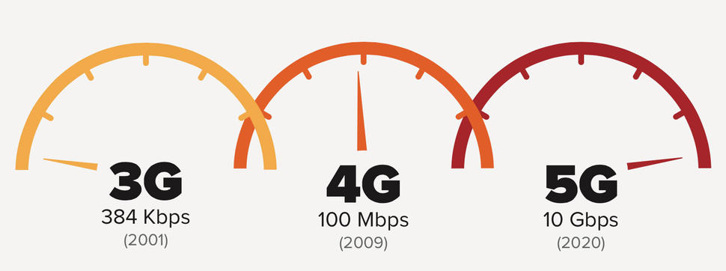
Tech trend #3 – 5G & high speed internet
Big data and predictive analysis
Cloud computing
slido.com
#X582

Slide 17
New Business Models
slido.com
#X582

Slide 18
Business Model Innovation
“The platform economy”
E-business
Crowdsourcing
Fremium
Peer-to-peer / sharing / disintermediation
New economy models
Smart incumbents
slido.com
#X582

Slide 19
Volatility & uncertainty
Business operating margins have become more volatile
Operating margins for listed firms have doubled since 1980
Market leadership is no longer a position of strength
1970: 2 percent
2014: 15 percent
slido.com
#X582

Slide 20
The demand side of the equation (Or, where do jobs come from?)
Emerging and growth sectors
Infrastructure & urban development
Environment and sustainability
The ‘experience’ economy
Technology, research and engineering
Health and human services
Gig work?
slido.com
#X582

Slide 21
DEMOGRAPHIC SHIFTS
slido.com
#X582

Slide 22
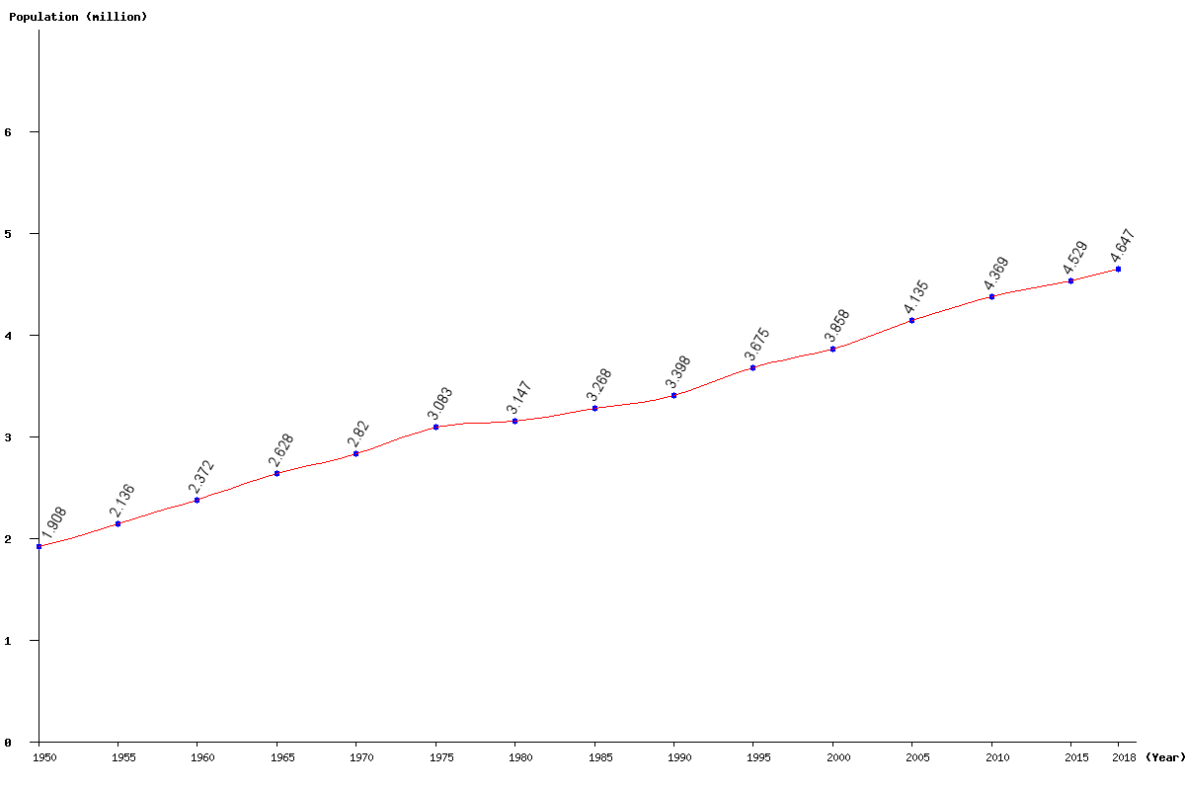
“Demography is destiny.”
Overall labour supply
A product of population growth.
The quality of labour supply
The geography of population growth.
Patterns of migration flows.
Investments in human capital & development.
Social attitudes towards work.
Motivation and opportunity
slido.com
#X582

Slide 23
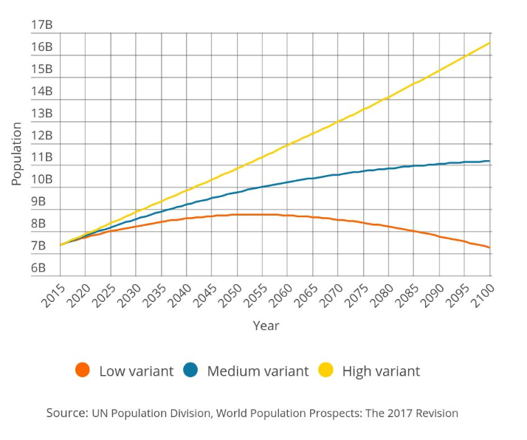
World population projections 2015-2100
slido.com
#X582

Slide 24
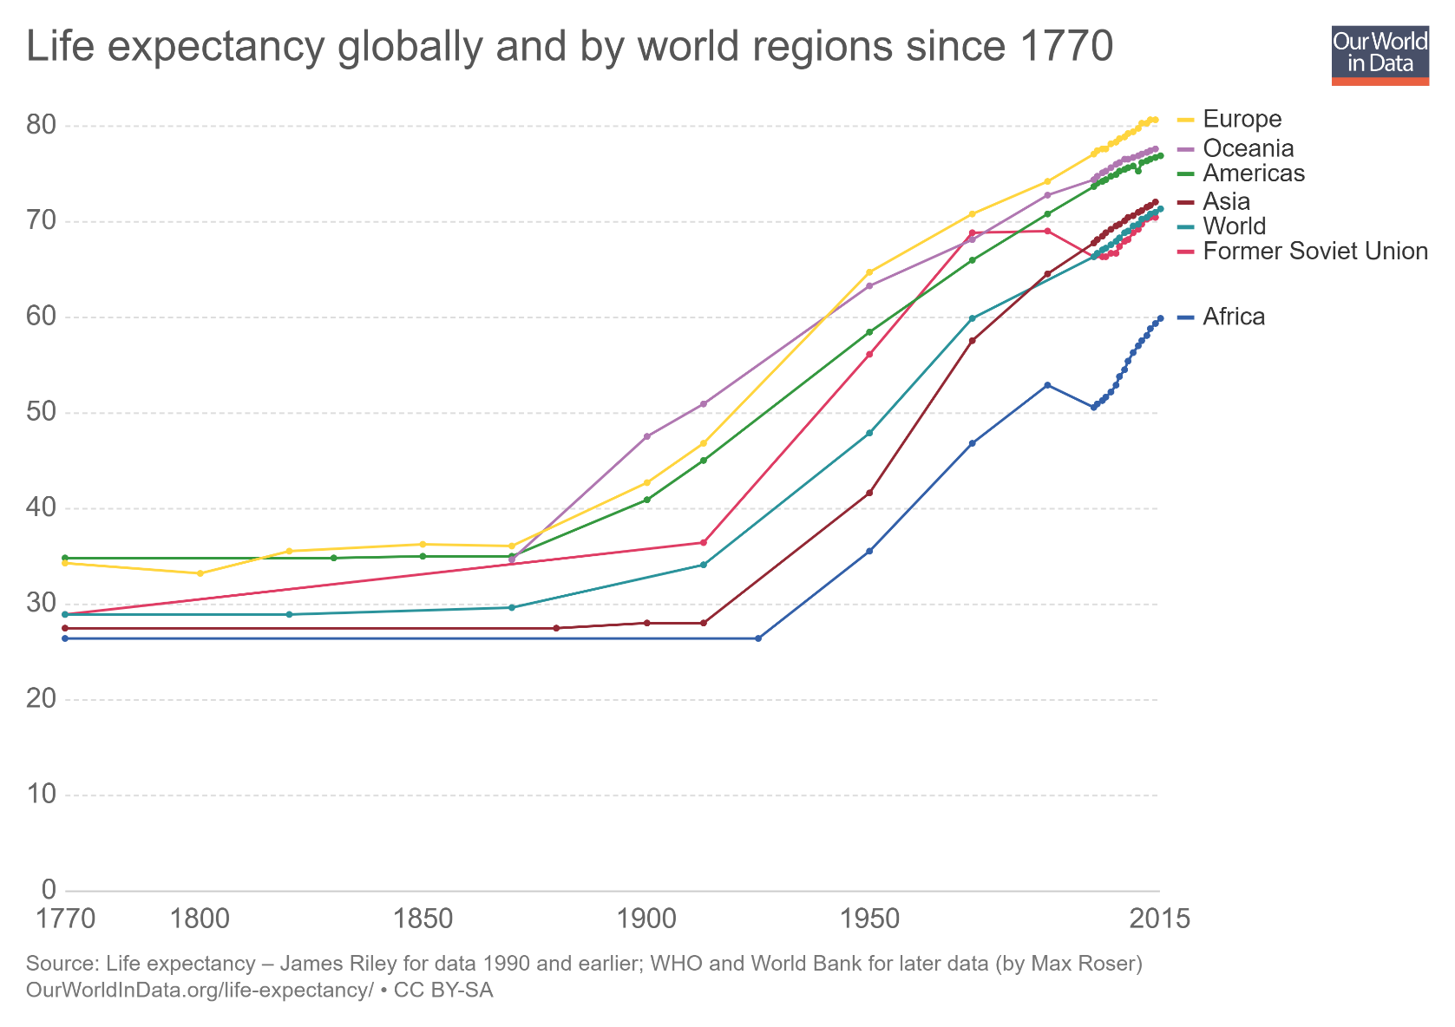
Life expectancy around the world has followed a similar pattern
slido.com
#X582

Slide 25
The median age is increasing
Source: CIA (2017) World Fact Book
slido.com
#X582

Slide 26
The NZ population is ageing
slido.com
#X582

Slide 27
Workforce diversity is increasing
slido.com
#X582

Slide 28
And social attitudes are changing
slido.com
#X582

Slide 29
Work attitudes vary across generations/life stage
What they want from work | ‘Traditionalists’ (1922-43) | ‘Boomers’ (1946-64) | ‘Gen X’ (1965-81) | ‘Millennials’ (1982-)
Work defines who I am. | ***** | **** | ** | *
It is important for me to be successful at work. | *** | ***** | * | ****
It is important to work hard & do a good job. | ***** | **** | * | ***
Being paid well is more important than anything else. | ** | **** | ***** | **
I care more about what I do outside of work, than at work. | * | ** | **** | *****
It is important for work to be meaningful. | * | ** | *** | *****
It is important that I share the same values as the organization I work for. | * | * | *** | *****
Job satisfaction is important. | ** | *** | **** | *****
I intend to change my job in the near future. | ** | ** | ** | **
Source: Twenge (2010) Journal of Business and Psychology
slido.com
#X582

Slide 30
Take-aways #1: General observations
For most of us, new technology is transformative, rather than disruptive.
Technology alters the bundle of skills, tasks & responsibilities that make up a job.
Technological change still creates more jobs than it destroys
But there are disruptive technologies and change out there.
Technology is not the factor shaping the future of work:
Human choice and creativity
Demography
Don’t forget the “demand” side of the equation.
slido.com
#X582

Slide 31
Take-aways #2: For those in established jobs & careers
Rethink skills:
Redundancy versus transferability
Skill profiles: technical, relational, physical
Upskilling as continuous improvement
Job crafting
Negotiate change and transition
Stereotyping and prejudice
Age, gender, ethnicity
Stereotype defying profiles
slido.com
#X582

Slide 32
Take-aways #3: For those starting out
The importance of skills:
Transferability
Micro-credentials: formal versus experiential
Coding is not everything
Signalling
The importance of what you do/who you are beyond the job
Rethinking careers
It doesn’t have to be a “portfolio” of disconnected jobs
Stereotyping and prejudice
The idea of “fragile talent”
slido.com
#X582

Slide 33
Take-aways #4: For the policy wonks
Skills and education:
Skill recognition and articulation.
The pattern of job destruction and creation.
Where will jobs of the future come from? And how to ensure they are quality jobs?
Labour market standards
Fragmentation of labour market flows and states: managing transitions.
Balancing flexibility and protection.
Rethinking standards for the non-standard worker.
Compliance
Leveraging new technology for enforcement.
Regulation
Code as regulation
Regulating code
The privatisation of regulation?
slido.com
#X582

Slide 34
Thank you!
slido.com
#X582

Slide 35
Upcoming Thought Leadership Seminars
Spirit of Service and the Future of the Public Service Work Force Speakers: Catherine Needham & Catherine Mangan, University of Birmingham | Rydges, Wellington | 12 April 2019
Enquiries to:
Thought Leadership
T +61 3 8344 1900
appliedlearning@anzsog.edu.au

Slide 36
Thought Leadership resources can be located here:
https://www.anzsog.edu.au/resource-library/resources-tlss

