Slide 1
E Tū Whānau
Te mana kaha o te whānau - The strength and power of the whānau

Slide 2
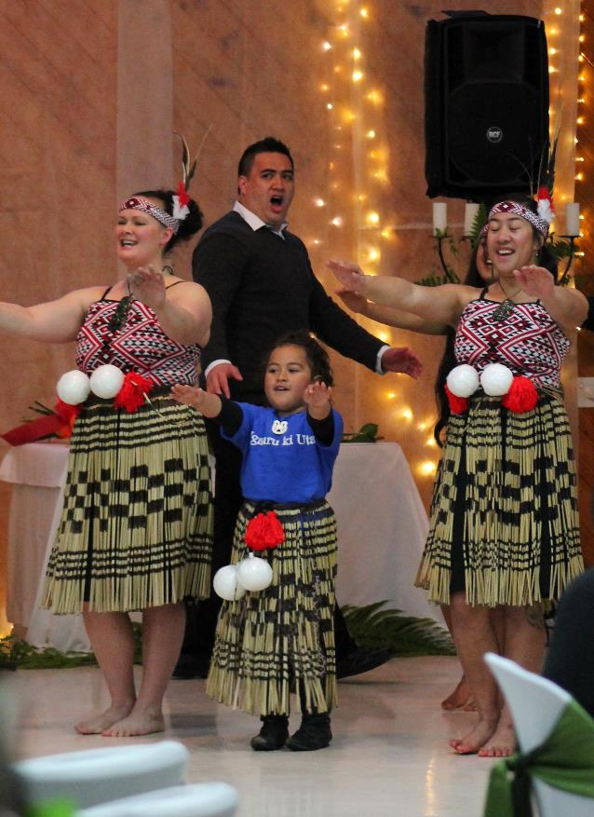
The vision
Whānau are strong, safe and prosperous – active within their community, living with a clear sense of identity and cultural integrity, and with control over their destiny
– te mana kaha o te whānau!

Slide 3
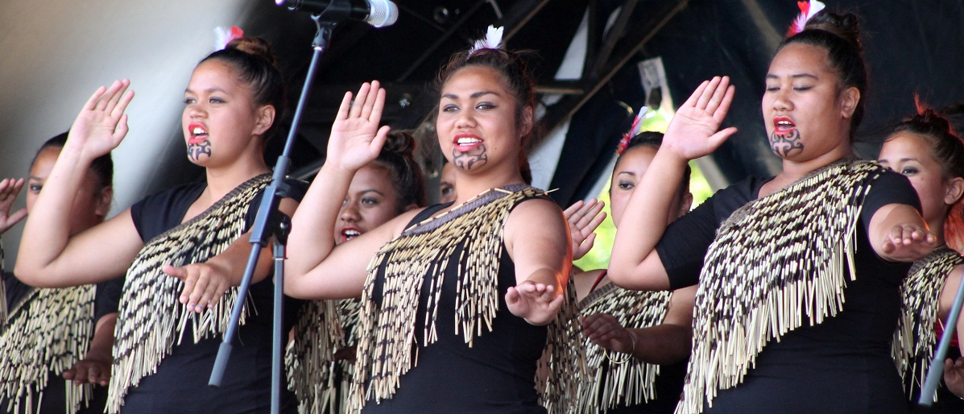
What is E Tū Whānau?
a kaupapa Māori movement to eliminate all forms of violence
designed and led by Māori with support from government
positive action in communities that helps whānau to thrive

Slide 4
The partners
Te Ao Māori – iwi leaders, whānau, hapū, practitioners, community leaders, Rangatahi (youth), kuia/kaumatua (elders)
MSD (Govt) – small team to nurture and support community action and change, support MRG, report to Govt
Maori Reference Group (MRG) - brokers this relationship. Mechanism for community voice to have direct access to Govt and vice versa

Slide 5
Where did it come from?
A mandate from the people lays foundation for E Tū Whānau
commitment from leaders at Hopuhopu Summit 2008
grassroots kōrero, support and input from hui all around Aotearoa
a new approach, owned by Māori, based on tikanga and the values that make whānau strong.
“The real strength of E Tū Whānau is that it belongs to our people – it’s not just some flash in the pan idea – it’s real, it’s genuine and it’s grounded in things Māori. That gives it a really strong chance of success.”
Darrin Haimona (Tainui, Ngāti Haua)

Slide 6
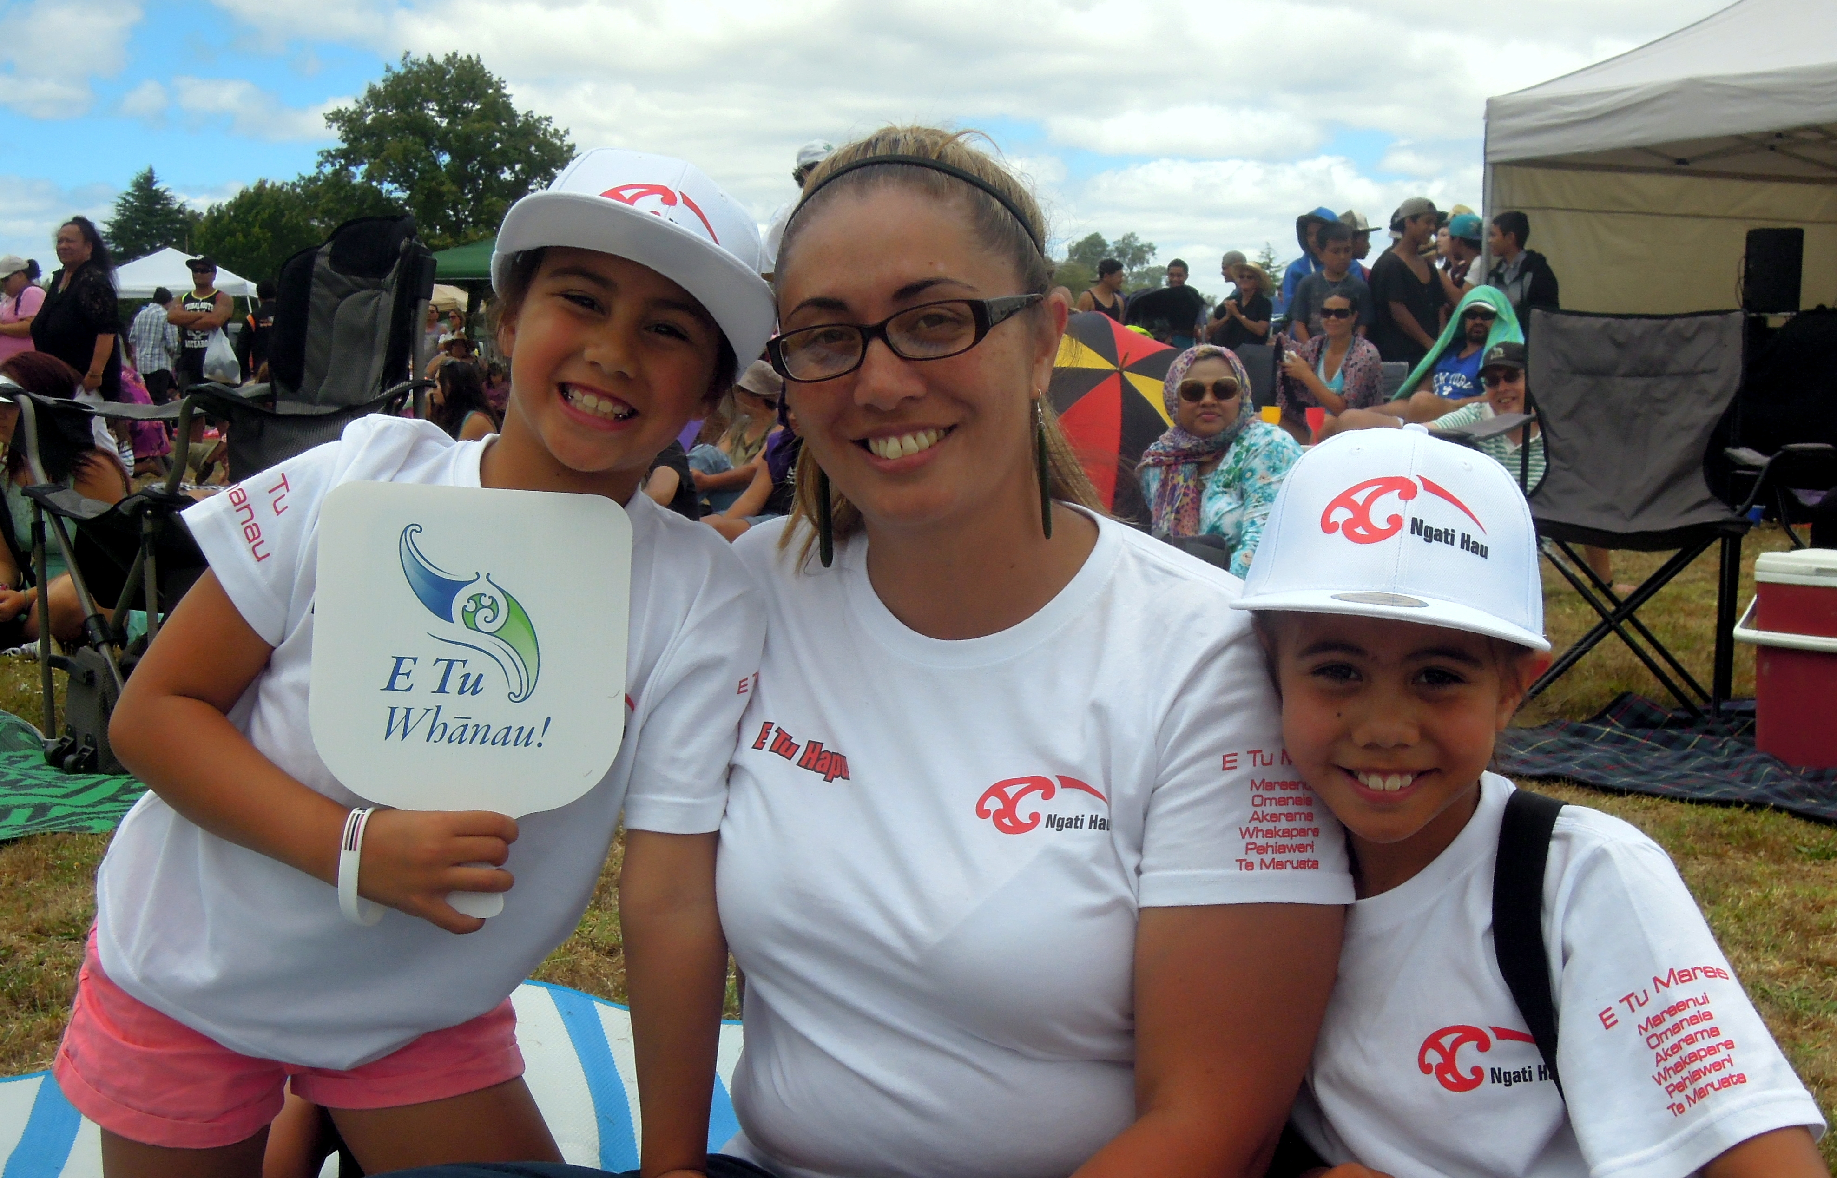
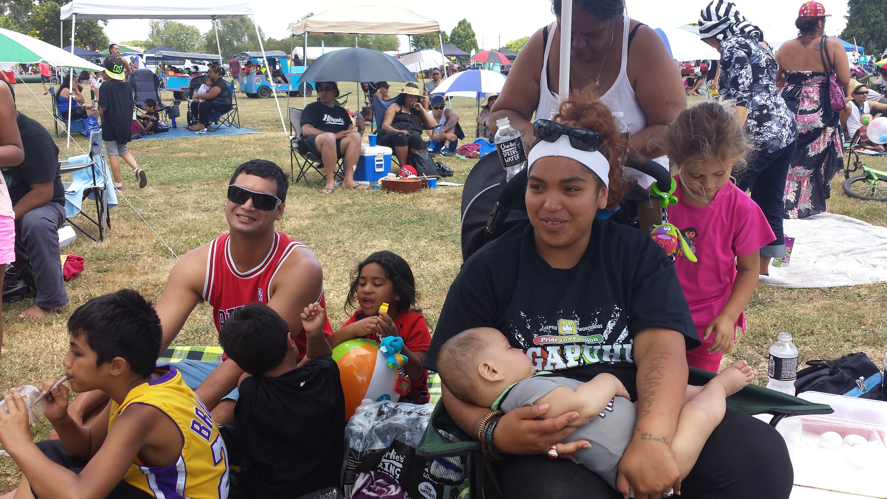
The kaupapa
E Tū Whānau nurtures & celebrates:
those things that make Māori strong and proud - te mana kaha o te whānau!
kahukura – leaders that inspire positive change in whānau and communities
tikanga & traditional values – the foundation for positive change.

Slide 8
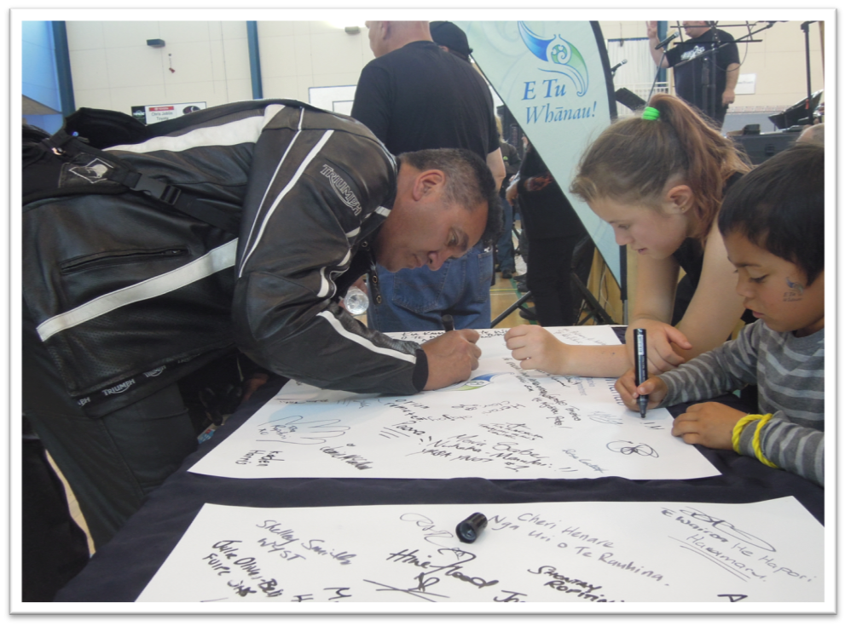
Standing strong against violence
Thousands have signed the E Tū Whānau Charter of Commitment to take a stand against violence

Slide 9
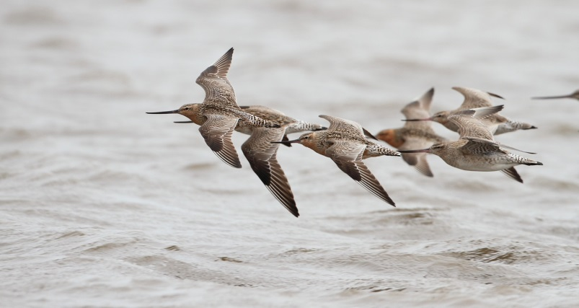
Kahukura cleave the air to provide the lift for others to follow

Slide 10
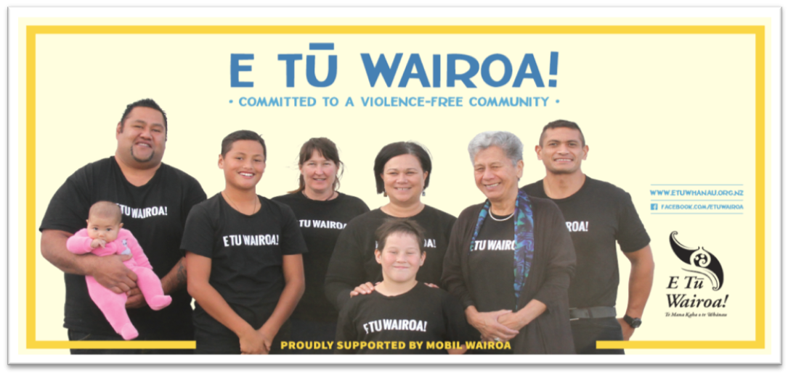
E Tū Whānau in action
Leadership
Partnerships of trust
Local solutions
Kōrero awhi, resources, support
Te mana kaha o te whānau!

Slide 11
Our Mahere Rautaki - Framework for Change
Sets the strategic direction and priorities for the next 5 years
Builds on our successes and what we have learned over the last 10 years
Articulates our ‘Theory of Change’
Identifies 7 outcomes domains that together contribute to wellbeing for whānau
WHĀNAU WELLBEING OUTCOMES:
Whānau are self-managing and resilient
Whānau are connected and feel like they belong
Whānau have a positive relationship in Te Ao Māori
Whānau feel safe in their homes and communities
Whānau are living healthy lifestyles
Whānau are strengthened and participating in society
Whānau have increased economic independence and rangatiratanga

Slide 12
What difference is it making?
“I have seen instances where the resources, coupled with facilitation, have led to transformation in families and individuals – from helplessness to hope.”
Survey Respondent
Survey results show ETW kaupapa, messages and resources resonate and support change
Strong and increasing demand
Range of emergent evidence indicating positive change

Slide 13
E Tū Whānau – an innovative partnership
Based on trusted relationships developed over time
Māori enabled to take the lead with strong government support
Genuine partnership and co-design principles integral
Distinct and shared responsibilities of both Māori and government were clearly articulated from outset, and honoured over time

Slide 14
